Slide 1
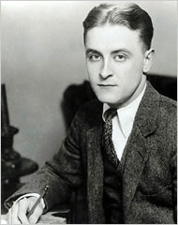
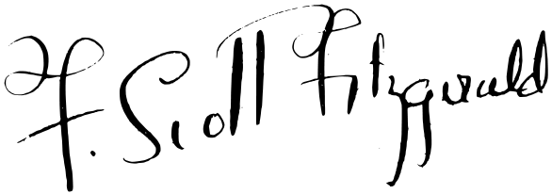
F. Scott
Fitzgerald
Colton Sledge
2nd Period
US History

Slide 2
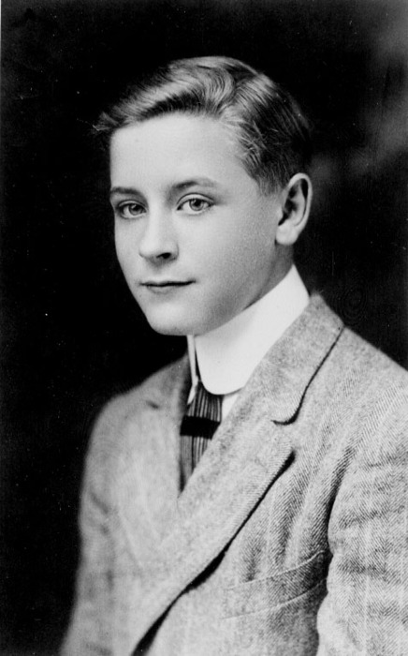
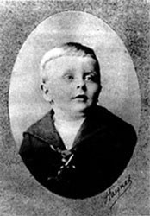
Background
Francis Scott Key Fitzgerald
Born: September 24, 1896, Saint Paul, Minnesota
Parents: Edward and Molly Fitzgerald
His dad was an unsuccessful business man. Fitzgerald grew up wanting to be successful unlike his father. His mother inherited wealth for him to go to the best prep schools, although he always felt out of place.
Fitzgerald worked on his school newspaper at the St. Paul Academy, and that is where he got his literary start. His stories for the paper were detective papers, the teacher published his stories and pushed him to go on and write.

Slide 3
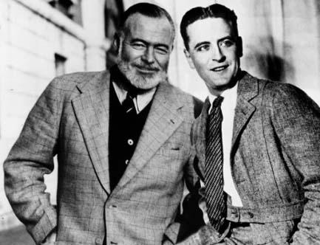
“The Lost Generation”
Fitzgerald was part of a group of writers from the 1920s known as the lost generation. These writers wrote about the effects that war, changing times, or hardships of the time had on them. Some of the other writers in the group include Ernest Hemingway and Gertrude Stein

Slide 4
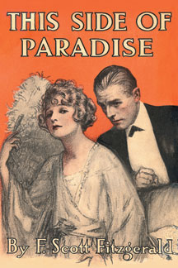
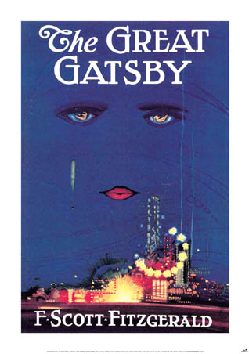
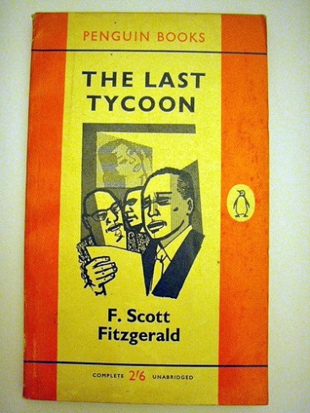
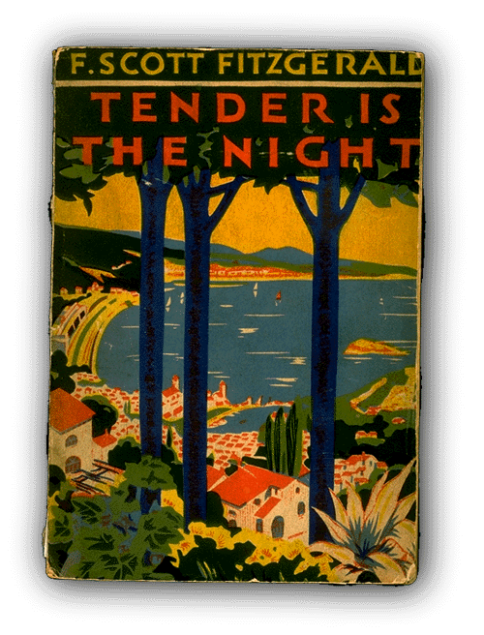
Works
This Side of Paradise 1920
Tales of the Jazz Age 1922
The Great Gatsby 1925 (most famous)
All the Sad Young Men 1926
Tender is the Night 1934
The Last Tycoon 1940

Slide 5
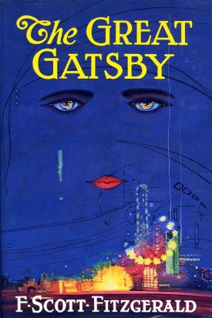
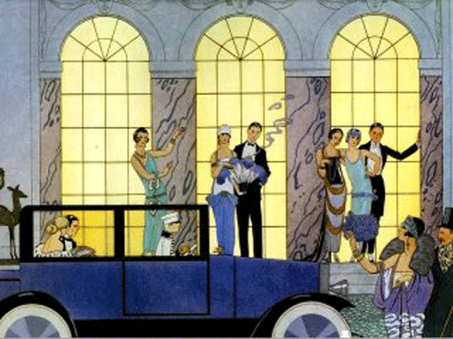
The Great Gatsby
The Great Gatsby is a tale of Jay Gatsby, a poor born man who works to become a rich man for a woman, Daisy. The story tells of Gatsby’s life trying to win over Daisy even though she is married. It has a great deal of symbolism, as much of his works do. The story takes a twist at the end when Gatsby’s car kills a woman and the husband of the woman searches for Gatsby and kills him, even though Daisy was driving.

Slide 6
Bio
Fitzgerald entered college only to drop out 3 years later due his focus on his writing. He entered the army and fell in love with Zelda Sayre. She wouldn’t yet marry him because she wanted to make sure he had enough money. In 1919 he was discharged from the army and moved to New York City. There he published his first novel This Side of Paradise, and one week later he proposed to Zelda. One year later they had a daughter. In 1924 he moved to France for inspiration to write his greatest novel, The Great Gatsby.

Slide 7
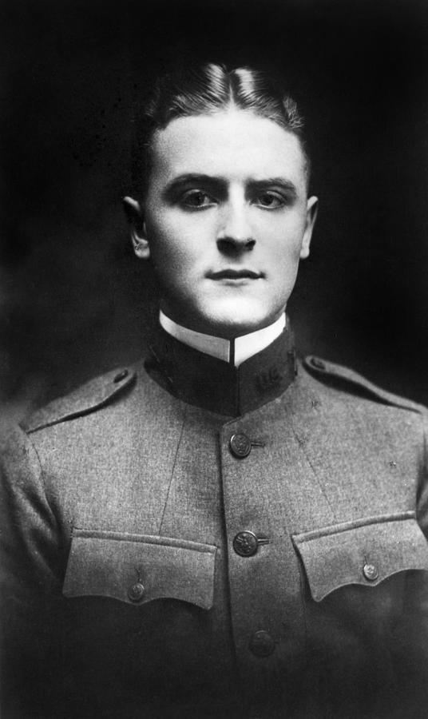
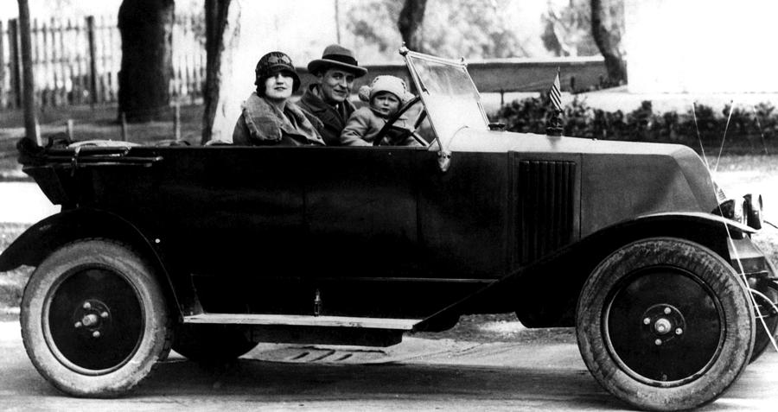
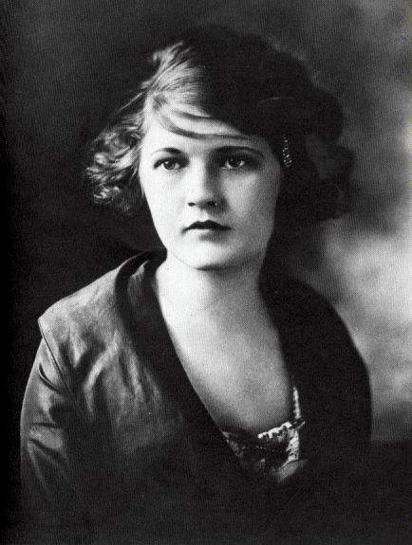
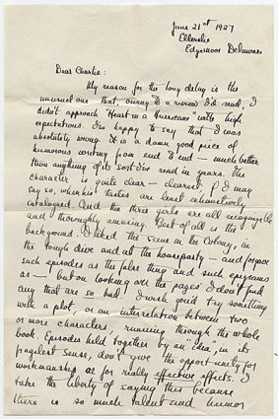
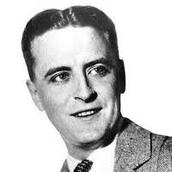
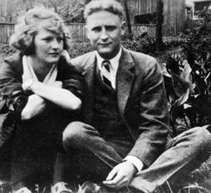
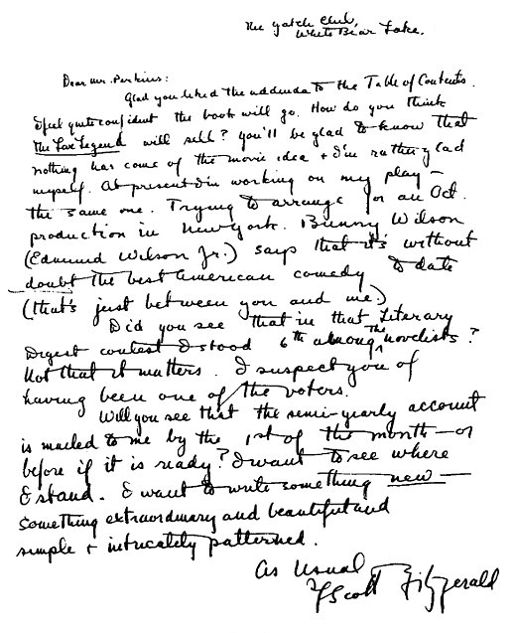
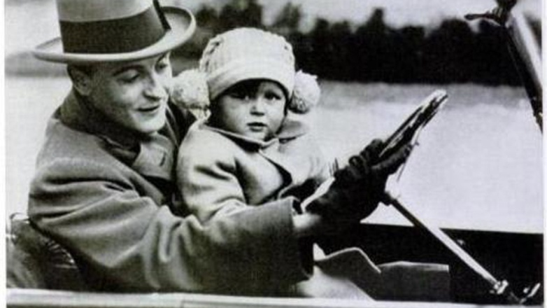
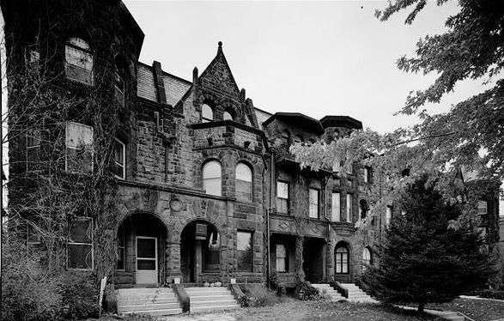

Slide 8
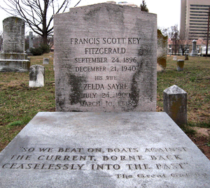
The Later Years
Throughout his career he published over 178 stories. He suffered a great fall in his career when nothing he wrote was successful after the publication of The Great Gatsby. He watched the other lost generation writers continue to grow while he only declined. Fitzgerald fell into depression and became an alcoholic. In 1937 he moved to Hollywood to write screen plays, only to make enough money to continue to write. He died of a heart attack on December 21, 1940. He was in the middle of writing his last book, The Last Tycoon.

Slide 9
Questions
Fitzgerald focused on writing and not his academics in college, and dropped out to peruse his writing career.
Was he right in making this choice or should he have focused on school to get a degree and then write?
Analyze the effects of the cultural time period on marriage and gender roles pertaining to Fitzgerald’s and Zelda’s love and marriage.

Slide 10
Sources
http://www.montgomerycollege.edu/Departments/hpolscrv/jbolhofer.html
http://www.pbs.org/kteh/amstorytellers/bios.html
http://www.sc.edu/fitzgerald/chronology.html
http://www.biography.com/people/f-scott-fitzgerald-9296261
http://www.aaa.si.edu/collections/images/detail/f-scott-fitzgerald-letter-to-charles-green-shaw-6066

