Slide 1
6.1 Identify how the effects of 19th century warfare promoted the growth of industrialism (i.e., railroads, iron vs. steel industry, textiles, coal, rubber, processed foods).

Slide 2
19th century warfare
When was the 19th century?
When was the 20th century?

Slide 3
19th century warfare
War of 1812
  http://www.history.com/topics/war-of-1812
Civil War 1861-1865
Spanish American War 1898

Slide 4
Railroads
1st transcontinental linked up in 1869
How would wars spur the growth of railroads?
Effects?

Slide 5
Railroads effects
Faster transportation, communication
Shrinking world

Slide 6
Iron vs. Steel
Iron was widely used to make gun parts, stoves, and machinery.
But in 1855, Henry Bessemer found an efficient way to refine iron into steel.
Steel was preferred bc it was cheaper, harder, and more durable.

Slide 7
An American brought the Bessemer conversion to the United States and began working for Andrew Carnegie, a Scottish immigrant.
Carnegie would go on to amass a fortune.
Raw steel production went from 30,000 tons in the late 1860s to 11 million tons in 1900.

Slide 8
Andrew Carnegie Video Clip
http://www.teachertube.com/viewVideo.php?title=Andrew_Carnegie_Biography&video_id=233035
http://www.biography.com/search?query=andrew%20carnegie

Slide 9
industry

Slide 10
Textiles
Civil War had a dramatic effect on production.
Mid 1800s, chemistry began to influence the industry, owing to the discovery of synthetic dyes.

Slide 11
coal
Production of coal, which was used to make steel, increased twenty fold.

Slide 12
Rubber
At first, there were problems with the material. It softened and hardened due to variations of heat and cold.
Charles Goodyear solved these problems with his discovery of the vulcanization process.
‘elastic metal’
From 1850-1900 – saw an increase of 2,000%

Slide 13
Processed foods
Food preservation involves the protection of food from deterioration so that will remain available for consumption.
Natural Ways Drying, smoking, pickling, salting, and fermentation
Human made ways – canning
  Began with pickles and ketchup
  Also benefited from the refrigerated railroad cars.

Slide 14
Map
Post civil-war agriculture in the US
Urban hot spots
Great Plains
  (look in red/blue workbooks for visuals)

Slide 15
Topics to cover
Manifest Destiny
Homestead Act
Advancements in Farming
Dawes Act
Immigrants – Factors in Immigration and differences in immigrants and their assimilation

Slide 16
http://www.teachertube.com/viewVideo.php?title=Manifest_Destiny&video_id=5885

Slide 17
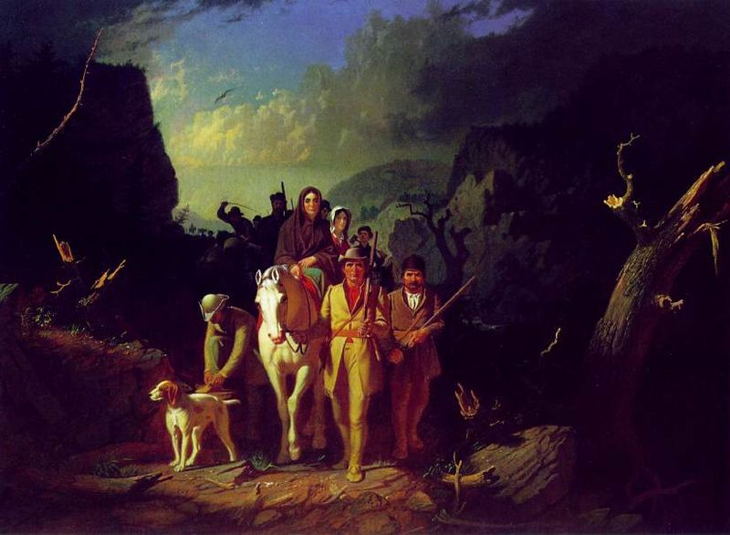

Slide 18
Manifest Destiny
During the 1840s, the pace of westward expansion in the US rapidly increased.
1845– James K. Polk became President.
He strongly supported expansion.

Slide 19
Manifest Destiny
– became a term used to describe how expansion was a God given right to the United States and Polk intended to expand from the Atlantic to the Pacific.

Slide 20
Polk
Annexed Texas in 1845
Oregon
Washington
Idaho
Parts of Montana
California
New Mexico
Arizona

Slide 21
Some Americans were excited about expansion.
Others opposed it. Why?
What balance could adding new states disturb?

Slide 22
Some Americans were excited about expansion.
Others opposed it. Why?
What balance could adding new states disturb?
Slave versus Free States
Wilmot Proviso – proposed slavery be forbidden in any new territory

Slide 23
http://www.teachertube.com/viewVideo.php?video_id=81407&title=Farming_in_the_1860s

Slide 24

Homestead act
1862, US passed the Homestead Act.
This bill gave men over the age of 21 the right to claim 160 acres of land.

Slide 25
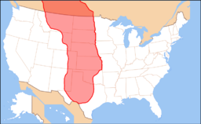
Homestead act
Agriculture greatly expanded into the Great Plains, the vast region stretching from Texas northward through the Middle West and up to Canada.
Many immigrants decided to try their luck as farmers in this region.

Slide 26
Advancements
Farming –
  Dug wells, then harnessed the wind power of windmills in order to pump water
  John Deere – steel plow
  Cyrus McCormick – mechanical reaper
Ranching –
  Railroads
  Barbed wire
Mining –Gold Rush sparked advancements in mining
  mining corporations took over and encouraged advanced equipment production to obtain harder to reach metals

Slide 27
Other Inventions
Indoor plumbing – running water in homes and work
Communications – telegraph lines and eventually telephone
Transportation –railroads, electric trolleys

Slide 28

Dawes Act of 1887
Purpose – to civilize Native Americans
Gave them 160 acres to farm
Didn’t take into account Indian culture
Most of the best land ended up in white hands.
Catastrophe
Hurt Native Americans instead

Slide 29
The New Colossus
Read the poem.
Answer the Questions

Slide 30
Gilded Age Video Clip
http://app.discoveryeducation.com/search?Ntt=gilded+age

Slide 31
Entrepreneur – a person who organizes and operates a biz, taking on greater than normal financial risks to do so.
new businesses fail
(depends on the source)

Slide 32
Agenda
Daily Openers
Daily Openers
Notes/Video clips/ Discussion/Mini Presentations
Quizlet Review
Socrative Quiz
Extended Writing
  Brainstrom
  Think, Pair, Share
  Writing Assignment
If you could start your own business, what would you do? (Any Creations?)
What is an entrepreneur?
Standard: US.6 Describe the changes in American life that resulted from the inventions and innovations of business leaders and entrepreneurs of the period: Henry Bessemer, George Pullman, Alexander Graham Bell, Andrew Carnegie, Thomas Edison, J.P. Morgan, John D. Rockefeller, Swift and Armour, & Cornelius Vanderbilt. Unit: Gilded Age

Slide 33
US.6 Describe the changes in American life that resulted from the inventions and innovations of business leaders and entrepreneurs of the period: (C, E)
· Henry Bessemer
· George Pullman
· Alexander Graham Bell
· Andrew Carnegie
· Thomas Edison
· J.P. Morgan
· John D. Rockefeller
· Swift and Armour
· Cornelius Vanderbilt

Slide 34
The Men Who Built America
Intro trailer stop at 1:32
https://www.youtube.com/watch?v=Rk5h3_l4h_Q

Slide 35
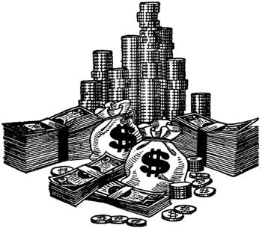
Robber Barons or Captains of Industry?
US.6 Describe the changes in American life that resulted from the inventions and innovations of business leaders and entrepreneurs of the period: Henry Bessemer, George Pullman, Alexander Graham Bell, Andrew Carnegie, Thomas Edison, J.P. Morgan, John D. Rockefeller, Swift and Armour, & Cornelius Vanderbilt

Slide 36
Today:
Do billionaires have a responsibility to help the poor?
  Do millionaires?

Slide 37
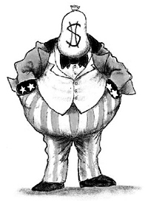
Who are the billionaires (Robber Barons) of today? http://www.forbes.com/billionaires/list/#tab:overall
Notes:
Walton- founder of Wal-Mart
Warren Buffett- CEO Berkshire Hathaway (holding company) and investor
Ellison- Oracle

Slide 38
Today’s Billionaires List – Forbes
http://www.forbes.com/billionaires/list/#tab:overall

Slide 39
Vocabulary Terms to Know
Monopoly?
Trust?
Corporation?

Slide 40

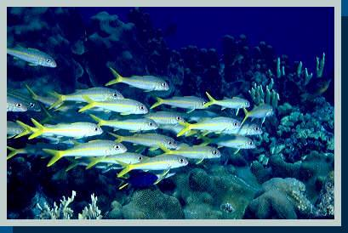
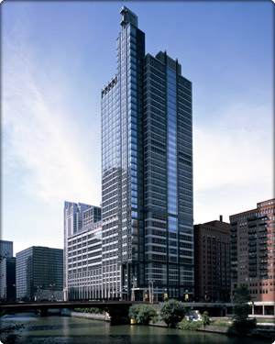

Vocabulary words to Know
Monopoly: A company that completely dominates a particular industry
Trust: a set of companies managed by a small group known as trustees, who can prevent companies in the trust from competing with each other
Corporation: A company recognized by law to exist independently from its owners, with the ability to own property, borrow money, sue or be sued

Slide 41
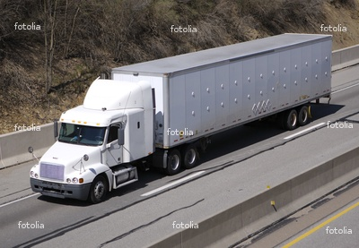
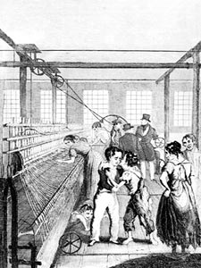

Corporate Monopolies
Horizontal and Vertical Integration

Slide 42
Henry Bessemer
Developed the first cost-efficient process to manufacture steel around 1854. This helped lead to the Industrial Revolution.

Slide 43
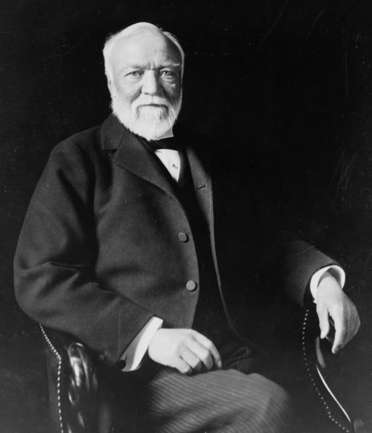
Andrew Carnegie
$75 Billion
Andrew Carnegie came from Scotland with his parents in 1848.
In 1861, at the age of 26, he started up the Freedom Iron Company, and used the new Bessemer process for making steel
He formed all of his companies into the Carnegie Steel Company in 1899, which controlled raw materials, manufacturing, storage, and distribution for steel.
  Vertical Integration
  http://www.biography.com/people/andrew-carnegie-9238756/videos/andrew-carnegie-steel-people-2079161373
  http://www.history.com/topics/andrew-carnegie/videos/the-men-who-built-america-andrew-carnegie#

Slide 44
The Gospel of Wealth by Andrew Carnegie
“In bestowing charity, the main consideration should be to help those who will help themselves; to produce part of the means by which those who desire to improve may do so; to give those who desire to rise the aids by which they may rise; to assist.”

Slide 45
Bloom’s Questions
Who was he? How would you describe his impact on the Gilded Age?
Classify him as an inventor, entrepreneur, or ‘robber baron.’
What facts/textual evidence back this up?
Contributions to the Gilded Age?
Support the importance of this man’s contributions to the Gilded Age. Give criteria.
6. Can you predict the outcome if your assigned person never existed? What would life have been like in America?
7. How could you improve upon their invention today?
8. Come up with an invention for America today. How will this invention affect American life?

Slide 46
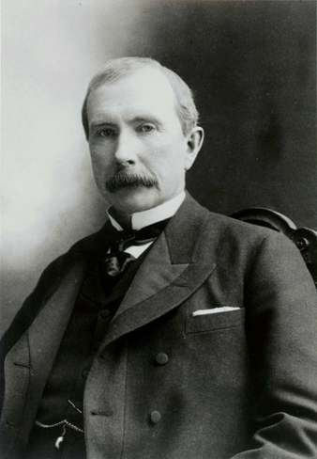
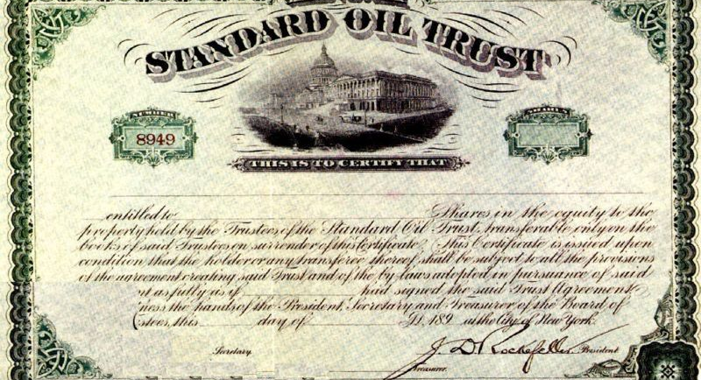
John D. Rockefeller
$192 Billion
Born in 1839
Started out as a bookkeeper
Established one of the first oil refineries
1870—With partners, forms a business trust: Standard Oil
At its peak, controls 90% of all oil companies
  Horizontal Integration

Slide 47
John Rockefeller and Standard Oil
Recognized the potential of the oil industry
Very hard worker
Spent most profits from the company to improve production
Philanthropist- gave over $500 million to charities
Made deals with the railroads to charge competitors more
Lowered prices to force other companies out of business-then raised prices
Low pay for workers
Sabotaged competitors
Paid government officials in the Senate

Slide 48
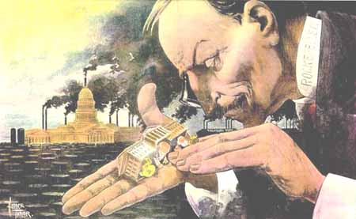
Rockefeller – Political Cartoon

Slide 49
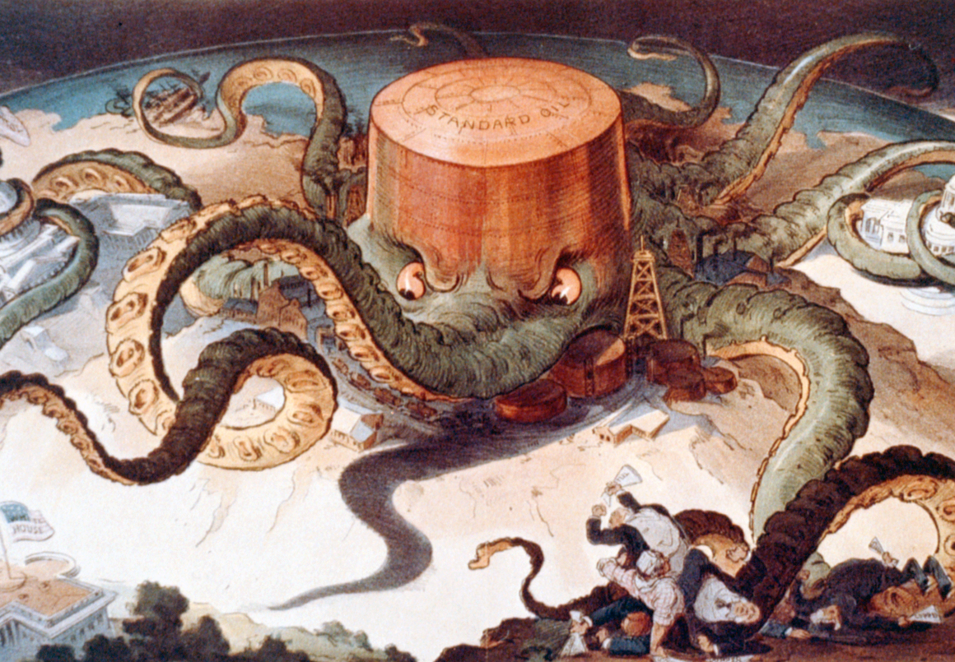

Slide 50
Large corporations developed in two major ways: horizontal or vertical integration
Horizontal integration is the growth of a business through acquiring additional business activities in the same industry.
J.D.Rockefeller’s Standard Oil
Vertical integration is the growth of a business through the acquisition of the materials that make the product, the factories that manufacture the products including the machines needed to produce the product, as well as the distribution channels to take the product to market.
Andrew Carnegie's steel company

Slide 51
Compare and contrast horizontal and vertical integration.

Slide 52
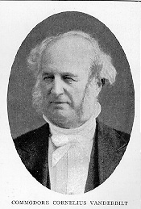
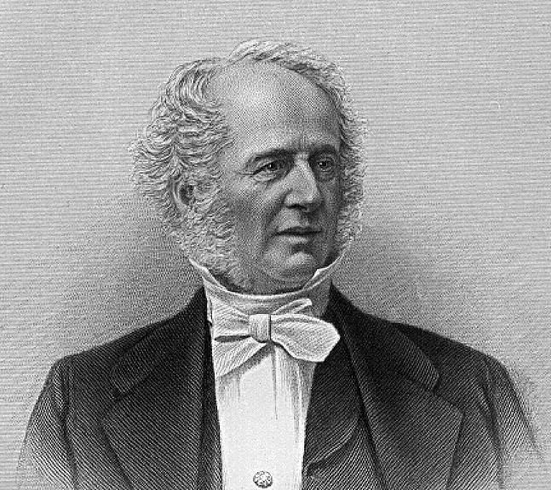
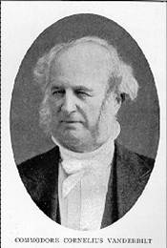
Cornelius Vanderbilt 1794-1877
Shipping tycoon- millionaire by 1846
Nicknamed “Commodore”
Built the first railroad line connecting New York City and Chicago. He also built New York’s Grand Central station
Most historians estimate that when he died he was worth $100 million ($1.7 billion in today’s dollars)
Vanderbilt University
Biltmore House

Slide 53
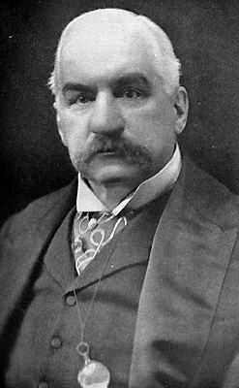

John Pierpont Morgan 1837-1913
Born into a wealthy family
Made a huge amount of money by financing railroad companies that were in financial trouble
In 1901, he bought Carnegie Steel. He turned that into U.S. Steel, the world's first billion-dollar corporation
By the early 1900s, Morgan controlled almost all of the major industries in the U.S. and had a large stake in the financial and insurance industries

Slide 54
George Pullman
Contributed greatly to long-distance travel with his invention of the sleeping car.

Slide 55
Alexander Graham Bell
Bell grew up in Scotland, the son of a speech teacher, and came to America in the early 1870s to establish his own school in Boston.
Invented the telephone in 1876
http://www.biography.com/people/alexander-graham-bell-9205497/videos/alexander-graham-bell-father-of-the-telephone-19570755976

Slide 56
Bloom’s Questions
Who was he? How would you describe his impact on the Gilded Age?
Classify him as an inventor, entrepreneur, or ‘robber baron.’
What facts/textual evidence back this up?
Contributions to the Gilded Age?
Support the importance of this man’s contributions to the Gilded Age. Give criteria.
6. Can you predict the outcome if your assigned person never existed? What would life have been like in America?
7. How could you improve upon their invention today?
8. Come up with an invention for America today. How will this invention affect American life?

Slide 57
EXTRA: Gilded Age Innovations clip (1:30)
http://app.discoveryeducation.com/search?Ntt=gilded+age+&N=18343
Unitedstreaming
Innovations of gilded age
Segment 13/13

Slide 58
Thomas Edison
Revolutionized every day life with his invention of the light bulb.
Three years later, he established the world’s first commercially successful electric power station in New York City.
Earned 1,093 patents
(patent – grant of an exclusive right to produce, sell, and profit from an invention for a certain number of years)

Slide 59
Thomas Edison clip
https://www.youtube.com/watch?v=ZlxVDdBtFQQ
Youtube
1:45 / 3:04
The History of Thomas Edison - a Short Story

Slide 60
Swift & Armour
Food processing
Armour – canned meat
Swift – used a refrigerated car to transport meat

Slide 61
How rich were the “robber barons” compared to Microsoft founder Bill Gates?

Slide 62
Justifications for Industrialists’ Extreme Wealth
Social Darwinism
Herbert Spencer
  Based on Charles Darwin’s theory of evolution
  Those who are rich are more fit, than those who are poor
  Attempted to use science to explain social classes
Gospel of Wealth
Andrew Carnegie
  God gave wealth to the most capable people
  It is the duty of the wealthy to give money to help the poor
    Carnegie gave millions of dollars away to establish libraries, colleges, and museums

Slide 63
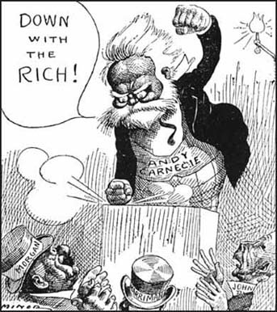

Slide 64
Working Conditions
Laborers were immigrants, African Americans, women, and children
12 hour days, six day or 7 days a week
Accidents were frequent, deaths occurred often
Low wages
No benefits, No workers compensation

Slide 65
Opposing View Points
Captains of Industry
  Created Jobs
  Increased production
  Provided cheap products
  Gave money back to the community
Robber Barons
  Exploited workers
  Corrupted the government
  Greedy

Slide 66
Review Quizlet
https://quizlet.com/46592737/flashcards
Study until time is up and then take a quick assessment.

Slide 67
http://www.socrative.com/
Click on the link!
Or go to safari and type in www.socrative.com
Click on student and then put in the following teacher passcode –
2E25EBA7
Once you hit submit, you can’t go back. Be sure you are ready before you hit submit!!

Slide 68
Vocabulary Review
Capitalism: An economic system in which industries are privately owned, and the prices, production, and distribution of goods are determined by competition on a free market.
Corporation: A large company that can generate capital (money) by selling stock on the stock market.
Monopoly: A situation in which one company has eliminated its competition.
Trust: An alliance of companies, run by a board of trustees, that function as one company.
Reduces competition
Illegal if it forms a monopoly

Slide 69
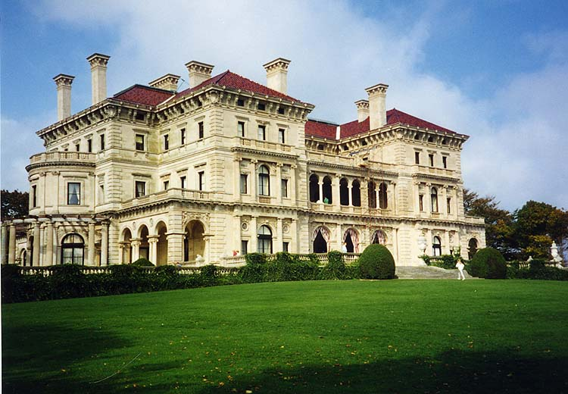
The Gilded Age…1870s-1900
Where was the most money made?
Was this positive or negative for America?
 | 1870 | 1900
Steel Production | 77,000 tons | 11 million tons
Oil production | 5 million barrels | 63 million barrels
Railroad track | 53,000 miles | 200,000 miles

Slide 70
What would Rockefeller say…
Monopolies are good because we can produce goods at a lower cost to consumers!
Now everyone can have cheap oil and gas.

Slide 71
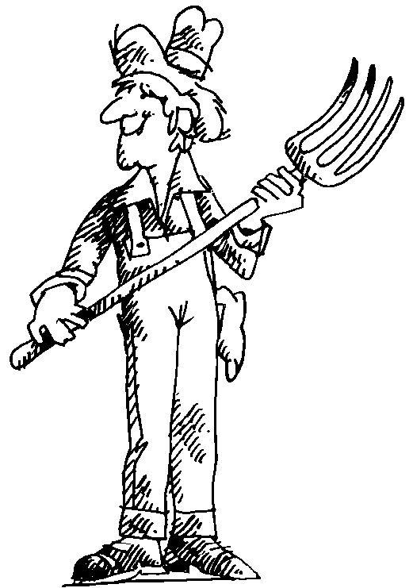
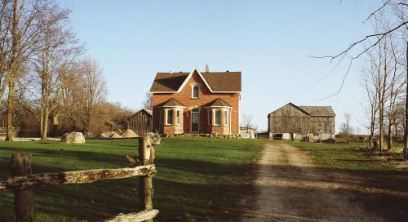
What would the Populists (poor farmers) say?
Monopolies are bad because they control the whole industry and there is no competition over prices.
We have to pay high prices to ship our wheat on the trains!
And these companies pay low wages to their workers!

Slide 72
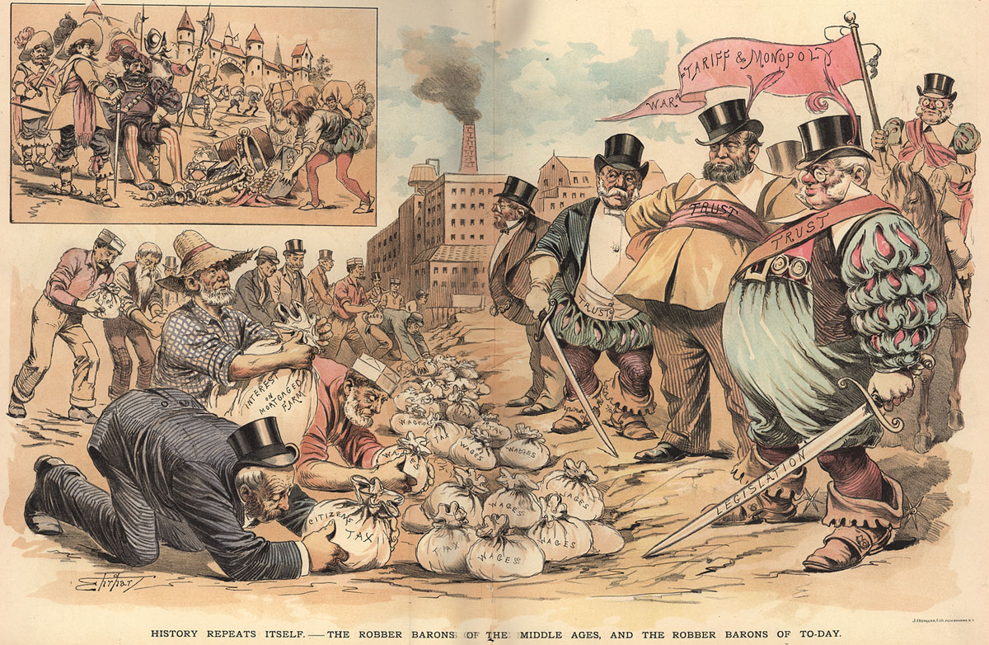

Slide 73
Socrative Quiz
Teacher’s Room Code - 2E25EBA7

Slide 74
OBJECTIVES:
US.4 Analyze the causes and consequences of Gilded Age politics and economics, including the rise of political machines, major scandals, civil service reform, and the economic difference between farmers, wage earners, and industrial capitalists, including the following:
Boss Tweed, Thomas Nast, Credit Mobilier, Whiskey Ring, Garfield’s assassination, Pendleton Act, Interstate Commerce Act. &
US.8 Evaluate multiple sources of information presented in diverse formats and media as in the political cartoons of Thomas Nast and others during the Gilded Age.
.

Slide 75
Extras
Flipped Classroom lecture:
  https://www.youtube.com/watch?v=RowsXnCUJVA&index=14&list=PLH4pm-ymp5y2XlJfKnuWowNAw7fLpbRw_

Slide 76
Extra
Link to more info about Tweed: https://www.princeton.edu/~achaney/tmve/wiki100k/docs/William_M._Tweed.html

Slide 77
Objectives:
Analyze the issue of corruption in national politics in the 1870s and 1880s.
Discuss civil service reform.
Assess the importance of economic issues in the politics of the Gilded Age.

Slide 78
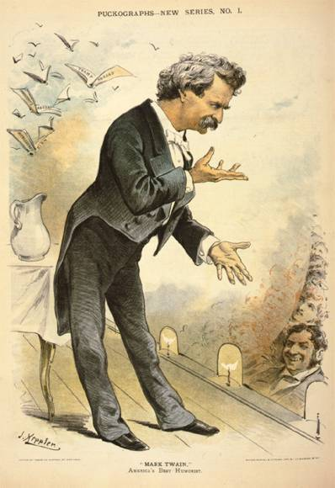
Gilded Age
1870-1890s
Mark Twain dubbed the period the ‘Gilded Age’
A thin layer of prosperity, experienced by some, was covering the poverty and corruption that existed in much of society

Slide 79

Gilded Age Economics

Slide 80
Laissez-Faire economics
Business leaders backed laissez-faire economics
Believed the government should not interfere with the economy regulating business
Instead, the market should freely determine supply, demand, profits, and prices.

Slide 81
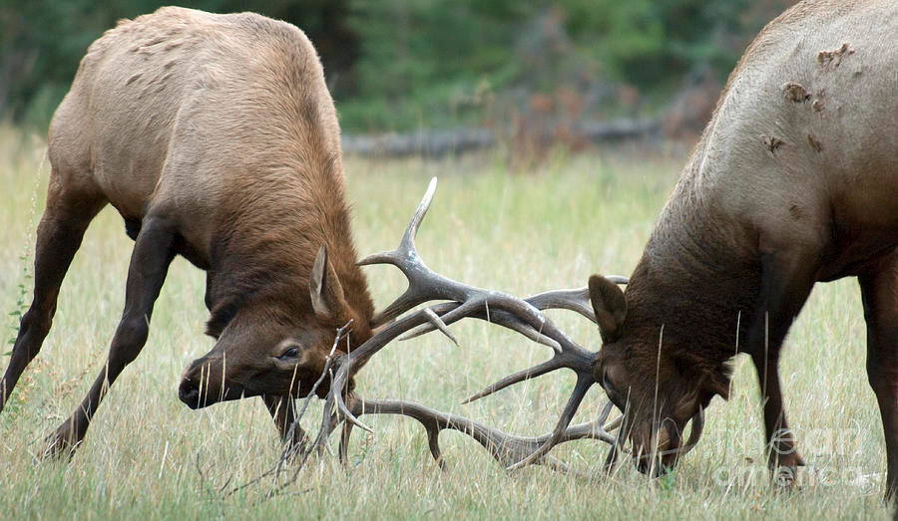
Laissez-Faire economics (cont.)
borrowed from the teachings of evolutionist Charles Darwin
Taught that life was a battle for ‘survival of the fittest’
Laissez-Faire capitalists believed that business was a battle for survival
What is a capitalist?
  They believed…

Slide 82
What is a capitalist?
  Believed property and businesses should be privately owned and that entrepreneurs and workers should be free to pursue making as much money as possible.

Slide 83
What is Economic Disparity ?

Slide 84
Economic Disparity
Gap between the rich and the poor
Example:
1880 Railroad Worker’s Annual Income
  General Manager – 15,000
  Senior Exec. - $5,000
  Unskilled Worker - $325
  In 1900, Andrew Carnegie made 25 million.

Slide 85
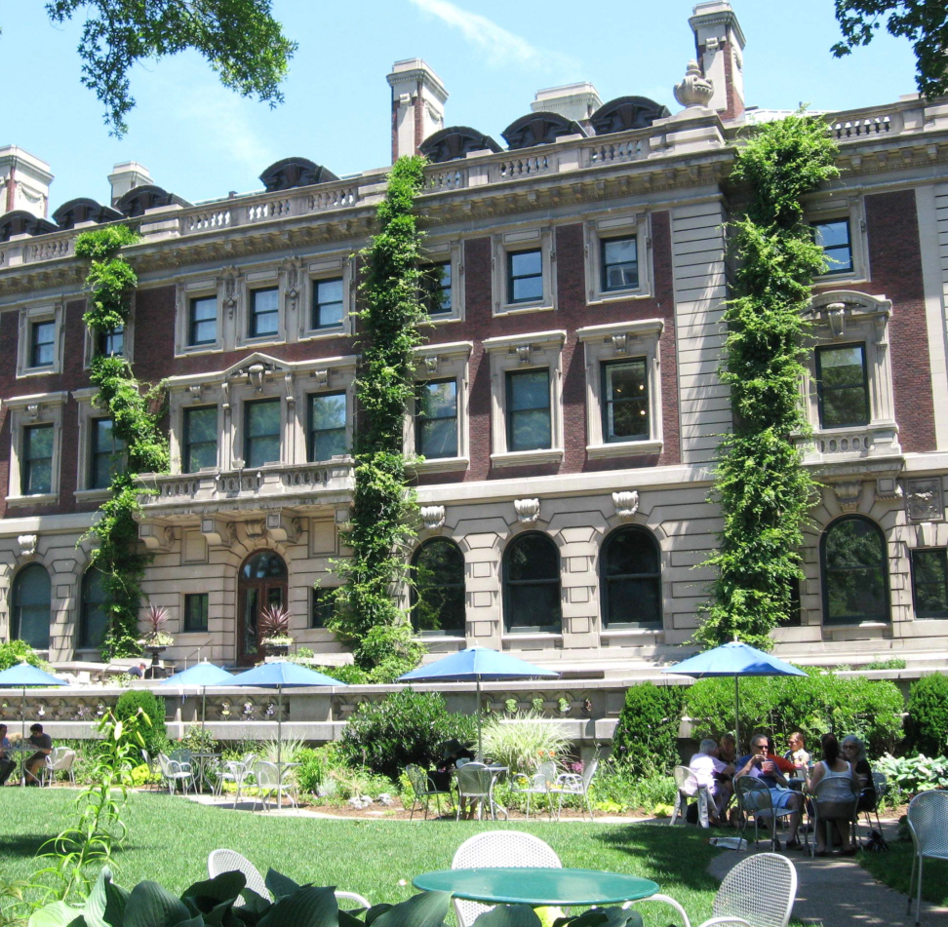
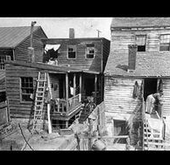
Housing
Andrew Carnegie’s home
Common dwelling for unskilled workers

Slide 86

Farmers
During the Gilded Age, many farmers could not repay loans.
Overproduction (too much production of farm goods) meant that agricultural prices had dropped.
Many farmers fell farther into debt and lost their land.

Slide 87
Who do you think was the biggest supporter of laissez-faire policies?

Slide 88
Watch clip
Gilded Age Crash Course - https://www.youtube.com/watch?v=Spgdy3HkcSs

Slide 89
Daily Openers
Explain the term laissez-faire.
Define the term economic disparity. Do you think it is a problem in the United States today? Explain your answer.
Agenda
Daily Openers
Reading Handout – Highlight important people and events
Notes
  Video clips
  Discussion
Quizlet

Slide 90
Gilded Age Politics
In 1868 Ulysses S. Grant became the 18th President of the US.
During his 8 years of tenure, numerous scandals occurred. –
  Black Friday
  Credit Mobilier Scandal
  The Whiskey Ring
  https://www.youtube.com/watch?v=nCZLae7kuTI
  (3 minute clip on Grant)

Slide 91
Credit Mobilier
Involved government officials illegally profiting from railroad industry.
In exchange for government favors, the Credit Mobilier company allowed government leaders to purchase cheap stock in the company.

Slide 92
Meanwhile, members of Congress (many of whom were in on the deception) approved more government funding for Credit Mobilier’s railroad project than was necessary.
Credit Mobilier’s executives and government officials pocketed almost $20 million.

Slide 93
Whiskey Ring
In 1875, the Whiskey Ring involved government officials stealing millions of dollars in government liquor-tax revenue.
Even the President’s own personal sec. was charged in the scandal.

Slide 94
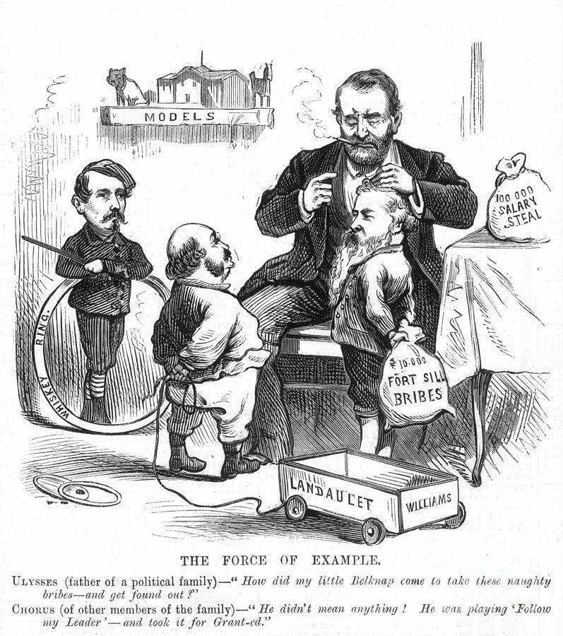
Whiskey Ring

Slide 95
Scandals like the Whiskey Ring, Credit Mobilier, and Black Friday led many citizens to associate Grant and the Republicans with corruption.
Such scandals contributed to the end of Reconstruction and a call for reform.

Slide 96
Civil Service Reform
Andrew Jackson had introduced the spoils system in 1828. This awarded political supporters with government positions.
What are some possible examples of this?
What are some problems with this system?

Slide 97
Civil Service Reform (cont.)
People were often times not qualified for the positions and this system led to more government corruption.
By the 1880s, many were calling for reform.

Slide 98
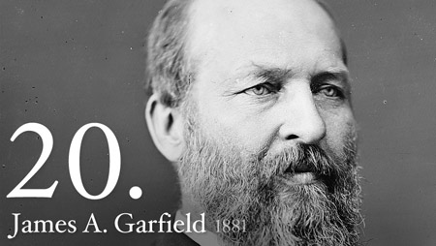
Reform finally came following the assassination of President James Garfield.
(A former Garfield supporter, who felt slighted when he did not receive the government position he wanted, shot and killed the President in 1881.)

Slide 99
James Garfield’s assassination
https://www.youtube.com/watch?v=N6USyilfk6w
Are Presidents in danger of assassination today by disgruntled Americans? By Foreigners?

Slide 100
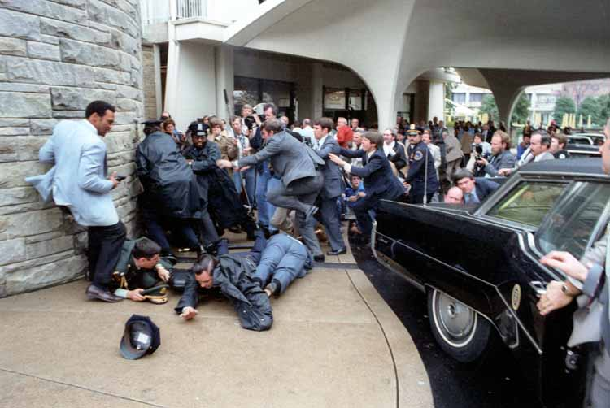
John Hinkley Jr. attempts to kill Reagan

Slide 101
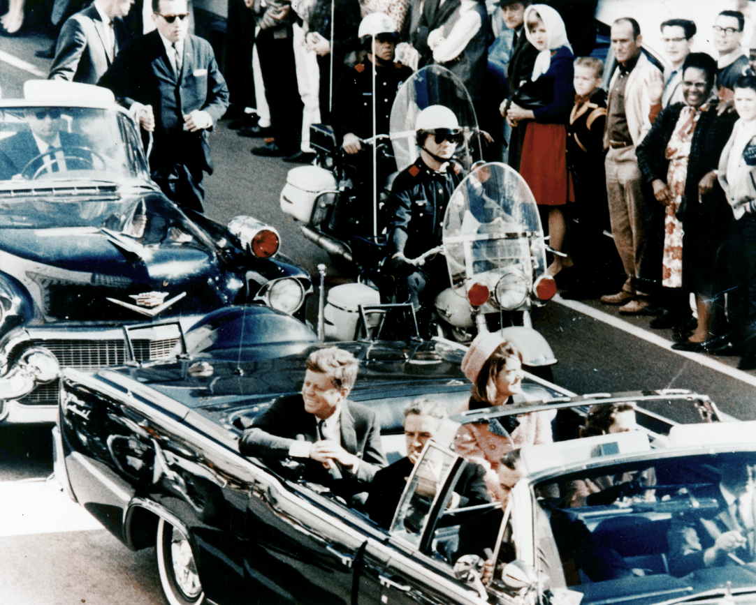
Lee Harvey Oswald assassinated JFK

Slide 102
Pendleton Act
Congress responded by passing the Pendleton Act in 1883.
The act established a Civil Service Commission that monitored government appointments and required that those appointed to certain offices meet specific qualifications.
  End spoils system
  Increase accountability
  Resulted in more qualified ppl serving

Slide 103
Grange Movement
Organization formed by farmers, mostly from the South and Midwest
Struggling financially, farmers formed the Grange to pool their resources and work collectively.
Felt abused by wealthy businesses
The movement was successful and encouraged several state governments to pass Granger Laws.

Slide 104
Interstate Commerce Act
This act gave the federal government the right to regulate railroads that transport farm products across state lines.

Slide 105
Political Machines
Political corruption was not just for the national level.
In big cities , the nation saw the rise of political machines
The fast growth of the urban population meant that governments had to improve existing services and provide new ones.
It also meant more public money and a greater role in government.

Slide 106
Political Machines
The political machine was an unofficial system meant to keep a certain party or group in power.
It was led by a political boss, who may or may not have held a political office.
Graft became commonplace during this time.
Graft?

Slide 107
Creating | Compile information together in a different way by combining elements in a new pattern or proposing alternative solutions
Evaluating | Present and defend opinions by making judgments about information, validity of ideas, or quality of work based on a set of criteria
Analyzing | Examine and break information into parts by identifying motives or causes. Make inferences and find evidence to support generalizations
Applying | Solve problems to new situations by applying acquired knowledge, facts, techniques, and rules in a different way
Understanding | Demonstrate understanding of facts and ideas by organizing, comparing, translating, interpreting, giving descriptions, and stating main ideas
Remembering | Exhibit memory of previously learned material by recalling facts, terms, basic concepts, and answers.

Slide 108
Graft – the use of one’s political position or job to gain wealth

Slide 109
Tammany Hall
New York City’s Boss William Tweed was the most notorious boss.
  Ran Tammany Hall – a political club that controlled the city’s Democratic Party
  Tweed stole over $100 million from the city treasury
  Thomas Nast, a political cartoonist, helped with the downfall of Tweed.
  ‘Stop those darn pictures! I don’t care what the papers say about me; my constituents can’t read. But darn it, they can see pictures!”

Slide 110
  ‘Stop those darn pictures! I don’t care what the papers say about me; my constituents can’t read. But darn it, they can see pictures!” – Boss Tweed
https://www.youtube.com/watch?v=YildL_ilQFY
  Boss Tweed clip (9 minutes) https://www.youtube.com/watch?v=Q9cIth6Js78
  Sample student project over Tweed
  You will be making a multi-media project this year! I’ll be showing you samples throughout the year to help get you thinking.

Slide 111
Standards for the Week
US.4 Analyze the causes and consequences of Gilded Age politics and economics, including the rise of political machines, major scandals, civil service reform, and the economic difference between farmers, wage earners, and industrial capitalists, including the following:
Boss Tweed, Thomas Nast, Credit Mobilier, Whiskey Ring, Garfield’s assassination, Pendleton Act, Interstate Commerce Act. &
US.8 Evaluate multiple sources of information presented in diverse formats and media as in the political cartoons of Thomas Nast and others during the Gilded Age.
US.8 Evaluate multiple sources of information presented in diverse formats and media as in the political cartoons of Thomas Nast and others during the Gilded Age.

Slide 112
Standards & Agenda
Standards:
-US.8 Evaluate multiple sources of information presented in diverse formats and media as in the political cartoons of Thomas Nast and others during the Gilded Age.
-Review Gilded Age standards
Agenda
Daily Openers
Political Cartoon Discussion: Whole Class
Video clip
Political Cartoon Handout
(Finish quizlet if needed)

Slide 113
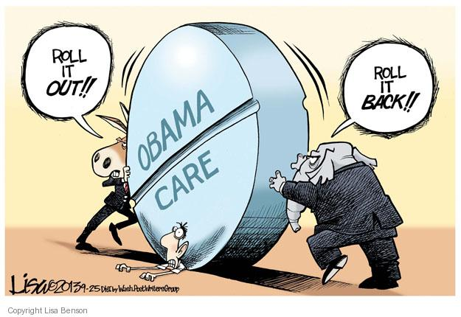
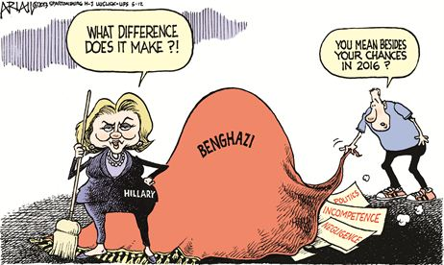
Daily Openers – Analyze the following cartoons:
1.
2.

Slide 114
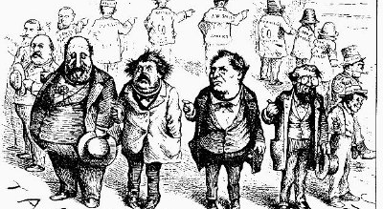
Tips on how to analyze a political cartoon.

Slide 115
Whole Class- Look at the following slides of Thomas Nast cartoons.
Try to do the following for each:
Find Boss Tweed.
Discuss the intended message from Nast.
What are some Gilded Age problems portrayed in the cartoons.

Slide 116
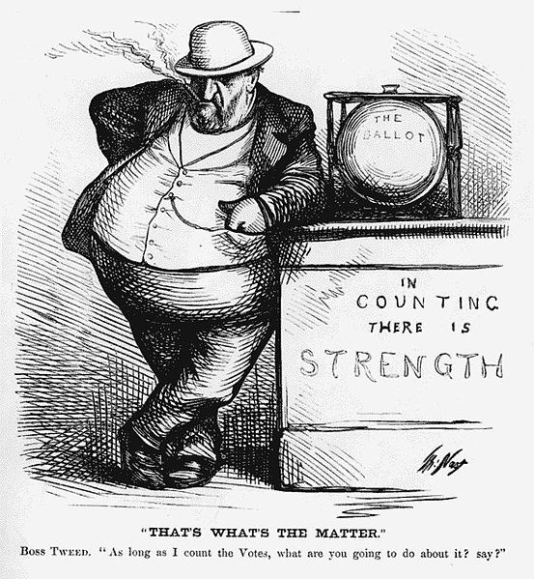
What does In counting
There is strength
Mean?
What does “IIn
Counting there is
Strength” mean?

Slide 117
Thomas Nast cartoon – Can you find Boss Tweed?

Slide 118
Video clip
Boss Tweed & Thomas Nast - https://www.youtube.com/watch?v=VHZYDbludDU&list=PLH4pm-ymp5y2XlJfKnuWowNAw7fLpbRw_&index=7
Pass out political cartoon handouts

Slide 119
Thomas Nast
Handout link (I gave you this copy – cartoons and DBQ) http://www.losal.org/cms/lib7/CA01000497/Centricity/Domain/340/Politcal_cartoon_analysis.pdf
Extra
Handout - http://sheg.stanford.edu/upload/Lessons/Unit%205_Civil%20War%20and%20Reconstruction/Nast%20Cartoons%20Lesson%20Plan1.pdf

Slide 120
US.8 Evaluate multiple sources of information presented in diverse formats and media as in the political cartoons of Thomas Nast and others during the Gilded Age. (C, P)

Slide 121
Look at the following slides of Thomas Nast cartoons.
Try to do the following for each:
Find Boss Tweed.
Discuss the intended message from Nast.
What are some Gilded Age problems portrayed in the cartoons.

Slide 122
Thomas Nast cartoon – Can you find Boss Tweed?

Slide 123
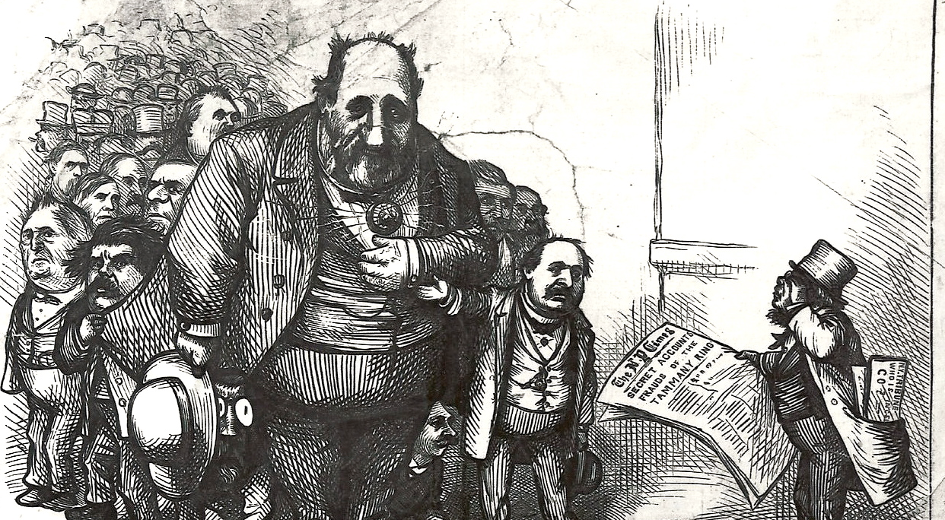

Slide 124
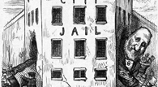
image.jpg

Slide 125
Thomas Nast
Handout - http://sheg.stanford.edu/upload/Lessons/Unit%205_Civil%20War%20and%20Reconstruction/Nast%20Cartoons%20Lesson%20Plan1.pdf

Slide 126
Imperialism

Slide 127
What were two causes of American Imperialism during the late 1800s. early 1900s?
Daily opener

Slide 128
Describe the Spanish American War.

Slide 129
Daily opener
Why has America been imperialistic?

Slide 130
What is imperialism?

Slide 131
American Imperialism
What is imperialism?
  Possession of foreign territories or colonies for the benefit of the home country; a policy of expansionism to increase a nation’s economic or political power

Slide 132
Why was America Imperialistic?

Slide 133
What was a consequence of American imperialism?

Slide 134
Why was America Imperialistic?
Desire for Raw Materials which could help make Money (Economy)
Militarism – felt needed to expand to remain secure, show off United State’s military power

Slide 135
3. Religious & Moral Obligations – whites had an obligation to help others, some good intentioned, some racists
4.Nationalism –Love of Country

Slide 136

Monroe Doctrine
Policy that said the US would oppose any attempts by European nations to extend their influence in the Western Hemisphere

Slide 137
Identify consequences of American imperialism
Spanish American War
Expanding Trade
Yellow journalism
Military occupation
Extractive economies
Panama Canal
The idea of a superior Anglo-Saxon culture

Slide 138
Origins of the Spanish American War
In the late 1800s, the island of Cuba was still under Spanish rule.
In 1895, the Cuban people rebelled.
Spain sent 15,000 troops to restore order.
As part of their strategy, the Spanish relocated thousands of Cuban citizens into concentration camps.
These camps had miserable conditions and many Cubans died.

Slide 139
As pressure mounted for the US to intervene, competing newspapers printed stories about abuse carried out by the Spanish.
Often exaggerated and untrue, these stories were meant to sell papers rather than accurately report the facts.
This brand of journalism became known as yellow journalism.
It served to ignite the emotions of the US people.

Slide 140
Foreign Policy

Slide 141
Citizens in the US began to call for a tougher stance towards Spain and a more aggressive foreign policy.
One of the many voices calling for war was that of Assistant Secretary of the Navy Theodore Roosevelt.
When the US finally did go to war, Roosevelt resigned his position in the administration to become a Lt. Colonel. He commanded a group of volunteers known as the Rough Riders.

Slide 143
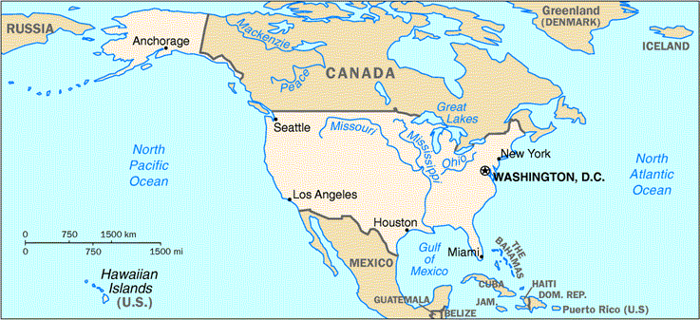
Where is Cuba? Is it close to the US?

Slide 144
The Spanish American War finally began in 1898.
A US battleship, the USS Maine, exploded while anchored in a Cuban harbor.
Immediately, the newspaper blamed Spain for the sinking of the USS Maine, and US citizens called for war.

Slide 145
2 minute clip on the Spanish American War
https://www.youtube.com/watch?v=q1goSNElCyE

Slide 146
War in Motion
Upon hearing the declaration of war, US Commodore George Dewey set sail for another Spanish colony, the Philippines Island.
Meanwhile in Cuba, Roosevelt led the Rough Riders in bold charges up in Kettle and San Juan Hills.
  This became the most famous incident of the war and helped the US achieve victory over the Spanish.

Slide 147
Military Occupation
(consequence of American imperialism)
In less than three months, the US had defeated Spain in both Cuba and the Philippines.

Slide 148
Following the war, Puerto Rico and Guam became US territories.
Cuba remained independent, but the US held great influence over the island.
The most controversial territory was the Philippines.
  Isolationists versus Imperialists

Slide 149
Quizlet over terms
What was America’s ‘splendid little war’?
Why did Teddy Roosevelt carry a big stick?
What did President Roosevelt do with 7,800 miles?
Why did the United States enter World War I?
What were three important dates of WWI?
Evaluate Woodrow Wilson’s 14 Points.

Slide 150
Isolationists
Many US citizens were isolationists.
  They believed the US should stay out of foreign affairs and did not promote expansion.

Slide 151
Isolationists
Even if they supported the war in Cuba because it was very close to the United States, they did not support the fighting in the Philippines and did not want the Philippines to become a US territory.
Those who opposed expansion argued that annexing the Philippines would undermine democracy and increase the likelihood of future wars in the Pacific.

Slide 152
Imperialists
Imperialists like Theodore Roosevelt, however, argued that the US should keep the Philippines.
They saw the territory as crucial for protecting US economic interests in Southeast Asia.

Slide 153
Philippines
While the isolationists and imperialists argued, the Filipinos launched guerilla warfare.
Fighting lasted roughly 2 years.
In the end, the Philippines became an unorganized territory of the United States. (until 1946)

Slide 154
Expanded Trade
As a result of the United State’s victory over Spain, the US possessed territories that spanned the Pacific Ocean.
In addition to protecting these areas, trade became increasingly important. US hoped to infiltrate new trade in Asia and make a lot of money.

Slide 155
Panama Canal
https://www.youtube.com/watch?v=IOTA-S9MovE (10 min)
https://www.youtube.com/watch?v=q2T7CL9wqyM (2 min)
https://www.youtube.com/watch?v=Pv0upmpPw3c (3 min)

Slide 156
Panama Canal
Theodore Roosevelt became the 26th President in 1901.
Roosevelt was an imperialist who envisioned the Panama Canal.
  This would serve the US military and economic interests by allowing ships to travel between the Atlantic and Pacific oceans without having to go around South America.

Slide 157
Teddy R

Slide 158
The Columbian government would not allow the US to do this project, but later the Panamanian people revolted against the Columbians.
The US backed this revolt and in return, the Panamanians allowed the US to create the Panama Canal.
It was finished in 1914.

Slide 159
Superior Anglo Saxon Belief
The White Man’s Burden - obligation to help ‘civilize’ and ‘help lesser peoples’
Social Darwinism – survival of the fittest

Slide 160
Extractive Economy
A resource-based economy, dependant on harvesting or extracting natural resources for sale or trade
The US economy was developing more and more into an extractive economy.

Slide 161
World War I Article

Slide 162
Quiz over WWI article
What event took nine million lives?
Name 3 of the major Allies in this war.
Name 3 of the major countries involved in the Central Powers.
When was World War I?
Did the US enter the war when it started in 1914?
How did the US help Great Britain early on in the war?
What was the Lusitania?
How did u-boats play a role in WWI?
What were two of the permanent marks on American society mentioned in the article?
What did the final treaty require Germany to do?

Slide 163
Quiz over WWI article – Honors
What event took nine million lives?
The first World War was a total war. Name 3 things that Americans did to help the war effort. (citizens or organizations)
Name 3 of the major countries involved in the Central Powers.
What are the years for WWI?
Did the US enter the war when it started in 1914? (yes or no)
What did the 1917 Espionage Act do?
What was the Lusitania?
How did u-boats play a role in WWI?
What were two of the permanent marks on American society mentioned in the article?
What did the final treaty require Germany to do?

Slide 164
Vocab Quiz
The term yellow journalism refers to
A. newspapers encouraging the appeasement of foreign imperialist powers
B. sensationalist reporting
C. editorials opposing the policies of President Theodore Roosevelt
D. editorials endorsing the Open Door Policy with

Slide 165
2. Nationalism was a cause of American imperialism. What does nationalism mean?

Slide 166
3. What is the Monroe Doctrine?

Slide 167
4. Describe Manifest Destiny and the President that supported it.

Slide 168
5. What is imperialism?

Slide 169
6. A tax or duty on imported goods is a
Bomb
Roosevelt Corollary
Tariff
Suffrage

Slide 170
7. The 19th amendment in the United States deals with suffrage for women. What does suffrage mean?

Slide 171
8. When World War I started in 1914, the United States stayed neutral. By 1917, it could no longer be neutral and was forced to enter the war. What does neutrality mean?

Slide 172
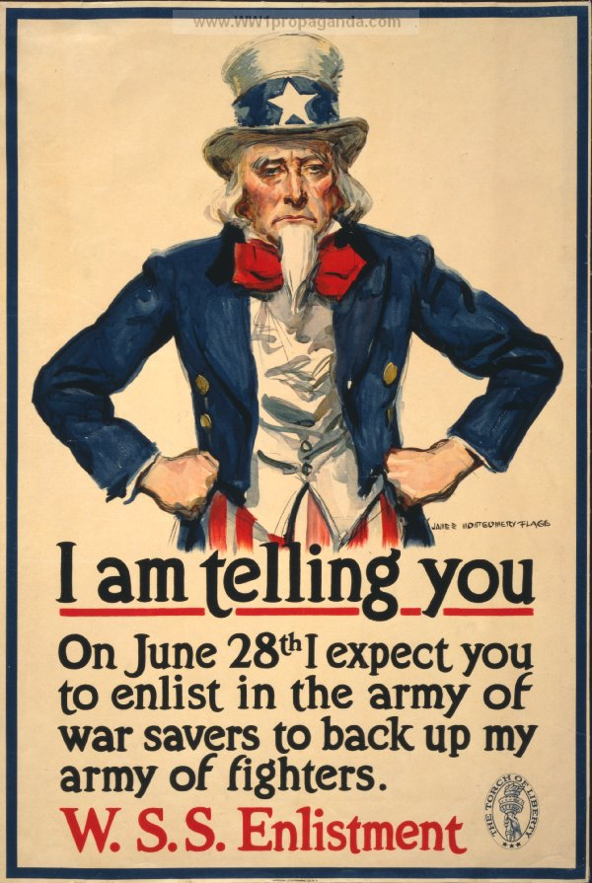
9. Propaganda played a large role in the US entering World War I. What is propaganda? Example -

Slide 173
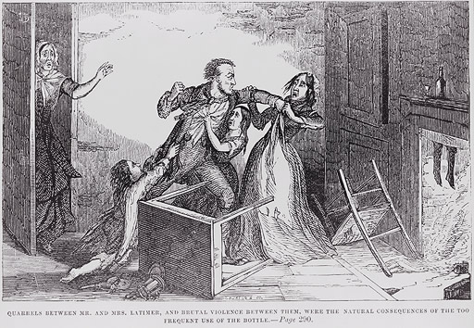
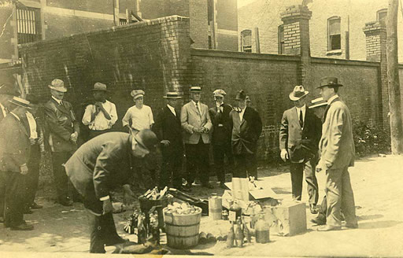
10.The 18th amendment ushered in Prohibition. Even though it was the law, it did not work. What was Prohibition?

Slide 174
Objective 7.3
Recognize the progress of political and social reform in America during this era:
  Women’s suffrage
  Regulation of food and drug
  Initiative
  Referendum
  Recall
  Protection of worker’s rights
  Antitrust Supreme Court decisions
  Muckrakers

Slide 175
Presentations will start in 2o minutes (8:59 a.m.).
Create a Visual
Discuss your topic
Explain it thoroughly
Practice Presenting

Slide 176
Daily opener
What was the significance of the Pendleton Act?

Slide 177
The Progressive Era
1890-1920
Turn of the 20th century
Time of political, social, and economic change and reform in the US

Slide 178
Progressives
Those who supported reforms during the Progressive Era
Tended to be white, middle class, and Protestant

Slide 179
Progressives
Called for regulation of business, improved wages for worker, and regulations over work environments

Slide 180
Progressive
Raged against upper class
Looked down on lower class

Slide 181
Protection of workers’ rights
Progressives also demanded reforms in the workplace
  1911 Triangle Shirtwaist Factory Fire
    146 deaths
    Locked exits
    Fire escape collapsed

Slide 182
Angry progressives demanded action
By 1920, most states had established workers accident insurance programs
Eventually reformers convinced legislators to:
set limits on how young workers could be
restricted hours
created safer working conditions

Slide 184
2. Women’s suffrage
Suffrage – right to vote
Susan B. Anthony – most recognized leader of the movement
Organized rallies and parades
19th amendment officially became part of the US constitution in 1920

Slide 185
Susan B. Anthony

Slide 186
US.18
Describe the movement to achieve suffrage for women, including its leaders, the activities of suffragettes, the passage of the 19th Amendment, and the role of Tennessee in the suffrage effort.
  (Anne Dallas Dudley, Harry Burn, Josephine Pearson, “Perfect 36”)

Slide 187
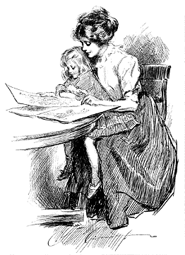
Progressive Era Women
Traditional Views of Women
Barefoot, pregnant, in the kitchen.
Primary caregiver.
Stayed in the home.
  Did not have a social life.
  Main job was to run the household.
  If in a poor family, the woman also had to work.
The Cult of Domesticity
http://www.library.csi.cuny.edu/dept/history/lavender/386/graphics/gibson.gif

Slide 188
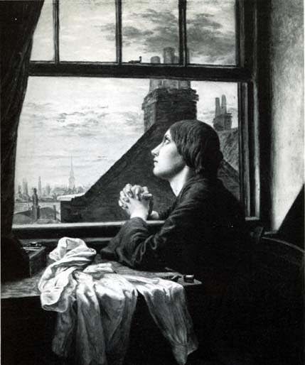
Progressive Era Women
Traditional Views of Women
Menial labor.
  Low-paying jobs.
  Worked as seamstresses, as machine operators, and as house cleaners.
  Very few professions: teaching, nursing, secretary.
No political or property rights.
  Once married, all property went to the husband.
  No suffrage (voting rights).
Subordination of women.
Second Industrial Revolution Seamstress
http://www.accd.edu/sac/history/keller/Serr/blunden1.jpg

Slide 189
All For The Big Bucks, Right?!
Remember that whatever these women made would go to their husbands or male guardians
For less that two dollars a week these women would work 50 or 60 hours a week….only to have to hand it over to their husbands

Slide 190
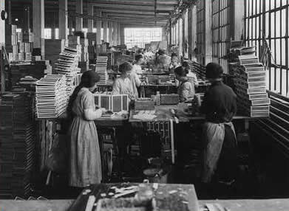
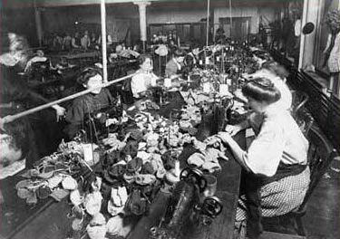

Slide 191
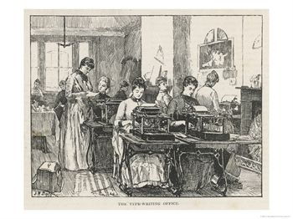
Progressive Era Women
SIR: New Jobs
More women enter the workforce thanks to the creation of new jobs.
  Center around the new consumerism.
New jobs include women being in the majority of salespersons and cashiers.
  Women are more polite, easier to control, and more honest than male workers.
Typing Pool
http://imagecache2.allposters.com/images/pic/MEPOD/10005620~An-Early-Typing-Pool-The-Typing-Office-of-the-Society-for-the-Employment-of-Women-Posteres.jpg

Slide 192
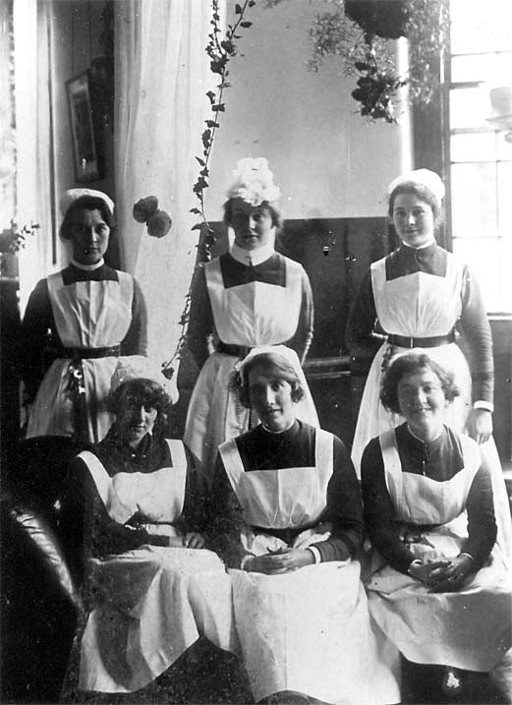
Progressive Era Women
SIR: New Jobs
Educated, middle-class women begin to gain prestige.
Dominate the nursing field, which was expanding.
  Made great nurses.
  Could not work as doctors.
Nurses, ca. 1920
http://www.berkshirerecordoffice.org.uk/collections/images/fairmile/Nurses-early-1920s-7.14.gif

Slide 193
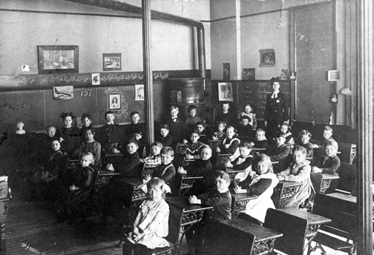
Progressive Era Women
SIR: New Jobs
Grade school teachers.
  Take over for males.
  Have a more caring attitude for the children, increasing the level of education.
Classroom, Late 19th Century
http://www.co.brown.wi.us/Museum/Collections/Collections/Photo_Reproduction_services/Snapshots_in_Time/2721.gif

Slide 194
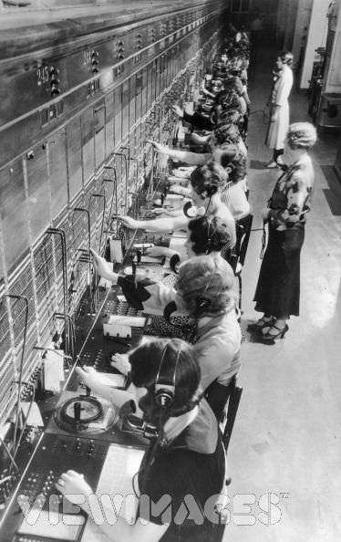
Progressive Era Women
SIR: New Jobs
Clerks, secretaries, and typists.
  Any man who has the same skills would be open for better jobs or were disinterested in office work.
Telephone Operators, Ca. 1910
http://cache.viewimages.com/xc/3226574.jpg?v=1&c=ViewImages&k=2&d=27D044C0A019FA6C8629D8D39FBF6609A55A1E4F32AD3138

Slide 195
Women Of The Early 1900’s
Education would be the first place that these up-ward moving women could obtain equality
Women of this time wanted to do more with their lives that simply have/raise children and keeping house

Slide 196
7.6
Recognize the role of TN in the women’s suffrage movement
  The Perfect 36
  Anne Dallas Dudley
  Harry Burn
  Governor Albert Roberts

Slide 197
A. The Perfect 36
Tennessee and the states before it that voted in favor of women’s suffrage became known as the perfect 36

Slide 198
B. Anne Dallas Dudley
Important activist in the women’s suffrage movement
Played a key role in campaigning for the ratification of the 19th amendment

Slide 199
C. Harry Burn
TN General Assembly locked in a tie
Burn planned to vote NO until he received a letter from his mother.
He voted in favor of women’s suffrage and the 19th amendment had the ‘perfect 36’ necessary to become part of the constitution
Josephine Pearson – Anti-suffrage

Slide 200
D. Governor Albert Roberts
Called a special session to vote on the 19th amendment

Slide 201
Regulation of food and drug
1906 Congress passed the Pure Food and Drug Act and the Meat Inspection Act
  Regulated the food and drug industries
  Required accurate labeling of ingredients, strict sanitary conditions, and a rating system for meats

Slide 202
The Jungle – Upton Sinclair – released in 1906
Exposed nasty meatpacking conditions

Slide 203
Led to the creation of the Food and Drug Administration- FDA in 1906
  FDA – still in charge of safety regulations

Slide 204
The Federal Food, Drug, and Cosmetic Act of 1938 was passed after a legally marketed toxic elixir killed 107 people.
The Medical Device Amendments of 1976 followed a U.S. Senate finding that faulty medical devices had caused 10,000 injuries, including 731 deaths.

Slide 205
US.17
Analyze the goals and achievements of the Progressive movement, including the following:
  Adoption of the initiative, referendum, and recall
  Adoption of the primary system
  16th Amendment
  17th Amendment
  Impact on the relationship between the citizen and the government

Slide 206
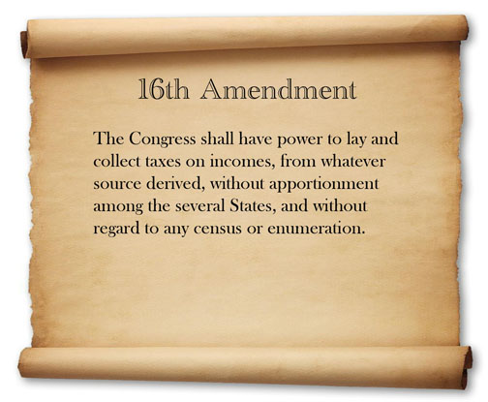
16th Amendment –
Allowed the income tax

Slide 207
16th Amendment
Created national income tax

Slide 208
Reform Accomplishments
Regulation of city utility monopolies (water, gas, electricity) by 1915 2 out of 3 cities had some city owned utilities.
Voters gain more direct influence in lawmaking & choosing candidates (1913 17th amendment) United States Senators elected by Popular Vote (Not State Legislator)
30 states abolished child labor (under 14) & some states adopt min wage laws

Slide 209
Government Reforms of The Progressives
In Wisconsin, Reform Governor Robert M. La Follette established the direct primary
This is an election in which citizens vote to select nominees for upcoming lections
By 1916 all but four states had direct primaries
The 1900 ,the hurricane in Galveston, Texas killed more than 8,000
Because many of the city officials were killed the town decided to replace their major and alderman into a five man commission.
This became known as the Galveston Plan and was used across the country as a means to curb corruption

Slide 210
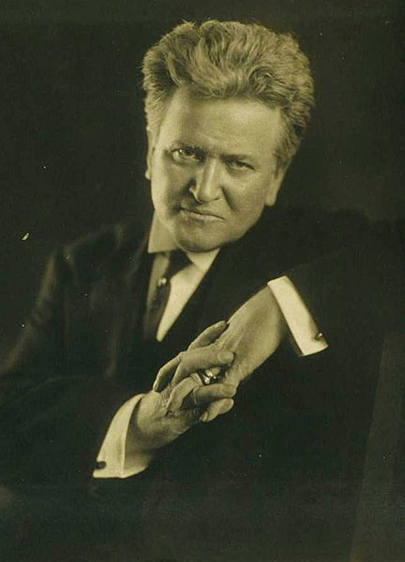
La Follette & Direct Democracy
Initiatives Referendums and Recalls
The Initiative-the power to put a proposed law on the ballot in an election by a petition
The Referendum- allowed citizens to approve or reject laws
The Recall gave voters to remove office holders

Slide 211


Robert Lafollette
Direct Primary led to…
Initiatives…
Referendums…
Recall….
17th Amendment
  1913 – Direct election of senators

Slide 212

Election Reform
Citizens fought for and secured such measures as secret ballots, referendums, and recalls. Citizens could petition and get initiatives on the ballot.
In 1899, Minnesota passed the first statewide primary system.

Slide 213


Slide 214

Direct Election Of Senators
Before 1913, each state’s legislature had chosen U.S. senators. To force senators to be more responsive to the public, Progressives pushed for the popular election of senators.
As a result, Congress passed the 17th Amendment in 1913.

Slide 215
Women's Rights

Slide 216
Women’s Colleges
Examples: Randolph-Macon College Women’s College in Virginia
Martha Washington College in Abingdon, Va
Sweet-Briar College also in Va
Milligan College
Tennessee Teacher’s College (Tennessee Tech)
A growing number of women’s colleges begin to spring up through out the country
These colleges tended to prepare women for careers in nursing and teaching

Slide 217
Initiative
Allowed citizens to force a vote on certain issues without having to wait on public officials to bring it up.

Slide 218
Referendum
Citizens could vote directly on proposed laws rather than having political leaders make all of the decisions

Slide 219
Recall
Citizens have the power to remove officials from office

Slide 220
Protection of workers’ rights
Progressives also demanded reforms in the workplace
  1911 Triangle Shirtwaist Factory Fire
    146 deaths
    Locked exits
    Fire escape collapsed
    https://www.youtube.com/watch?v=4ulaG9x4GpE

Slide 221
Angry progressives demanded action
By 1920, most states had established workers accident insurance programs
Eventually reformers convinced legislators to:
set limits on how young workers could be
restricted hours
created safer working conditions

Slide 222
. Antitrust Supreme Court decisions
Rockefeller and several associates created the Standard Oil Trust in 1890
  Controlled the oil industry
  Severely limited market competition
  Many Americans demanded government intervention.

Slide 223
In response, Congress passed the Sherman Antitrust Act
  Did not allow any combination of companies that would limit trade and commerce
  During the Progressive Era, a number of trusts ended after the government challenged them in court.

Slide 224
Daily opener
What is yellow journalism?

Slide 225
African Americans and the Progressive Era
Different leaders within the African American community arose in the late 19th and early 20th century. Although, they shared a common goal of improving the lives of African Americans they often differed over how to best achieve such goals.

Slide 226
Video Clips
Booker T. Washington
  https://www.youtube.com/watch?v=07cispyOhWQ
  Marcus Garvey
  https://www.youtube.com/watch?v=R-XjloOKl60
  W.E.B. Du Bois
  https://www.youtube.com/watch?v=TGOEED_MexI

Slide 227
Quiz
Define imperialism.
When was the Progressive Era?
Discuss two reforms made during the Progressive Era.
What does suffrage mean?
Name one well known person involved in the suffrage movement.

Slide 228
Temperance Movement
wanted to make alcoholic drinks illegal.
In 1919, supporters of the temperance movement won passage of the 18th amendment(Prohibition)
  prohibited the sale and manufacturing of alcohol.
  Only amendment thus far to be repealed.

Slide 229
7.4 Identify the causes of American involvement in World War I (i.e., security concerns, economic benefits, Wilsonian diplomacy, propaganda).

Slide 230

World War I
1914-1918

Slide 231
Daily opener
List three of the Allied Powers for WWI.
List three of the Central Powers.

Slide 232
What is yellow journalism?
Daily Opener

Slide 233
Bet You Didn’t Know: WWI
http://www.history.com/topics/world-war-i/world-war-i-history/videos/bet-you-didnt-know-world-war-i

Slide 234
Daily opener
When was WWI?
Why was there a WWI?

Slide 235
World War I (1914–1918)
Imperial, territorial, and economic rivalries led to the “Great War” between the
Central Powers (Germany, Austria-Hungary, and Ottoman Empire)
the Allies (Great Britain, France, Russia, Japan, and eventually the US)

Slide 236
Stats
About 9 million combatants killed
20 million wounded
6 million crippled
117,000 dead from the US

Slide 237
Causes of World War I
http://www.history.com/topics/world-war-i/world-war-i-history/videos/causes-of-world-war-i?m=528e394da93ae&s=undefined&f=1&free=false

Slide 238


Slide 239
Trench Warfare
Technology superior to tactics
  Machine gun versus a human charge through "No man's land"
  New technology = poison gas, airplanes
Very high death rates
  Battle of the Somme = 600,000 allied and 500,000 German dead for 125 miles of land
  Battle of Verdun = 700,000 killed on both sides with no gain in territory

Slide 240
Battle of the Somme
http://www.history.com/topics/world-war-i/world-war-i-history/videos/1916-battle-of-the-somme?m=528e394da93ae&s=undefined&f=1&free=false

Slide 241
Trench Warfare: Bet You didn’t kow
http://www.history.com/videos/bet-you-didnt-know-trench-warfare#bet-you-didnt-know-trench-warfarehttp://www.history.com/videos/bet-you-didnt-know-trench-warfare#bet-you-didnt-know-trench-warfare

Slide 242
Trench Warfare
From Erich Remarque's All Quiet on the Western Front
  "We see men living with their skulls blown open; we see soldiers run with their two feet cut off… Still the little piece of convulsed earth in which we lie is held. We have yielded no more than a few hundred yards of it as a prize to the enemy. But on every yard there lies a dead man."

Slide 244
Trench Warfare
http://www.history.com/topics/world-war-i/world-war-i-history/videos/trench-warfare?m=528e394da93ae&s=undefined&f=1&free=false

Slide 245
US remains neutral.
President Woodrow Wilson declared the US neutral and won re-election in 1916 with the slogan – “He kept us out of war.”

Slide 246
Interventionism – the philosophy that the US should get involved with international conflicts
Isolationism – the philosophy that the US should NOT get involved

Slide 247
Reasons for US involvement in WWI:
Economic reasons
National security
Propaganda
Economic benefits

Slide 248
Economic Reasons
If Great Britain lost the war, the US economy would suffer from the loss of investments in Britain.

Slide 249
National Security
German U-boats (submarines) began sinking US ships.
  Sinking of Lusitania – killed 128 Americans
  http://www.history.com/topics/world-war-i/world-war-i-history/videos/u-boats-sink-the-lusitania-in-1915 (stop at 1:20)
Notes:
1st period stopped

Slide 250
Security Concerns
Feb. 23, 1917 Zimmermann telegram intercepted
  Letter from Germany to Mexico proposing an alliance, promised to give Mexico land back

Slide 251
Propaganda
Information that is widely spread to help build support for one side, while making people hate or dislike the other side
Wilson set up a special committee to convince people to back the war against Germany

Slide 252
Economic Benefits
Industrial production rose - b/c of high demands for food, weapons, fuel, and many other supplies
Farmers saw agricultural prices rise

Slide 253
The US enters WWI.
April 2nd, 1917, President Woodrow Wilson asked Congress for a declaration of war against Germany.
The US gave the Allies the final edge it needed to force Germany to sign an armistice (agreement to stop fighting).
Once the fighting stopped, the leaders of several nations met together for a peace conference in Paris.

Slide 254
25 interesting facts about WWI that you didn’t know
https://www.youtube.com/watch?v=bRcKpWZOalo

Slide 255
Wilsonian Diplomacy
President Wilson went to the peace conference with no desire to punish Germany, but wanted to engage in diplomacy (find solutions that would satisfy both sides without further fighting).
He did NOT want to put harsh conditions on his former enemy and he did NOT want to gain territory.
Wilson’s goal was peace and stability.

Slide 256
Wilson’s Fourteen Points
Wilson’s Plan
  Reduction in weapons
  Right to self-determination (power to govern oneself)
  http://avalon.law.yale.edu/20th_century/wilson14.asp

Slide 257
League of Nations
Wilson also proposed founding the LON.
The purpose would be to provide a place where countries could peacefully discuss solutions to their differences rather than go to war.
Ironically, the US did not join the LON, but several other countries did.

Slide 258
After the War –
Return to Isolationism
The US feared the League of Nations would drag them back into war and wanted to stay out of foreign affairs.

Slide 259
Treaty of Versailles
Unlike Wilson, many of his European allies wanted retribution.
Europe had fought in the war longer and lost more lives than the US and wanted someone to pay.
Germany was forced to take responsibility for the war and pay reparations to the Allies.
In today’s dollars - $400 billion
http://www.csmonitor.com/World/Europe/2010/1004/Germany-finishes-paying-WWI-reparations-ending-century-of-guilt
Notes:
http://www.csmonitor.com/World/Europe/2010/1004/Germany-finishes-paying-WWI-reparations-ending-century-of-guilt

Slide 260
Treaty of Versailles
http://www.history.com/topics/world-war-i/world-war-i-history/videos/treaty-of-versailles-end-world-war-i?m=528e394da93ae&s=undefined&f=1&free=false

Slide 261
Treaty of Versailles
These conditions ultimately led to economic depression and great bitterness on the part of most Germans, and created the conditions necessary for the rise of a young, charismatic leader – Adolf Hitler.
Despite his masterful diplomacy, President Woodrow Wilson failed to get his own country to sign the treaty ending WWI.

Slide 262
Legacy of WWI
http://www.history.com/topics/world-war-i/world-war-i-history/videos/legacy-of-world-war-i?m=528e394da93ae&s=undefined&f=1&free=false

Slide 263
The end of WWI marked America’s emergence as the world’s clear economic leader.

Slide 264
Read Zimmerman article

Slide 265
Extra: The Christmas Truce
http://www.history.com/topics/world-war-i/world-war-i-history/videos/the-christmas-truce?m=528e394da93ae&s=undefined&f=1&free=false

Slide 266
Daily opener
Put your daily opener book on my desk. (if complete)

Slide 267
Quiz
Why did the US initially remain neutral during World War I? What changed and led the US to enter the war?
What is propaganda, and what role did it play in the US during WWI?
What were some of WWI’s economic effects on the US?
What were President Wilson’s diplomatic goals after the war? In what ways did the Treaty of Versailles support Wilson’s goals? In what ways did it work against them?

Slide 268
World War I clip
https://www.youtube.com/user/crashcourse

Slide 269
7.1 Identify causes of American imperialism (i.e., raw materials, nationalism, missionaries, militarism, Monroe Doctrine).
Test Question - List and explain the causes of American imperialism.

Slide 270
Progressive Era Review Clip
http://app.discoveryeducation.com/search?Ntt=progressive+era+

Slide 271
Impromptu Skits
Start Time – 9:46
Video Taping Beings at 10:15
Requirements
  Cover a topic(s) from assigned section
  Must be historically accurate
  At least one visual created
  Act or Narrate
  2-3 Minutes

Slide 272
7.10 Analyze the American isolationist position versus interventionist arguments.
Test Question - Analyze the American isolationist position versus interventionist arguments.

Slide 273
Review Questions
Define imperialism.
Which President encouraged imperialism by his excitement for the Spanish American War and the Panama Canal?
Explain one reason the US was imperialistic.
Evaluate the United States today in the area of imperialism. Is the US imperialistic? Why is it or is it not?
Why did World War I begin? Did a single incident start the ‘Great War’?
Imagine you were a diplomat in the early 1900s. What could you have done to prevent World War I from ever starting?

Slide 274

America Moves to the City

Slide 275

Mass Migration
By 1900, 4 in 10 Americans lived in cities
US had 3 cities with over 1 million people (NYC 3.5 million)

Slide 276


Cities Reach Skyward
Skyscrapers became possible due to steel and the electric elevator

Slide 277

Mass Transit
Electric trolleys and subways brought workers from suburbs to cities

Slide 278



Slide 279

Department Stores
Macy’s (NYC) & Marshall Fields (Chicago)
Mail order catalogs (Sears & Roebucks)

Slide 280

City Living Side Effects
Most buildings had no indoor plumbing
Was no trash pick-up service
No water treatment facility

Slide 281

Tenement Housing
Several poor families would be crammed onto each floor
Harbored insects and disease

Slide 282

Immigration

Slide 283

Europeans
Between 1870-1920, 20 million people came from Europe
Most came from southern and eastern Europe to find land and jobs in US

Slide 284

Journey to America
Most immigrants came by steamship
Traveled in crowded cabins, shared beds, toilets, and suffered from disease

Slide 285
Ellis Island
Immigrant processing station for Eastern US
Pass a medical exam and legal requirements
1892-1924, 17 million people passed through Ellis Island

Slide 286


Slide 287


Slide 288


Slide 289
Angel Island
Immigrants suffered harsh questioning and long detention in filthy buildings
Located in San Francisco Bay, CA

Slide 290


Slide 291


Slide 292


Slide 293

Immigrant Hardships
Find a place to work and live
Sought out people with same language and culture

Slide 294

Immigrants and the Political Machine
Machines helped with jobs, housing, and citizenship in exchange for votes

Slide 295
Nativism
Native-born Americans formed anti-immigrant groups
Only opposed Italian, Greek, Jewish, Polish, and Asian immigrants

Slide 296
Nativism
Work was scarce out west after railroads went bankrupt
1882 Congress passed Chinese Exclusion Act, which restricted immigration until 1943

Slide 297
Hypocrisy
1886 the Statue of Liberty was assembled in NYC harbor
“Give me your tired, your poor
Your huddled masses yearning to breathe free
The wretched refuse of your teeming shore”

Slide 298

Reforming Society
Social Gospel movement inspired many reformers
Jane Addams established Hull House in Chicago 1889

Slide 299
Reforming Society
Hull Houses (settlement homes) were founded across the US
Helped immigrants adapt to US life-style & fought for social reform (women’s right)

Slide 300
Churches Adapt to City
Rural protestant churches lost influence in city life
Took a more liberal approach rejecting biblical literalism, and questioned the idea of original sin

Slide 301

Growth of Catholics
Catholics grew from new immigrants
By 1900 they were the largest single denomination in US

Slide 302

Angering the Church
Charles Darwin published On the Origin of Species in 1859
Detailed his theory of “natural selection”

Slide 303

Expanding Public Education

Slide 304

Schools
Mandatory attendance laws for ages 8-14
Separate schools for blacks and whites

Slide 305

High Schools
Million began attending High Schools
Taught math, science, civics, and also vocational courses

Slide 306

Higher Education
1880-1920 college enrollment quadrupled
Medical and Law schools were established

Slide 307

Higher Education
Morrill Act of 1862 gave land and money to public universities to teach Ag
Notes:
Morgan hall

Slide 308

Expanding Education to Blacks
Booker T. Washington founded the Tuskegee Institute in 1881
Taught agriculture and vocational trades

Slide 309

George Washington Carver
Taught at Tuskegee Institute
Discovered new uses for the peanut (shampoo, axle grease), sweet potato (vinegar), and soybean (paint)

Slide 310

W.E.B. Du Bois
First black to attain a doctorate from Harvard
Helped found the NAACP which demanded complete equality for blacks

Slide 311
Print Publications
Newspapers turned to sensationalism of sex, scandals, and other stories to sell papers
Joseph Pulitzer (New York World), William Randolph Hearst (owned numerous papers)

Slide 312
Literary Writings
Samuel Langhorne Clemons (Mark Twain) – Adventures of Tom Sawyer
Jack London – Call of the Wild
Emily Dickinson

Slide 313

Changing Morals
Women’s liberation spawned sexual freedom
Increased divorce rates, birth control, and free love
Notes:
Victoria woodhull

Slide 314

Women’s Suffrage
Wyoming 1st state in 1869 to give women the right to vote
By 1918 most states had full or partial suffrage

Slide 315
Prohibition
Women’s Christian Temperance Union (WCTU) 1874
Anti-Saloon League 1893
Both wanted to outlaw sale of alcohol

Slide 316


Slide 317

“Kansas Cyclone”
Carrie A. Nation smashed bottles and bars with a hatchet

Slide 318

Amusement Time
Phineas T. Barnum and James A. Bailey joined to form the “Greatest Show on Earth” in 1881

Slide 319

Wild West Show
William “Buffalo Bill” Cody first performed in 1883

Slide 320
Spectator Sports
Baseball becomes a professional sport in 1870s
Basketball invented by James Naismith in 1891
Football became popular as well

Slide 321


Slide 322



Slide 323


Slide 324

Recreational Activities
Bicycling, tennis, and croquet became popular

