Slide 1
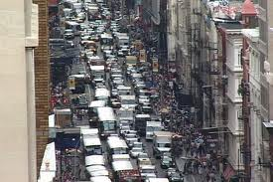
Building Modern America

Slide 2
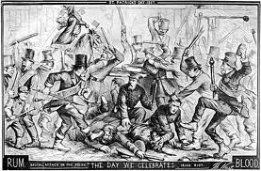
Gilded Age Politics 1869-1896

Slide 3
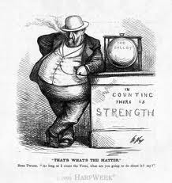
Effects of Reconstruction
Spawned political waste, extravagance, & graft
Made people distrust professional politicians

Slide 4
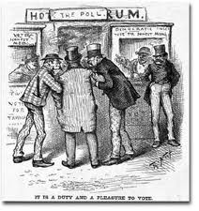
Rise of the Political Machine
A group that controls activities in a city and offers services to voters in exchange for votes

Slide 5
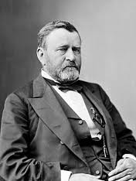
Election of 1868
People turn to General Ulysses S. Grant for an outsider
Wins 214 of 294 electoral votes, but only wins popular vote by 300,000 (black voters)

Slide 6
Era of Good Stealings
Jim Fisk and Jay Gould tried to corner the gold market
“Black Friday” Sep. 24, 1869, they bid the price of gold up
Grant released gold from treasury to bring price down

Slide 7
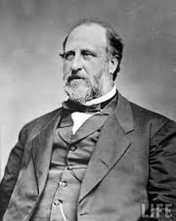
Era of Good Stealings
William “Boss” Tweed ran Tammany Hall in NYC
Stole roughly $200 million from NYC treasury using fraud and graft

Slide 8
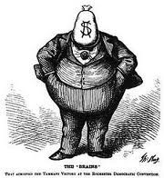
Era of Good Stealings
Tweed was caught in 1871 and tried by Samuel J. Tilden
Died in prison in 1878

Slide 9
Era of Good Stealings
1864 congress gave contracts to Union Pacific and Central Pacific to build transcontinental railroad
Executives at Union Pacific formed the Credit Mobilier construction company

Slide 10
Era of Good Stealings
They hire CM to lay track at 2-3 times the actual cost and pocketing the difference
Company gives stock to congressmen to keep them quiet
Newspaper exposed the Credit Mobilier Scandal 1872

Slide 11
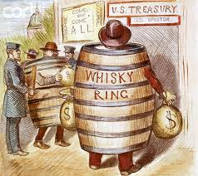
Era of Good Stealings
1875, the Whiskey Ring was exposed
Stole millions in excise (whiskey) taxes from the treasury

Slide 12
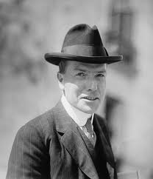
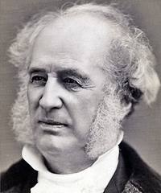
Grant’s Woes
Economic Panic of 1873, caused by profit war between railroads and John D. Rockefeller

Slide 13
Currency Debate
Wealthy wanted gold standard for currency (Republicans)
Poor wanted a cheaper currency, paper or silver (Democrats)
Democrats took House of Rep. in 1874 election

Slide 14
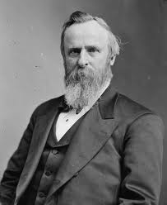
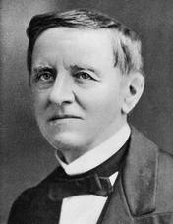
Election of 1876
Rutherford B. Hayes v. Samuel J. Tilden
Results in the compromise of 1877

Slide 15
Compromise of 1877
Electoral vote deadlock with 3 states remaining: Florida, SC, Louisiana
Congress agreed to only count Republican votes, if Hayes removed troops from South

Slide 16
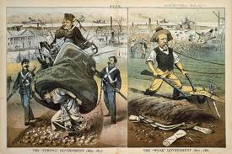
Return of the “Old South”
As the troops left, the carpetbagger governments collapsed
They were replaced with “redeemer” governments (white supremacy)

Slide 18
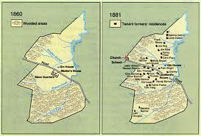
Plantation Farming
Slavery was replaced with sharecropping and tenant farming

Slide 19
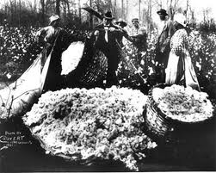
Sharecropping and Tenant Farming
Sharecropping – tenant uses land in return for share of crops produced
Tenant Farming – rent the land for money, crops, or some combination of the two

Slide 20
Crop-Lien System
Merchants provided food and supplies to farmers on credit
When crop was harvested the farmer turned it over to merchant to pay debt

Slide 21
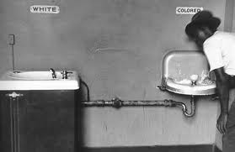
Jim Crow Laws
Laws created to separate the races
Enacted literacy tests and poll taxes to keep blacks from voting

Slide 22
Grandfather Clause
Exempted you if your father/grandfather voted in election of 1860
Circumvented the 15th amendment

Slide 23
Plessy v. Ferguson 1896
Supreme Court ruled JC laws did not violate the 14th amendment
Established the principal of “separate but equal”

Slide 24
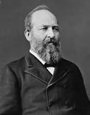
Election of 1880
Hayes alienates his party by seeking political reform
James A. Garfield (R) vs. Winfield Scott Hancock (D)
Garfield wins

Slide 25
Change in Politics
Politicians used ‘spoils system’ to give cronies jobs
Garfield gave jobs to those who wanted reform

Slide 26
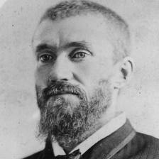
Change in Politics
Charles J. Guiteau assassinates Garfield because he thought Chester A. Arthur would give him a job

Slide 27
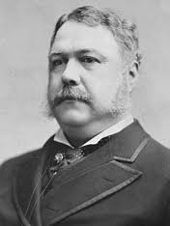
Change in Politics
Chester A. Arthur becomes president
Passes the Pendleton Civil Service Act of 1883, made Gov. employment based on merit not cronyism

Slide 28
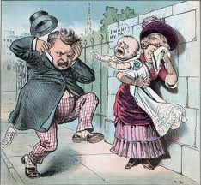
Election of 1884
James G. Blaine (R) vs. Grover Cleveland (D)
Cleveland wins

Slide 29
‘Grover the Good’
Cleveland wanted to lower tariffs to help the south, but it angered industrialists (Republicans)
The Pendleton CSA created alliance between Republican party and business

Slide 30
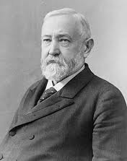
Election of 1888
Benjamin Harrison (R) vs. Grover Cleveland (D)
Harrison wins

Slide 31
“Billion Dollar Congress”
1st Congress to spend that much
Also raised tariffs to their highest level ever (48% average on imported goods)
People had to buy domestic

Slide 32
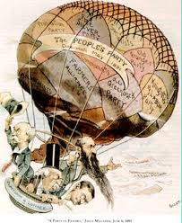
The Populists
Rural movement fighting against ‘injustice’
Became known as the Populist Movement

Slide 33
Populist Movement
Graduated income tax
Direct election of senators
Shorter workday
Gold and Silver monetary standard

Slide 34
Election of 1892
Cleveland (D), Harrison (R), & Weaver (Populist)
Cleveland wins, only president elected after losing

Slide 35
Depression of 1893
Caused by overbuilding of railroads, labor disputes, and agricultural depression
8,000 business went out-of-business in 6 months

Slide 36
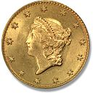
Depression of 1893
Sherman Silver Purchase Act of 1890 made Gov. buy silver and issue paper currency that could be redeemed for gold dollars

Slide 37
Depression of 1893
US gold reserves were almost depleted
Cleveland and congress repealed Sherman Silver Purchase Act

Slide 38
Depression of 1893
Cleveland convinced J.P Morgan to loan Gov. $65 million ($25 billion)
Cleveland also didn’t lower tariffs

Slide 39
Mid-Term Election of 1894
Republican take congress
Sets stage for Presidential election of 1896

