Slide 1
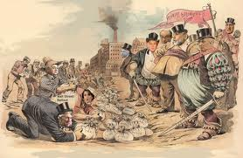
Rise of Industry and the Effect on America

Slide 2
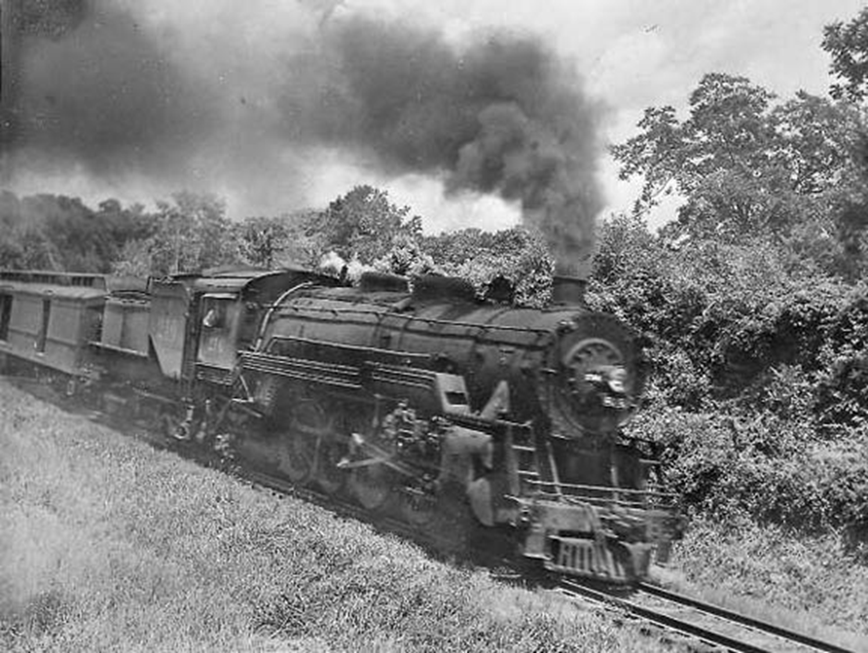
Trains

Slide 3
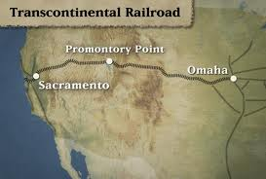
Transcontinental Railroad
1862 Congress authorizes Union Pacific and Central Pacific to build railroad
For each mile of track laid, they got 20 square miles of land

Slide 4
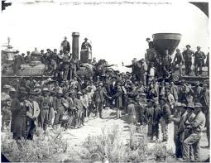
1869

Slide 5
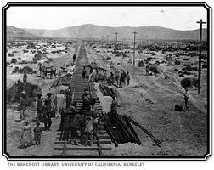
Building the Railroads
Built by mostly Chinese and Irish immigrants
35,000 miles of track in 1865, by 1900 there were 192,556 miles of track

Slide 6
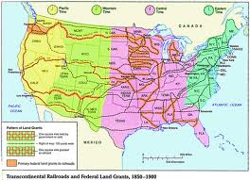
Country of Railroads
4 more railroads were given land grants to build across US
Many towns & cities owe existence to railroads (Denver)

Slide 7
Effects of Railroads
Adopted 4 standard time zones in 1883
Carried settlers out west stimulating immigration
Carried mined and Ag goods East

Slide 8
Up/Downside to Railroads
Created numerous millionaires (Cornelius Vanderbilt)
Contributed to rise in new industries (oil & steel)
Contributed massive corruption

Slide 9
Wrongdoing of Railroads
Stock Watering – selling stock far in excess of its actual value
Charged excessive rates to out due one another
Worked together and engaged in price fixing

Slide 10
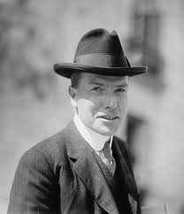
Creating a Depression
John D. Rockefeller turned oil into kerosene at his refineries
Railroads brought oil to refineries for low rates to keep his business

Slide 11
Creating a Depression
Railroads eventually raised rates because they were losing money
Rockefeller builds pipelines from oil fields to his refineries

Slide 12
Creating a Depression
Railroads lost 60% of revenue
Many declared bankruptcy and Wall Street collapsed as well

Slide 13
Interstate Commerce Act
Congress passed the ICA in 1887 creating the Interstate Commerce Commission (ICC) to regulate railroad rates
ICC had no authority to set rates

Slide 14
New Business Practices
Vertical Integration – own all phases of manufacturing from mining to marketing
Horizontal Integration – ally or buy your competitors to create a monopoly
Trusts – several small companies act as one large corporation

Slide 15
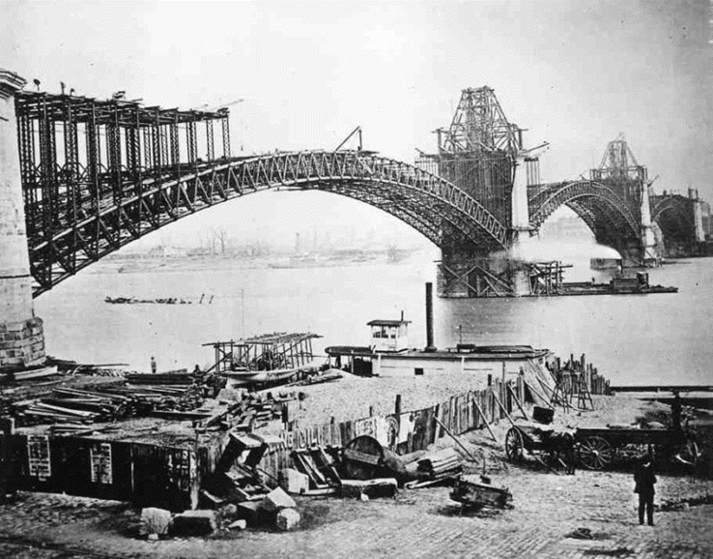
Rise of Carnegie
Scottish immigrant, entered steel industry in 1873 to have steel for Eads bridge
Used the Bessemer process to mass produce steel

Slide 16
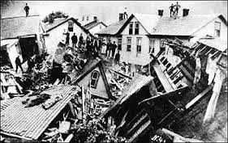
Carnegie Steel
By 1900, Carnegie produced ¼ of the nations steel
Held partially responsible for Johnstown Flood that killed 2,000 people

Slide 17
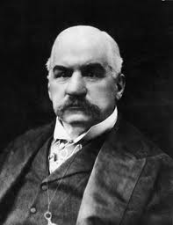
Carnegie Steel
J.P. Morgan bought Carnegie Steel for $450 million ($400 billion) in 1901
Renamed it U.S. Steel

Slide 18
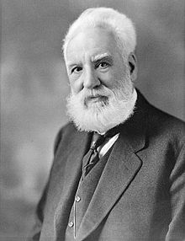
Inventions
Alexander Graham Bell & Thomas Watson invent the telephone 1876
Thomas Alva Edison invented the electric lightbulb 1879

Slide 19
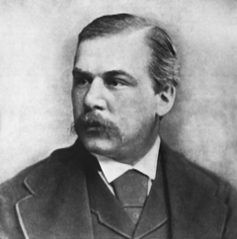
Power behind the Light Bulb
Edison created D/C current to power the bulb
J.P. Morgan invested in Edison’s company The Edison Electric Company

Slide 20
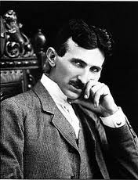
Edison’s competition
An employee Nikola Tesla created A/C current
Hired by George Westinghouse to develop and distribute A/C current

Slide 21
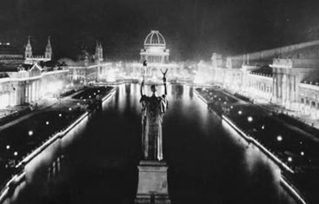
Chicago Worlds Fair 1893

Slide 22
JP’s revenge
Threatens to sue Westinghouse in order to steal patents for A/C current
Buys controlling major in Edison’s company, fires him and renames it General Electric Company

Slide 23
Effects of the Light Bulb
Allowed factories to have light
Eliminated darkness at night
Caused Rockefeller to finance the creation of the gasoline engine

Slide 24
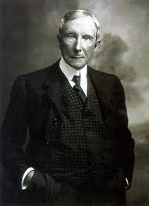
John D. Rockefeller
Made fortune turning oil into kerosene
By 1880, owned 95% of oil refineries through horizontal integration

Slide 25
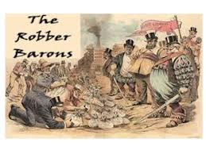
Public Backlash
Labeled the titans of industry “Robber Barons”
Started movement, The Social Gospel Movement – preached salvation through serving the poor

Slide 26
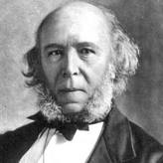
Justifying Wealth
Herbert Spencer proposed idea of Social Darwinism
Survival of fittest business or person

Slide 27
Government Shuts People Up
Sherman Anti-Trust Act of 1890
Forbade trusts and monopolies, but never defined what trusts or monopolies were
More trusts were formed after 1890 than before 1890

Slide 28
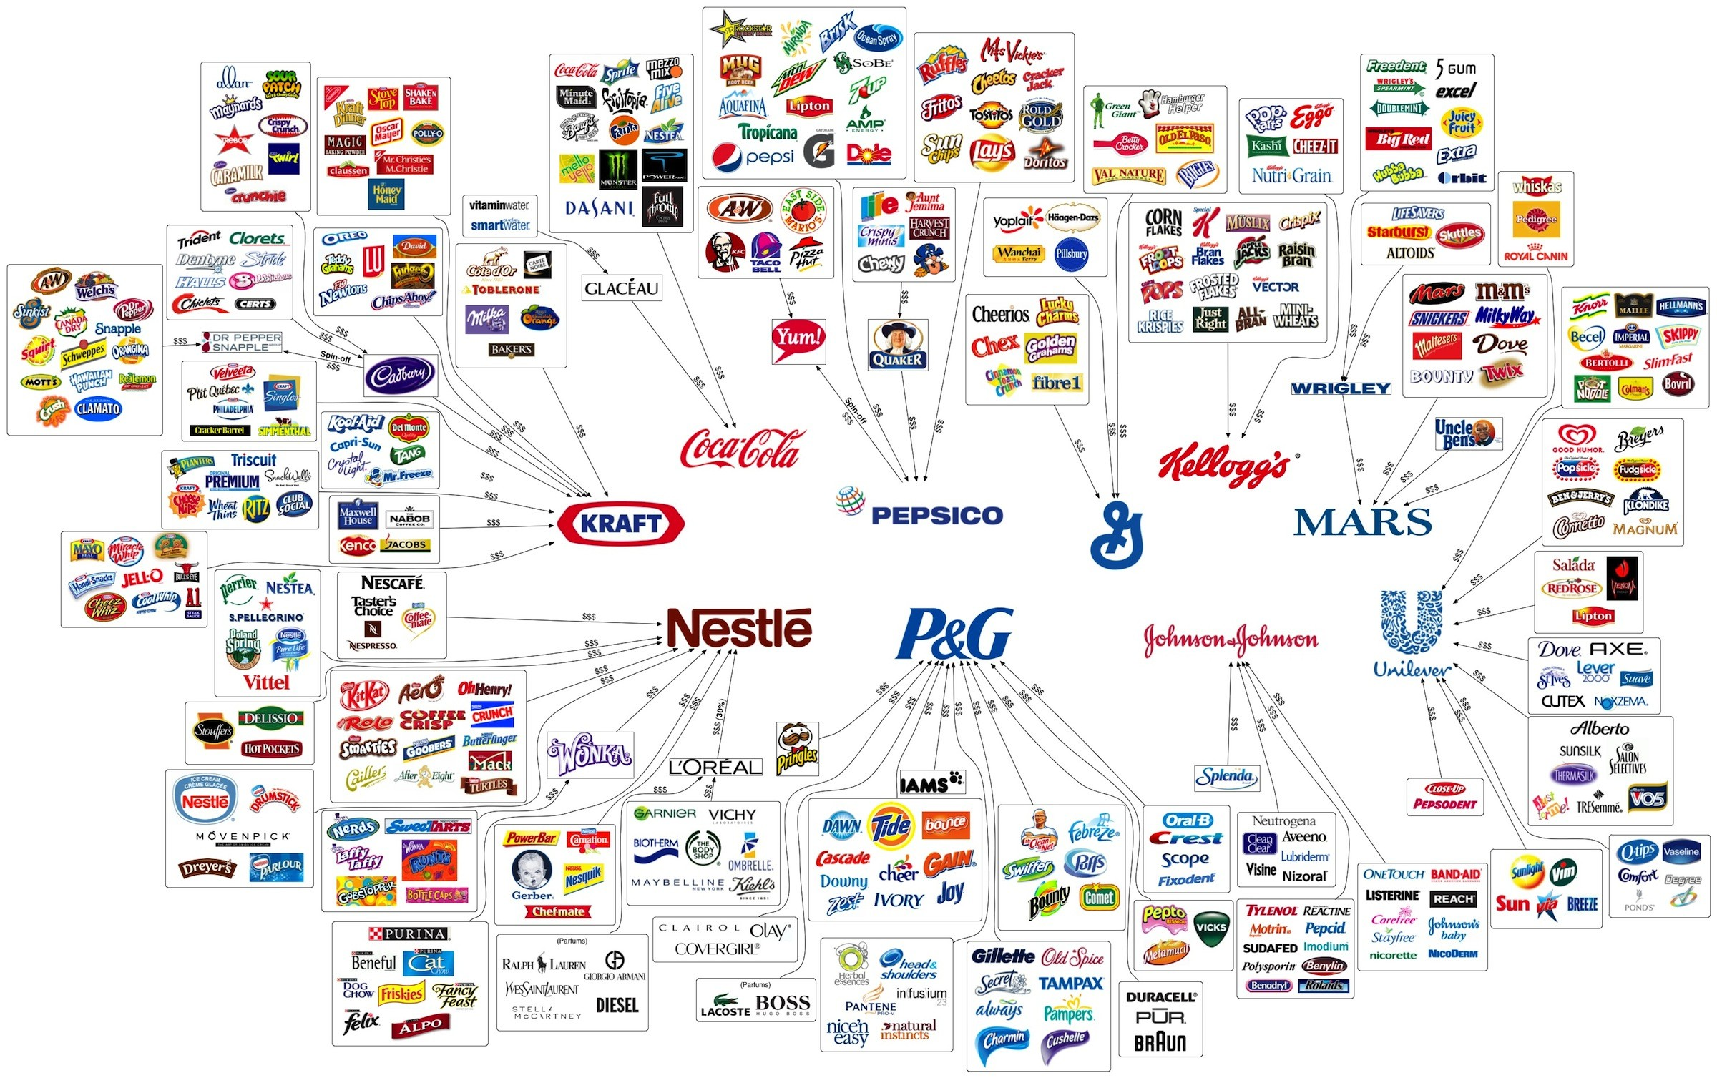

Slide 29
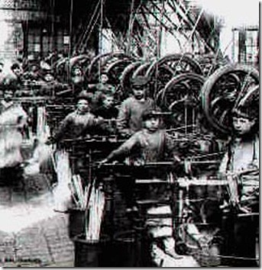
Unions Emerge (Again)
Workers worked long hours with low pay
No vacation, no sick leave, & no pay for injury on the job

Slide 30
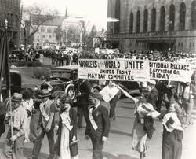
Knights of Labor
Wanted to include all workers in one big union
Fought for 8-hr day, sick leave, better pay

Slide 31
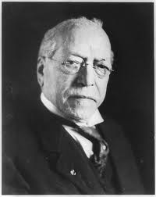
American Federation of Labor (AFL)
Formed and led by Samuel Gompers in 1886
Wanted better pay, hours, and working conditions

Slide 32
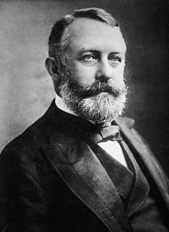
Strikes Turn Violent
The Homestead Strike in 1892 at Carnegie Steel
Pinkerton detectives hired to end strike, ended up killing 9 workers, wounding dozens more

Slide 33
Haymarket Square Bombing
Police tried to break-up worker strike and someone threw a dynamite bomb
Ended the success of the Knights of Labor

Slide 34
Government Helps Destroy Unions
Army was used to put down strikes
Employers used the Sherman Antitrust Act to get courts to file injunctions against unions

Slide 35
Effects of the Industrial Revolution
Agriculture declined as many people moved to work in factories
Many women became office workers
By 1900 2 in 3 workers depended on wages

Slide 36
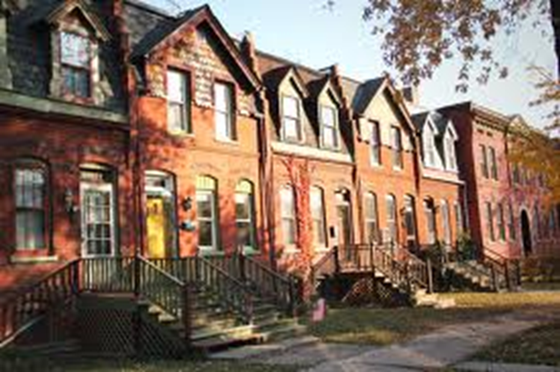
The Company Town
Created by George Pullman who built sleeper cars and other railroad cars
Where employees lived for rent, but cost of living was more than paycheck

Slide 37
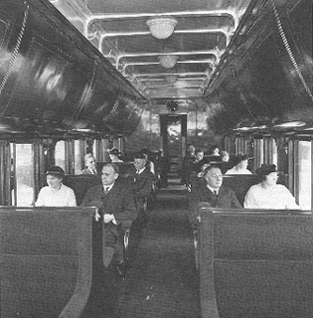

Slide 38
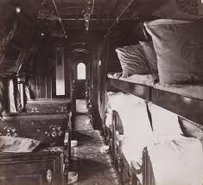

Slide 39
Effects of IR on the South
Textile Mills were only industry to come South
Many southerners became wage earners

