Slide 1
Weapons of World War II
Will Skinner

Slide 2
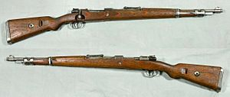
Kar 98K
Bolt action, standard issue for German soldiers
Made in Germany by the Mauser brothers
Most used weapon for Germany in the war

Slide 3
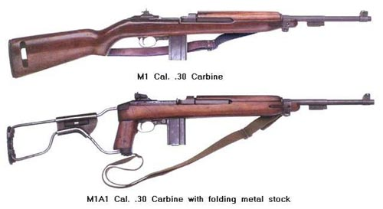
M1 Carbine
Semi-automatic, made in the U.S.
Lighter and smaller than Thompson and M1 Garand, which made it useful in tight situations
Used by U.S. Paratroopers, ammo bearers, mortar teams, artillery crews

Slide 4
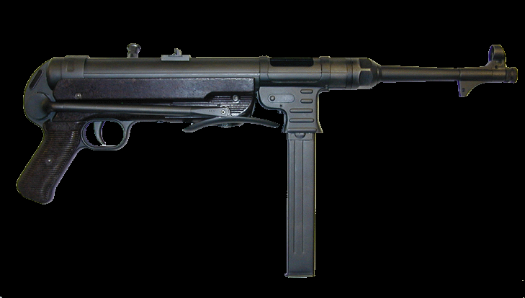
MP40
Automatic submachine gun, German-made
Used by German paratroopers, squad leaders, and commandos
Symbol of German soldiers

Slide 5
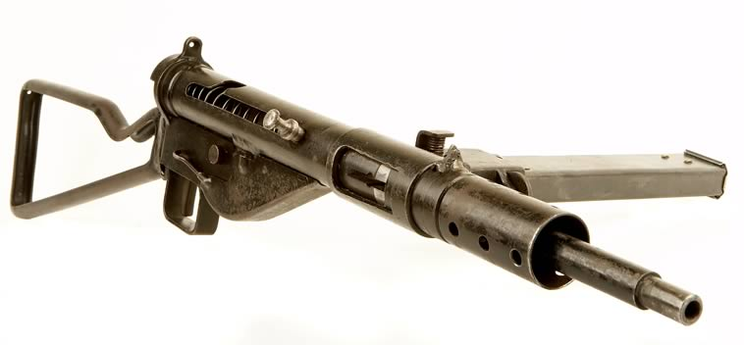
Sten Gun
British-made submachine gun
Slim, side-mounted mag, easy to assemble and disassemble which made it useful for resistance fighters
Used by commandos in WWII, and by British paramilitary and guirrilla until 1994

Slide 6
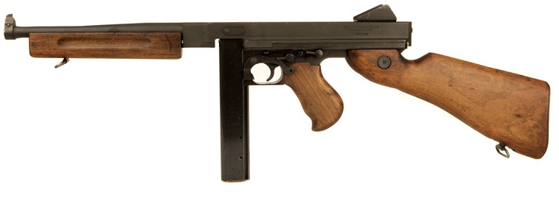
Thompson
American-made submachine gun
Used in Irish Civil War, American gangsters, and law enforcement, the Thompson was adopted by the U.S. Army just before the war
Used by paratroopers and commandos

Slide 7
PPSh-41
Russian-made submachine gun
Highest rate of fire in WWII, could support a drum mag that held 71 rounds, 3000 made a day
So effective that Russia outfitted entire regiments and divisions with it

Slide 8
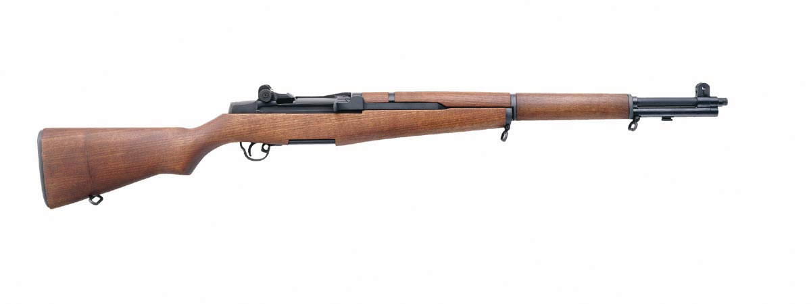
M1 Garand
“Greatest battle implement ever devised.” – General Patton
In a time of bolt-action rifles, the Garand was the only semi-auto rifle that was standard issue in any army
Gave superiority over every other army

Slide 9
Questions
What were some reasons for the U.S. to have a weapon like the M1 Garand other than the obvious advantages?
Why would a gun like the Sten Gun be useful for resistance fighters?

Slide 10
Sources
http://www.toptenz.net/top-10-infantry-weapons.php
http://www.capitanhipower.com/Design/RIFLES.htm
http://world.guns.ru/smg/rus/pca-41-e.html

