Slide 1
US.54 Examine
Examine the impact of American actions in foreign policy in the 1920’s, including the refusal to join the League of Nations, the Washington Disarmament Conference, and the Kellogg-Briand Pact.

Slide 2
Daily opener
What were the reasons for WWII? (1939-45)
Why did the US enter WWII? (Dec. 8th, 1941)

Slide 3
Why did we have a world war II?
French | Unsatisfactory | Geography | Satisfactory
German | Adequate | Gymnastics | Excellent
History | Satisfactory | Physics | Adequate
Mathematics | Unsatisfactory | Art | Excellent
Chemistry | Adequate | Geometry | Adequate

Slide 4
Daily Question
List the causes of WWII.

Slide 5
Daily Question
Why and when did Japan bomb Pearl Harbor?

Slide 6
Daily Opener
In what ways did citizens have to sacrifice during WWII?
If we had a global war today, in what ways would citizens suffer?
Get out an iPad
Log in to clevelandhistory.weebly.com

Slide 7
Daily Question
What was the Final Solution?
Get out study guides for WWII test.
Don’t have a study guide? Open your textbook to chapter 16 & 17 and start reading over bold terms.

Slide 8
Causes of World War II
Treaty of Versailles
Failure of the League of Nations
Fascism
Japanese imperialism
Economic Worldwide problems

Slide 9
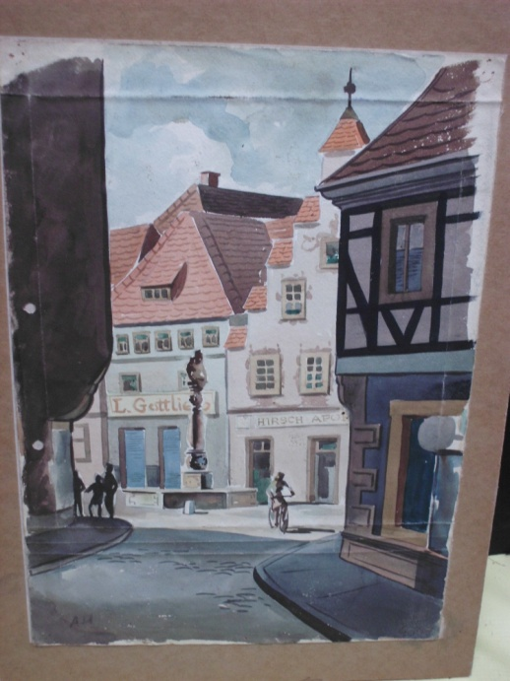
DQ
Is this artist good enough to get into a prestigious art school?

Slide 10
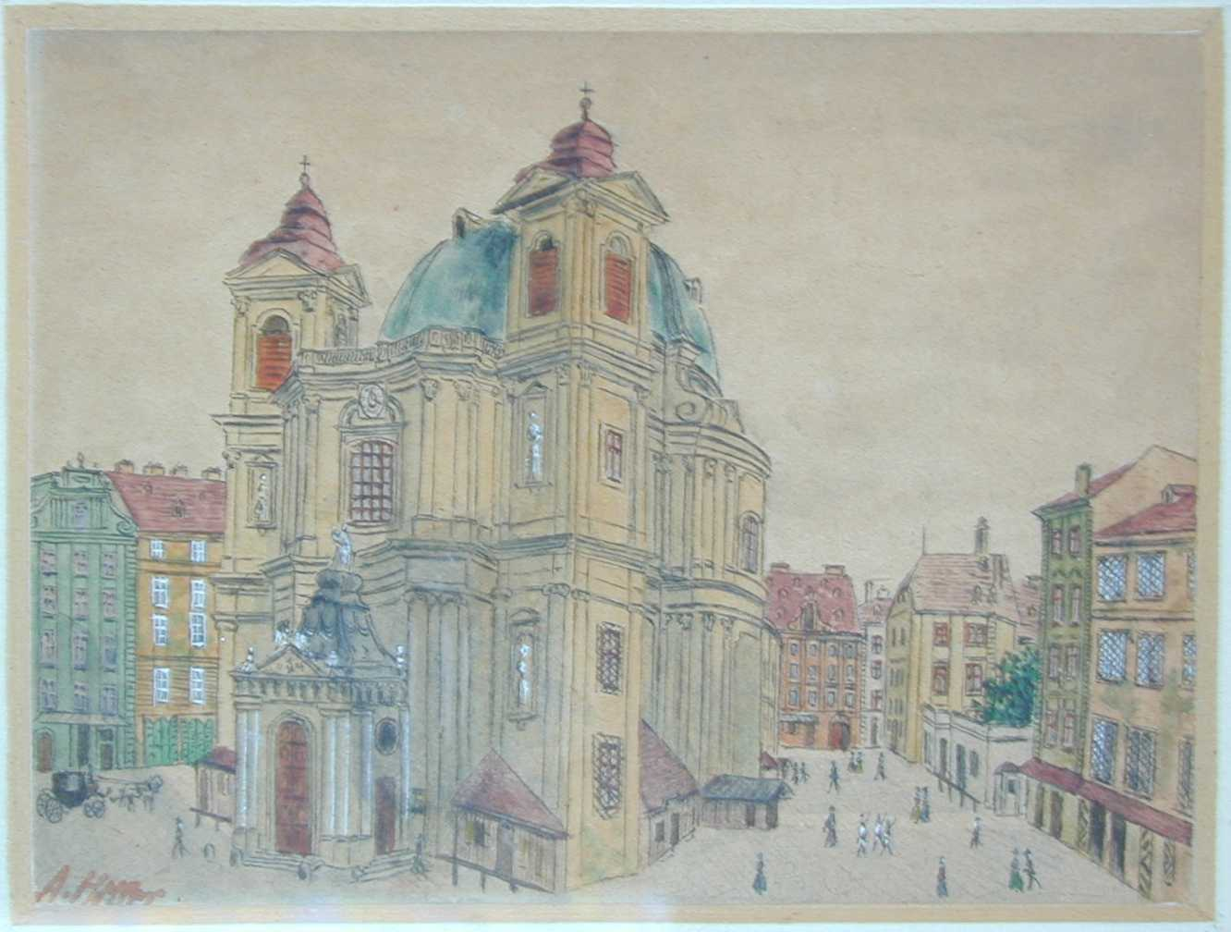
Daily Question
Give an example of how a parent or teacher has used classical conditioning on you.

Slide 12
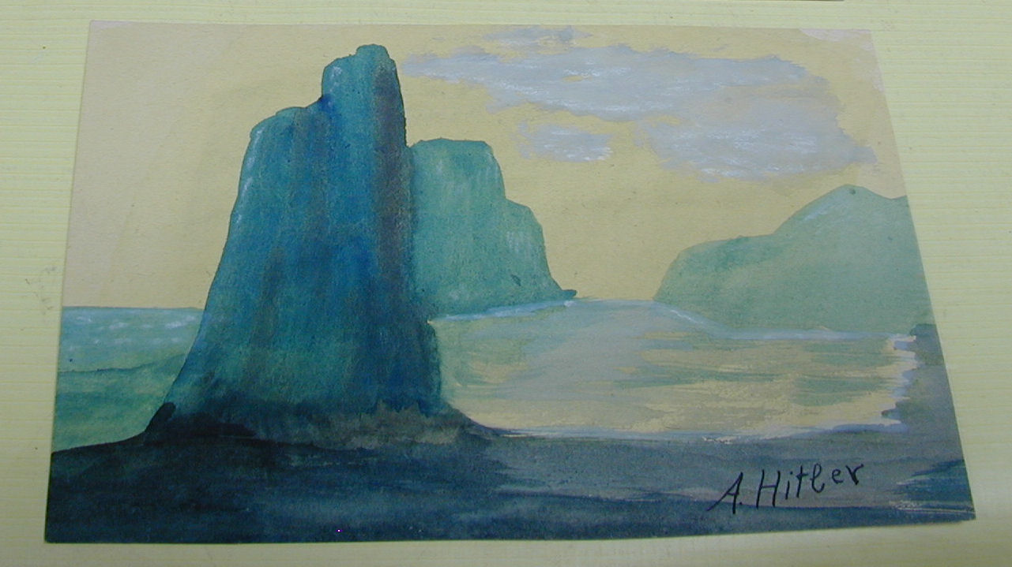

Slide 13
Vocabulary Review
Fascism
Nationalism
Totalitarianism
Communism
Nationalism

Slide 14
Identify the causes of World War II
Treaty of Versailles
failure of the League of Nations
Fascism
Japanese imperialism
economic worldwide difficulties

Slide 15
Treaty of Versailles
Officially ended WWI
Placed harsh conditions on Germany, making it pay for the war
These conditions and the devastation of the war led to worldwide economic depression (Great Depression 1929-1939/40)

Slide 16
Failure of the League of Nations
Founded as an organization to promote peace between countries, the League had no way of enforcing its decisions.
As nations like Germany, Japan, and Italy began to expand and invade foreign territories they ignored the League’s demands and eventually withdrew from the organization altogether.

Slide 17
Totalitarianism
Political system in which the state or government has total control over the lives of citizens
Seek to control and enforce loyalty to state and its leader in every day life
Those who oppose are often arrested or executed
Example – Nazi Germany
Hitler used nationalism and anti-semitism

Slide 18
Fascism
Totalitarian political system that emphasizes intense nationalism and military expansionism
Benito Mussolini- Italy

Slide 19
Communism
Form of government in which the state owns nearly all property and controls the nations economy
Welfare of state is more important than the people
Joseph Stalin – communist government that was totalitarian

Slide 20
Japanese Imperialism
Japan – small country
Emperor Hirohito
Needed more resources
Decided to invade the South Pacific
Invaded Manchuria
League of Nations demanded that they withdraw
Japan left the League of Nations

Slide 21
What’s the difference between fascism and Totalitarianism?
Fascism is a political system where the nation or the race of people in the nation are more important than the individual. In fascist states, individual freedoms are of little consequence when compared to the overall goal of protecting or furthering "the whole."
Totalitarianism is the presence of totalitarian rule, or dictatorship. The two are not mutually exclusive -- e.g., a fascist state is often ruled by a totalitarian leader. However, a totalitarian state does not necessarily have to be fascist

Slide 22
Worldwide economic difficulties
Great Depression began in 1929
Desperate people turn to desperate measures- Hitler

Slide 23
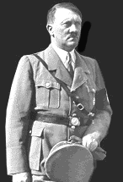
Adolf Hitler
Rise to Power

Slide 24
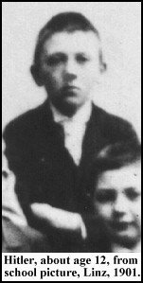
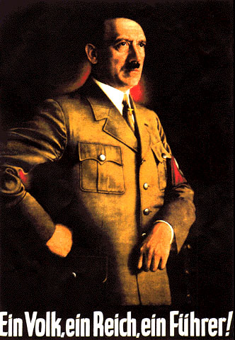

Slide 25
Birth
Adolf Hitler was born on April 20, 1889 in Braunau, Austria.
Adolf was 1 of 6 children - 3 of who died at early ages

Slide 26
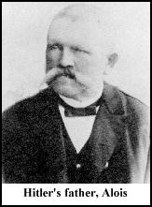
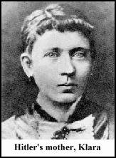
Parents
Alois Schickelgruber Hitler was a customs official who was illegitimate by birth.
His father, Adolf’s grandfather, may have been Jewish.
He died when Adolf was 14 and left him a small inheritance.
Klara Hitler was very young when she married the older Alois.
She showered young Adolf with love and affection. Adolf carried a picture of his mom until the day he died. She died of breast cancer when Adolf was 18 years old.

Slide 27
Education
Attended a Benedictine monastery school where he took part in the choir.
When it was time to choose a secondary school, Adolf wanted to become an artist.
His father wanted him to become a civil servant, but after his father died, he dropped out of high school and attempted to get into the Vienna Academy of Fine Arts - he failed.
The following slides are examples of Adolf’s artwork.

Slide 28
Years in Vienna
After his mother died, Adolf (now 18) decided to move to Vienna to pursue his dream of becoming a great artist.
Again he failed to gain entrance into the Academy
He eventually sold all his possessions and became a homeless drifter who slept on park benches and ate at soup kitchens throughout Vienna (age 19)
Adolf did manage to sell some paintings and postcards, but remained impoverished

Slide 29
Vienna -Importance
Influenced by the anti-Semitic mayor of Vienna, Karl Lueger
Became interested in the idea of German nationalism.
Also received first taste of politics

Slide 30
Daily Opener
List as many WWII leaders as you can.
When was WWII?

Slide 31
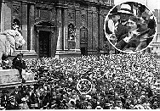
Military Service
Adolf left Austria at the age of 24 to avoid mandatory military service that was required of all men.
But he did sign up for military service at the start of WW I. He joined a Bavarian unit of the German Army. This is a picture of Hitler listening to an enlistment speech.

Slide 32
World War I
Excited to fight for Germany
Found a home fighting for the Fatherland
Highest rank held was corporal
Was a regimental messenger, not an easy job

Slide 33
Military Record
Was awarded the Iron Cross twice (5 medals overall)
Highest military honor in German Army
Single handedly captured 4 French soldiers
Blinded by gas attack towards end of war

Slide 34
German Loss in WW I
Hitler was devastated when he heard the news of the German surrender.
Believed there was an anti-war conspiracy that involved the Jews and Marxists.
Also, felt that the German military did not lose the war, but that the politicians (mostly Jews) at home were responsible for the defeat.

Slide 35
Life after WW I
Hitler was depressed after WW I.
Still in the army, he became an undercover agent whose job was to root out Marxists

Slide 36
German Worker’s Party
Hitler was sent to investigate this group in Munich in 1919.
He went to a meeting and gave a speech and then became a member.

Slide 37
NAZI Party is Formed
Began placing ads for meetings in anti-Semitic newspapers
Hitler changed the name to National Socialist German Worker’s Party or the NAZIS

Slide 38
Party Platform
Hitler drafted a platform of 25 points
Revoked Versailles Treaty
Revoked civil rights of Jews
Confiscated any war profits
Besides changing the party name, the red flag with the SWASTIKA was adopted as the party symbol

Slide 39
Daily Opener
Describe Hitler as a young man.

Slide 40
Beer Hall Putsch
October 30, 1923
Hitler held a rally in Munich beer hall and declared revolution
Led 2,000 men in an attempt to take over the Bavarian Government
It failed and Hitler was imprisoned.

Slide 41
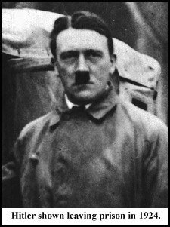
Trial and Jail
At his trial (Hitler was charged with treason), he used the opportunity to speak about the NAZI platform and spread his popularity.
The whole nation suddenly knew who Adolf Hitler was and what he stood for.
He was sentenced to five years, but actually only served about 9 months

Slide 42
Mein Kampf
Hitler’s book “My Struggle”
Sold 5 million copies, made him rich
Topics included: Jews were evil, Germans were superior race, Fuhrer principal, dislike of Communism and Democracy and need to conquer Russia

Slide 43
Legal Rise to Power
Used popularity from failed revolution and book to seize power legally
Spoke to mass audiences about making Germany a great nation again
Nazi Party:
1930 = 18% of vote
1932 = 30% of vote
Hitler becomes Chancellor in 1933

Slide 44
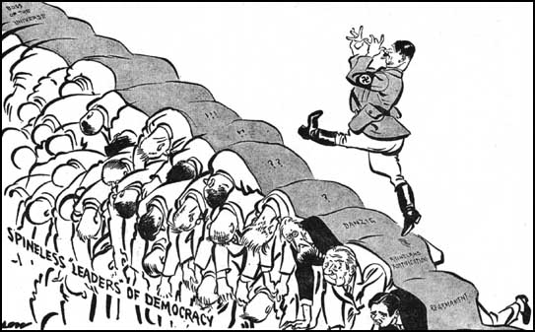
The Road to World War II
Interpret this cartoon.
-When interpreting cartoons, try to identify people, read, and look for symbols.

Slide 45
Strong Arm Tactics
The “Brownshirts” or SA (Stormtroopers)
SA was used to put down opposition parties
Threatened and beat up Jews and ant-Nazi voters
Wore brownshirts, pants and boots
Numbered almost 400,000 by 1932

Slide 46
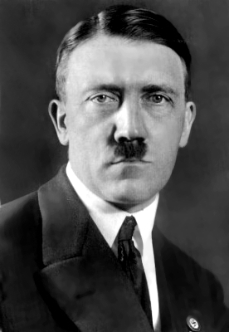
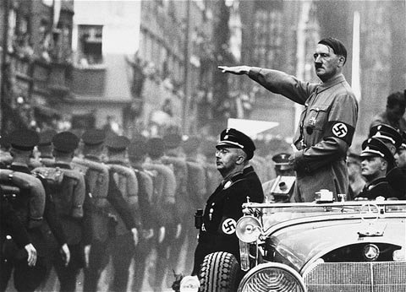
January 1933: Hitler became Chancellor of Germany

Slide 47
Dictator
“Reichstag fire” gives Hitler total power
In 1933, all parties were outlawed except the Nazi party
People’s civil rights were suspended
“Night of the Long Knives”

Slide 48
Appeal of Hitler
Germany was in the midst of an economic depression with hyper-inflation
Hitler was a WW I hero who talked about bringing glory back to the “Fatherland”
He promised the rich industrialists that he would end any communist threat in Germany
Constantly blamed Jews for Germany’s problems, not the German people.
Hitler was an excellent public speaker.

Slide 49
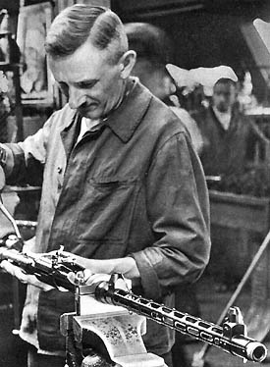
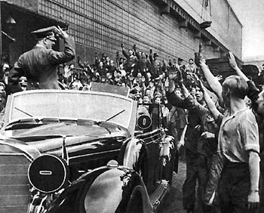
Hitler soon ordered a program of rearming Germany.

Slide 50
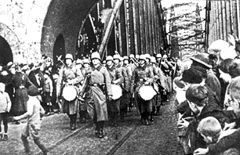
March 1936: German troops marched into the Rhineland.
The Rhineland was a region of Germany that was ‘demilitarised’ after the Treaty of Versailles. Germany was not allowed to have troops in the region.
Hitler’s actions showed how he was willing to directly challenge the treaty.

Slide 51
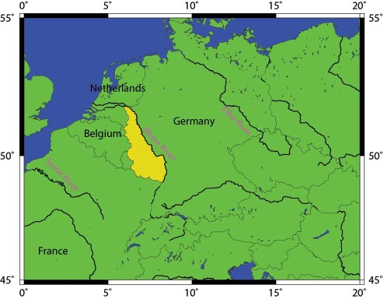
The Rhineland

Slide 52
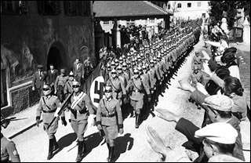
March 1938: Nazi Germany annexed Austria.
This went against the terms of the Treaty of Versailles which banned Germany from uniting with Austria.
However, the arrival of German troops was met with great
enthusiasm by many Austrian people.

Slide 53
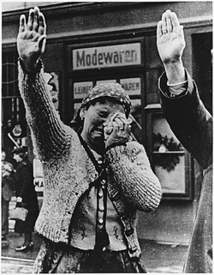
October 1938: Germany took over the Sudetenland. March 1939: Germany invaded Czechoslovakia.
This was the first aggressive step that suggested that a war in Europe would soon begin.

Slide 54
Hitler Bio clip
https://www.youtube.com/watch?v=0rZ4xwuAWFE

Slide 55
Appeasement
In efforts to avoid war, Great Britain and France signed a treaty with Hitler in which they agreed to Hitler’s capture of the Sudetenland.
In exchange, Hitler promised not to seize anymore land.

Slide 56
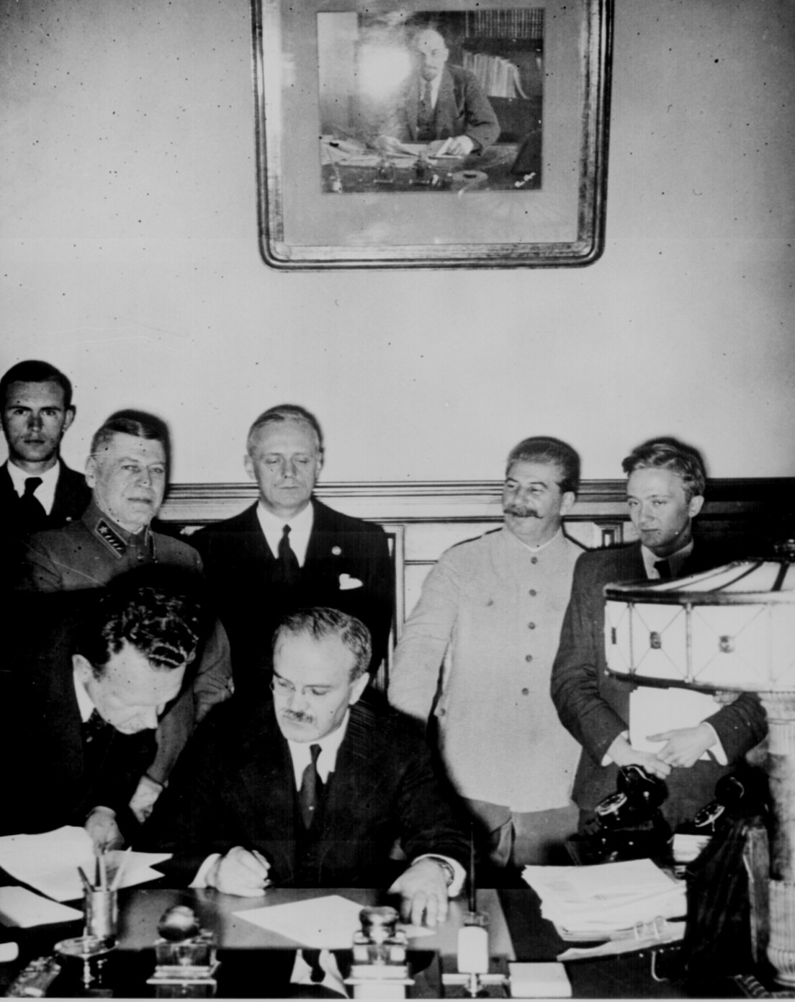
August 1939: Germany (Hitler) and Russia (Stalin) signed a non-aggression pact.
They promised that neither country would attack the other in the event of war.
As part of the deal, Hitler promised Stalin part of Poland, which he planned to invade soon.

Slide 57
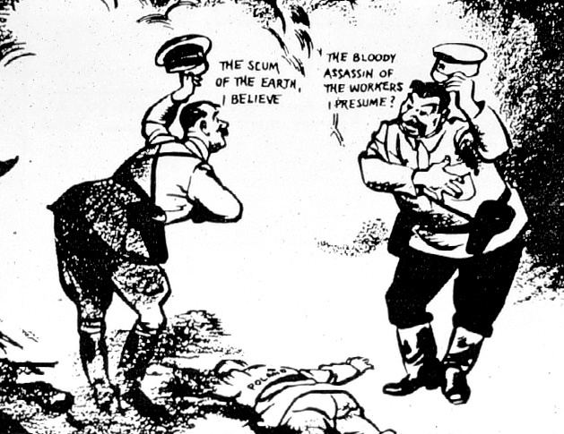
Stalin
Hitler
The non-aggression pact was surprising. Hitler and Stalin were seen as natural enemies.
When Hitler talked of taking over new land for Germany, many thought that he meant Russia.
Hitler also hated Communism, the form of government in Russia.

Slide 58
America in the 20th century: WWII: The Road to War
http://app.discoveryeducation.com/player/view/assetGuid/AB45D42B-8A7E-44F4-B4DC-7755F3FF247A

Slide 59
DQ - Analyze the cartoon.

Slide 60
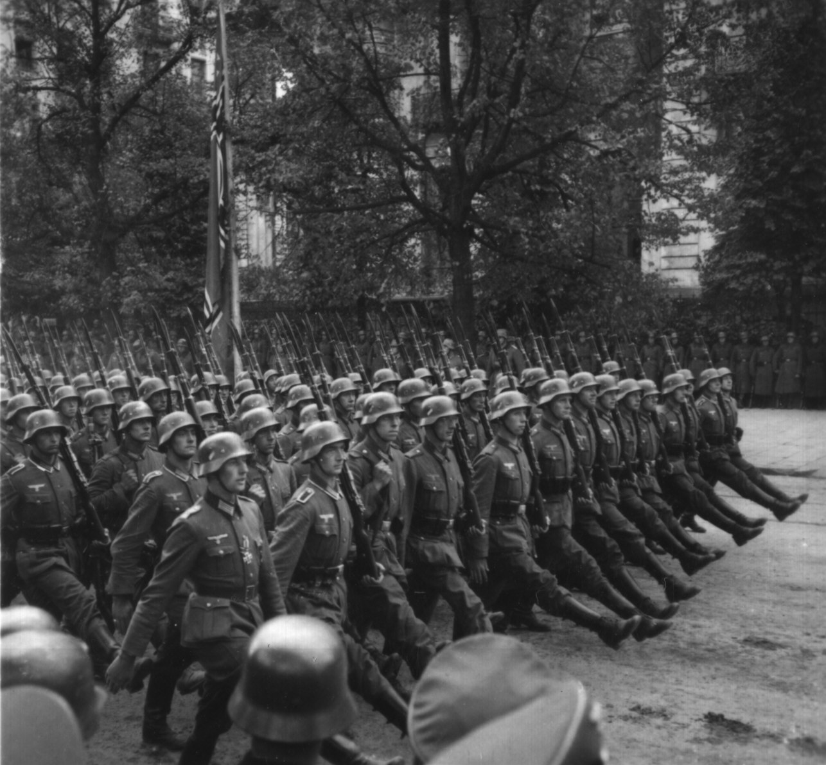
September 1939: Germany invaded Poland
World War II Begins
This started a war with Britain and France.
German troops marching into Warsaw, the capital of Poland.

Slide 61
Japanese Imperialism
Japan did not have access to natural resources despite being a fairly modernized country.
Invaded Manchuria
Invaded coastal cities of China
By 1940, Germany, Italy, and Japan
had formed an alliance known as
the Axis Powers

Slide 62
Daily Question
List the Axis Powers.
List the Allied Powers.
When was WWII?

Slide 63
April 1940
Hitler conquered Denmark and Norway

Slide 64
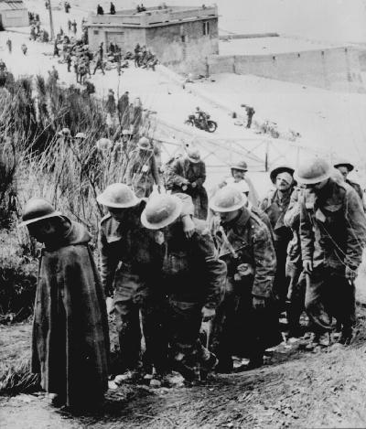
May 1940: Nazi Germany then took over Belgium, the Netherlands, and Greece
In May 1940, Germany used Blitzkrieg tactics to attack France and the Netherlands.
British troops were forced to retreat from the beaches of Dunkirk in northern France.
Captured British troops, May 1940

Slide 65
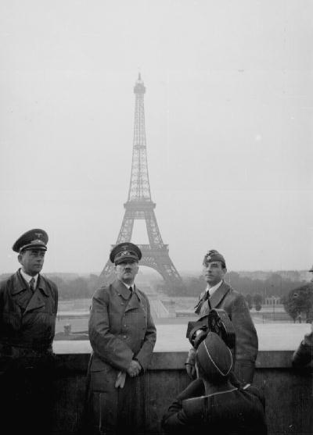
By June 1940, France had surrendered to the Germans.
Britain now stood alone as the last remaining enemy of Hitler’s Germany in Western Europe.
Adolf Hitler tours Paris after his successful invasion.

Slide 66
Hitler hoped to avoid a war with Great Britain and focus on the east, but Great Britain would not make peace with an aggressor like Germany.

Slide 67
Great Britain
Winston Churchill – Prime Minister
Hitler knew that he had to destroy Britain’s mighty Royal Air Force before he could cross the English Channel and launch an invasion of England
Battle of Britain - July – October 1940
Britain resisted long enough for Hitler to give up any idea of invading Great Britain

Slide 68
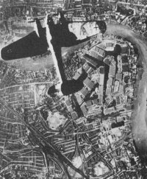
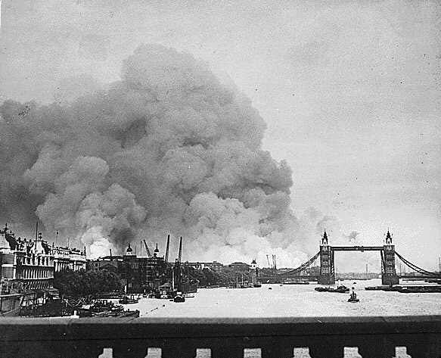
September 1940-May 1941: the Blitz
For the following nine months, the German air force (Luftwaffe) launched repeated bombing raids on British towns and cities. This was known as the BLITZ and was an attempt to bomb Britain into submission.

Slide 69
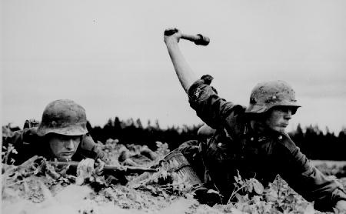
Operation Barbarossa, June 1941
But in May, 1941, Hitler ordered a change of tactics. He decided to halt the bombing of Britain and launch an attack against the Soviet Union. He betrayed Stalin and ignored the promises he had made.
This was a bold move that would prove to be an important turning point in the War.

Slide 70
Daily Opener
What was Operation Barbarossa? What was its significance?

Slide 71
Operation Barbarossa, June 1941
But in May, 1941, Hitler ordered a change of tactics. He decided to halt the bombing of Britain and launch an attack against the Soviet Union.
an important turning point in the War.

Slide 72
US
In 1940, FDR won a third term as President
FDR knew the US would have to get involved and told the American people, “If Great Britain goes down, all of us in the Americas would be living at the point of a gun. We must be the great arsenal of democracy.”
What does that quote mean?

Slide 73
Franklin Delano Roosevelt
During early 1941, with war raging in Europe, Franklin Roosevelt pushed to have the United States' factories become an "arsenal of democracy" for the Allies—France, Britain, and Russia.

Slide 74
Franklin Delano Roosevelt
Franklin D. Roosevelt was the only U.S. president to be elected four times.
He led the United States through the Great Depression and World War II.
http://www.biography.com/people/franklin-d-roosevelt-9463381

Slide 75
Isolationist sentiment diminishes
As Americans learned more about the war's atrocities, isolationist sentiment diminished. Roosevelt took advantage, standing firm against the Axis Powers of Germany, Italy, and Japan.
Bipartisan support in Congress expanded the Army and Navy and increased the flow of supplies to the Allies.
Hopes of keeping the United States out of war ended with the Japanese attack on Pearl Harbor on December 7, 1941.

Slide 76
Lend-Lease Act
Could send aid to any nation whose defense was considered vital to United State’s national security
“If your neighbor’s house is on fire, you don’t sell him a hose, you give it to him. Then, you take it back after the fire is out. This helps your neighbor and makes sure that the fire doesn’t spread to your own house.”

Slide 77
Imperialist Japan
Wanted to expand but the US naval fleet at Pearl Harbor was in the way
Admiral Isoroku Yamamoto’s plan was all but impossible, but he decided to sail 6 aircraft carriers (huge ships that carry war planes) across the Pacific undetected and launch a surprise attack on Pearl Harbor.

Slide 78
The US knew that Japan was planning an attack.
A few minutes before 8 a.m. on Dec. 7th 1941, Japanese airplanes began the first wave of bombings on the Pacific fleet at Pearl Harbor.
In less than 2 hours, the Japanese air attack sank or seriously damaged a dozen naval vessels, destroyed almost 200 warplanes, and killed or wounded nearly 3,000 people.
FDR emotionally described Dec. 7th as “a day which will live in infamy.”
The US entered World War II on the Allied Powers side.

Slide 79
Mini Bio: Tojo
https://www.youtube.com/watch?v=wSQJVkAfQ0A

Slide 80
Quiz
How did the Treaty of Versailles and the failure of the League of Nations contribute to the onset of WWII?
What is anti-Semitism? How did Hitler use Anti-semitism to gain support for his leadership in Germany?
How did Japanese imperialism contribute to the onset of WWII?
What happened at Pearl Harbor? How did it contribute to US involvement in World War II?
When was WWII?

Slide 81
Vocabulary Review
Totalitarianism
Fascism
Communism
Nationalism
Anti-Semitism

Slide 82
Totalitarianism
Political system in which the state or government has total control over the lives of citizens

Slide 83
Fascism
Totalitarian political system that emphasizes intense nationalism and military expansionism

Slide 84
Communism
Economic and political philosophy advocating collective ownership of property and means of production

Slide 85
Nationalism
Intense devotion to national interests

Slide 86
What is anti-Semitism?
Daily opener

Slide 87
Anti-Semitism
Prejudice or discrimination against Jews

Slide 88
Allied Powers vs. Axis Powers
Great Britain
United States
Soviet Union
France
WWII – 1939-45
US enters after Japan bombed Pearl Harbor on Dec. 7th, 1941.
Germany
Italy
Japan

Slide 89
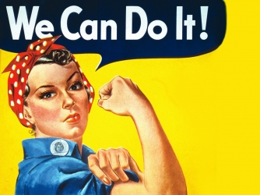
Symbol for working woman

Slide 90
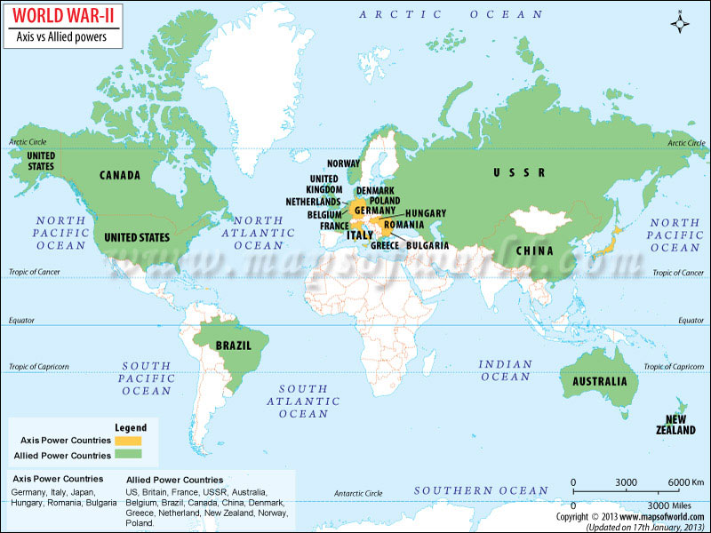

Slide 91
Top 10 and 25 interesting facts about WWII
https://www.youtube.com/watch?v=slOPreochsc
https://www.youtube.com/watch?v=myjz2UUdNVA

Slide 92
D-Day
Stalin wanted the Allies to create a second front in western Europe against the Axis Powers
Roosevelt, Churchill, and Stalin met together in Dec. 1943 to plan.
General Dwight D. Eisenhower was appointed the supreme allied commander in charge of Operation Overlord.
The date of the invasion was June 6, 1944 and became known as D-Day.

Slide 93
D-Day cont.
The first soldiers to hit the beach at Normandy, France were met with heavy gunfire.
It took Allies less than a week to get over 500,000 troops ashore.
By the end of August 1944, the Allies liberated Paris, which had been under German occupation for four years.

Slide 94
D-Day video clip
http://www.history.com/shows/america-the-story-of-us/videos/d-day-invasion
https://www.youtube.com/watch?v=v1FJXK4qy-k

Slide 95
Battle of the Bulge (Dec. 1944-Jan. 1945)
Germany launched one final, surprise attack during the winter and at first caught the Allies off guard.
Hitler almost broke through the Allied lines, which would have divided the Allies and made them easier to defeat.
The bulge in the Allies defenses that this attack caused led to the battle being named the Battle of the Bulge.

Slide 96
Battle of the Bulge cont.
Thanks largely to the heroic efforts of US troops under General George Patton, the Allies recovered to beat back the German assault.
The Allies eventually won, ending Germany’s hopes of stopping the Allied march toward Berlin (Germany’s capital).
Significance – Last German offensive in the west

Slide 97
Battle of the Bulge video clip
http://www.history.com/search?search-field=battle+of+the+bulge+&asset-type=Videos

Slide 98
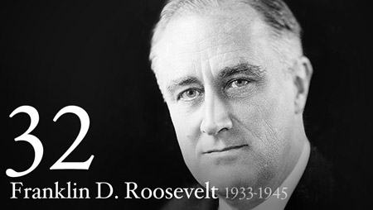
FDR
Died April 12th, 1945
http://www.whitehouse.gov/about/presidents/franklindroosevelt

Slide 99
V-E Day
With Soviet forces bearing down on the capital, Hitler retreated to his bunker.
Hitler ordered everyone, even young boys, be armed and defend Berlin with their lives.
In the face of certain defeat, Hitler, with his wife and dog, committed suicide on April 30th, 1945.

Slide 100
The Allied invasion not only ended the war, but it exposed atrocities committed by the Nazis.
Hitler’s “Final Solution to the Jewish Problem”
Holocaust
6 million Jews were killed

Slide 101
War in the Pacific
Within hours of attacking Pearl Harbor, Japan also attacked the Philippines, destroying nearly half of the US airplanes stationed there.
More than 75,000 US soldiers and Filipinos became prisoners of war.

Slide 102
The Battle of Midway
June 1942
Proved to be a turning point in the war
This time, it was the Japanese who failed to detect the location of its enemy’s aircraft carriers.
US planes were able to attack the Japanese while they loaded bombs on their planes

Slide 103
Island Hopping
The US decided to advance on Japan from two directions.
1st – across central Pacific
2nd – south involving invasion of Philippines
General Douglas MacArthur had promised to liberate island.
US began a process of island hopping. It attacked and conquered one group of islands and then moved on the next.

Slide 104
US forces also won key battles at Guadalcanal, Iwo Jima, and Okinawa.

Slide 105
The Manhattan Project
Top secret endeavor to create the atomic bomb
During the early 1940s, the government established Oak Ridge, Tennessee as a base to carry out the project.
The government kept the town a secret, not even allowing it to appear on maps.

Slide 106
Hiroshima
Harry S. Truman became President after FDR died in office.
He is the first and only President to use an atomic bomb in war.
On August 6th, 1945, the US dropped the first atomic bomb Enola Gay on the Japanese city of Hiroshima.

Slide 107
Hiroshima
Leveled the city
Killed thousands instantly

Slide 108
Nagasaki
When Japan delayed in surrendering, the US bombed Nagasaki on Aug. 9th.
Japan surrendered on Aug. 14th, 1945.
US celebrated V-J Day (Victory over Japan)

Slide 109
Ethical?
US.69 Write an opinion piece evaluating the Manhattan Project, including the rationale for using the atomic bomb to end the war.

Slide 110
WWII
Write 1-2 paragraphs on each of the following questions.
1. Should the US have used atomic bombs on Japan during WWII?
2. List and explain the five causes of World War II.
3. Evaluate Hitler’s appeal and his rise to power.
4. Compare and contrast Chamberlain and Churchill’s leadership and make a statement about who was more effective and why.
Timeline
5. Create a timeline of World War II with at least 10 events. Label it as best you can with months, days, and years.
Vocabulary Define the following terms and explain their significance to World War II.
6. anti-Semitism
7. nationalism
8. fascism
9. communism
10. blitzkrieg

Slide 111
Daily Question
How do you think World War II affected people at home in the US?

Slide 112
The Wars Effects at Home
Describe the war’s impact on the home front, including rationing, bond drives, movement to cities and industrial centers, and Bracero program.

Slide 113
Money
Raised taxes
Sold bonds
Called on citizens to make sacrifices
Introduced the idea of withholding income tax

Slide 114
Food
Victory gardens
Rationing
Forced the public to conserve resources that needed to support the war effort

Slide 115
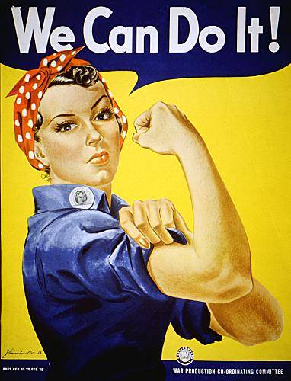
Rosie the Riveter
Women of all cultural and racial backgrounds stepped forward to take jobs traditionally held by men.
Rosie the Riveter became
the symbol of those women
who entered the workforce
to fill gap left vacant by men

Slide 116
Home Front Clips – Rosie
http://www.history.com/topics/world-war-ii/us-home-front-during-world-war-ii

Slide 117
Northern Migration
Increase in production meant that many blacks could now find work in northern factories.
Over 2 million African Americans made their way from the South to the cities of the North.
Often ended up in urban ghettos
Racially fueled riots killed 34 people in Detroit.

Slide 118
Wartime Production
WWII ended the Great Depression
Created high demand for food, textiles, rubber, metal, and many other products
Wartime production led to economic prosperity.

Slide 119
GI Bill
Congress passed legislation providing military veterans with benefits such as job priority, money for furthering their education, training, and loans for purchasing homes and property.
Contributed to rise of the middle class

Slide 120
Baby Boom
Marked period known as the Baby Boom
Members of the generation born within the first few years after World War II

Slide 121
The War & TN

Slide 122
Manhattan Project
Oak Ridge, TN
Atomic bomb
Ended war with Japan

Slide 123
Fort Campbell
1942 started construction
Tennessee/ Kentucky
As thousands of young men joined the armed forces, many found themselves trained and stationed at Fort Campbell.

Slide 124
Camp Forrest
One of army’s largest training bases during war
Detainment camp for civilians believed to pose a threat

Slide 125
Important Industries
Memphis Manufactures produced many of the goods that citizens and soldiers needed
Chattanooga’s war production plants – produced supplies for US military, creating jobs for TN and helping the Allies win the war
ALCOA – Aluminum Company of America
Eastman chemical plant – explosives

Slide 126
US. 72 Identify and explain the reasons for the founding of the United Nations, including the role of Cordell Hull.

Slide 127
Cordell Hull
From TN
Played a key role in founding the United Nations after the war
United Nations – international peacekeeping body
Received Nobel Peace Prize for this

Slide 128
Daily Opener
List WWII leaders.

Slide 129
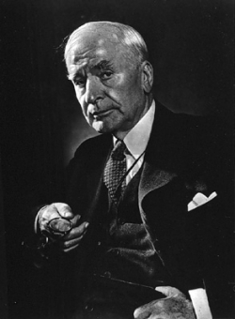
Cordell Hull
Served as President Roosevelt’s Secretary of state from 1933-44
Longest standing in US history

Slide 130
Quiz
What were some of the ways the US government tried to raise money to support WWII?
In what ways did citizens have to sacrifice?
What was the GI Bill and what was it intended to do?
Who was Cordell Hull?
What were some of his contributions during and after the war?

Slide 131
US.62 Identify the roles played and significant actions of the following individuals in World War II: (H, P)
· Franklin Roosevelt
· Winston Churchill
· Joseph Stalin
· Harry Truman
· Adolph Hitler
· Benito Mussolini
· Hideki Tōjō
· Dwight Eisenhower
· George C. Marshall
· Douglas MacArthur

Slide 132
Daily Opener: Pick the candidate you would vote for during the 1930s.
CANDIDATE #1 I am a womanizer, have self-interested policies and unfortunately suffer from ailing health.
CANDIDATE #2 I have a drinking habit, am an interventionist, and have a defiant tongue or attitude.
CANDIDATE #3 I am a decorated war hero, do not drink and want to create a stable economy.

