Slide 1
The Progressive Era
1890-1920

Slide 2
US.10
Analyze the similarities and differences between the ideologies of Social Darwinism and Social Gospel.

Slide 3
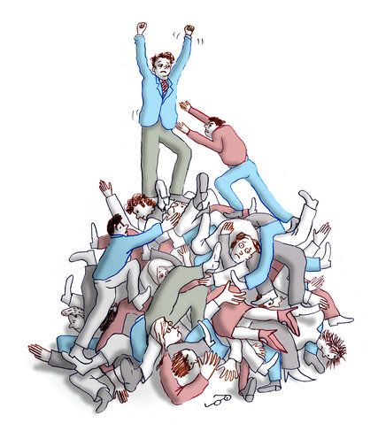
Social Darwinism

Slide 4

Social Darwinism
Belief that Charles Darwin’s biological idea of “survival of the fittest” should also be applied to social and economic issues; Social Darwinists believe that wealth is a measure of one’s inherent value and those who had it were the most “fit”.

Slide 5
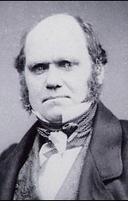
Charles Darwin
1859 published a book titled The Origin of Species
Theory of Evolution
Natural Selection.
Struggle is normal.
Some are superior.
There are benefits when the unfit are eliminated.

Slide 6
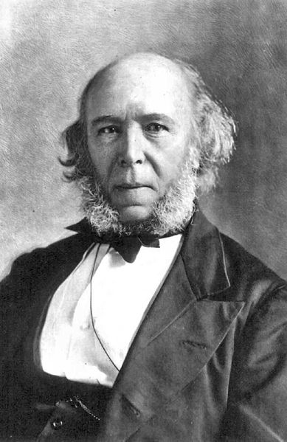
Herbert Spencer
1971 – English Philosopher who coins phrase “Social Darwinism”

Slide 7
What is Social Darwinism?
Social Darwinism is:
- individuals compete naturally.
- the incompetent lose and the strong
win. ie. “survival of the fittest”.
Government must not interfere unless the unfit are stealing from the fit.

Slide 8
Government or No Government?
Should the Government interfere with Business????
-By 1880 many Social Darwinists
were saying “NO”?!?!?
Others wanted the Government to get more involved in promoting Social Darwinism and Laissez-faire.

Slide 9
Social Darwinism and Business
Natural Competition controls the economy.
Government is not there to help people, but to support business.
Big business can take over small business.
Ruthless methods are OK.

Slide 10
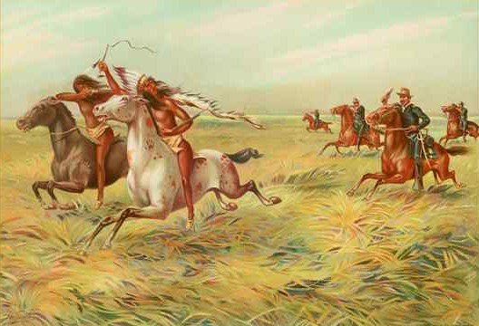
Social Darwinism and Race
Only the strong races can survive.
Technology should be kept by races that create advancement.
Justification for genocide.

Slide 11
America’s Reaction
“Self-made man” concept built the country.
“Rugged Individualism” is good.
Wealth is the reward for hard work and ability.
Failure is due to lack of ability and laziness.

Slide 12
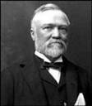
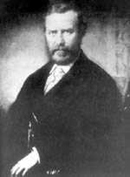

The Social Darwinists
Andrew Carnegie
T. Roosevelt Sr.
C. Vanderbilt

Slide 13
What comes of Social Darwinism?
Philanthropy: using one’s fortune to further social progress.
Focused efforts and energies on all individuals.
Expands the gap between the rich and the poor.

Slide 14
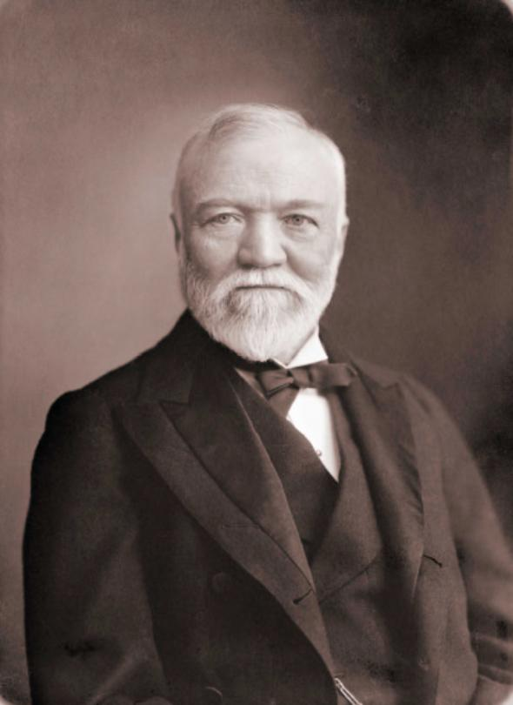
Social Gospel
The purveyors of the Social Gospel urged for government action to accomplish social reforms and refused to hold the poor solely responsible for their plight. These positions set them at odds with the Gospel of Wealth advocates like Andrew Carnegie

Slide 15
Progressives and Society
Progressives promoted laws to improves living conditions, public health and schools
Some felt that Christianity should be the substance in which the reforms are based on
Walter Rauschenbusch (WR) was one of these
WR blended the idea of German socialism and American Progressivism into his own plan for building a better society

Slide 16
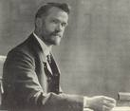
Social Gospel
First presented by Baptist minister Walter Rauschenbusch; states that by following the Bible’s teachings about charity and justice people could make society “the kingdom of God”.
Closure Question #2: Describe Walter Rauschenbusch’s ideas about Social Gospel and the Progressive Movement. (At least 1 sentence)

Slide 17
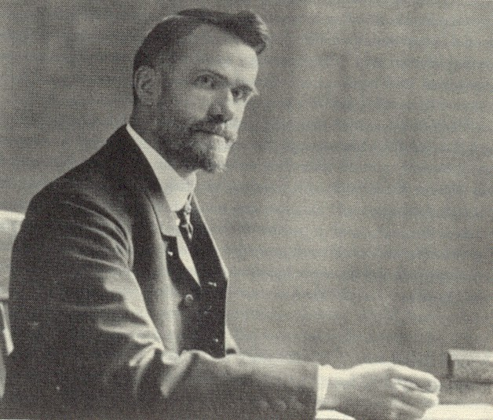
Walter Rauschenbusch
Rauschenbusch’s book Christianity And The Social Crisis outlined what he called the Social Gospel
By following the Bible’s teaching people could make society “The kingdom of God.”

Slide 18
US.11
Using textual evidence, compare and contrast the ideas and philosophies of Booker T. Washington and W.E.B. Dubois.

Slide 19
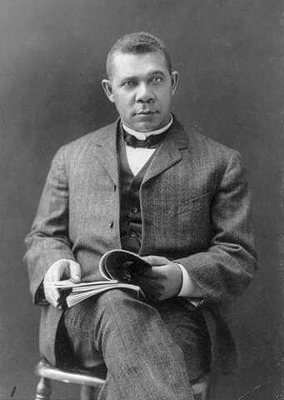
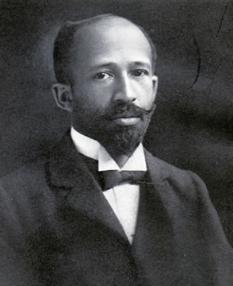
Washington and Du Bois

Slide 20
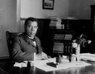
Booker T. Washington
(1856-1915) The most famous black leader during the late 19th century; Washington argued that African Americans should not focus their energy on trying to overturn Jim Crow, but instead should build up their economic resources and establish their reputations as hardworking and honest citizens.

Slide 21
Booker T. Washington
Born an slave in 1856, Washington argued that blacks should accommodate themselves to segregation
This, rather than trying to fight Jim Crow, Washington believed would be a better strategy
Washington believed that blacks should “pull themselves up by the boot straps” by being educated and building economic resources
This belief led Washington to become involved in the Tuskegee Institute which taught vocational training

Slide 22
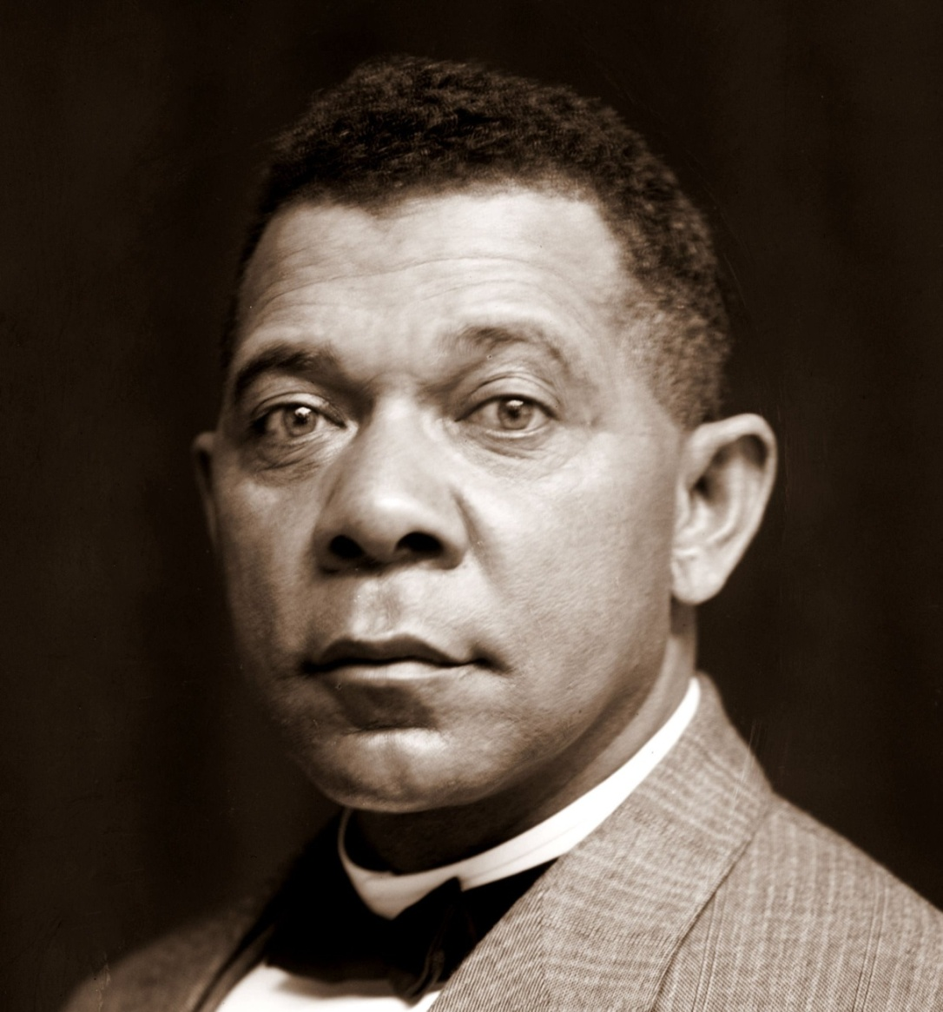
Booker T. Washington

Slide 23
Booker T. Washington
Conservative
Founded the Tuskegee Institution
Had worked very hard
had no formal education growing up
  Family too poor for him to attend school at one point packed salt 4AM to 9AM went to school & went back to salt mine for 2 more hours after.
Preached a philosophy of:
  Put aside political ambitions
  Focus on economic security & vocational skills
  Win white acceptance by succeeding economically

Slide 24
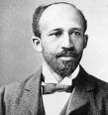
W. E. B. Dubois
Black leader in the late 19th century who opposed Booker T. Washington; Dubois was the first African American to graduate from Harvard University with a Ph.D. and believed that African Americans should engage in protests for their rights.

Slide 25
The Other Side of The Coin:
W.E.B. Du Bois
Du Bois was one of the first African Americans to earn a Ph.D from Harvard University in 1896
He was openly critical of Washington's willingness to accommodate southern whites
Du Bois encouraged blacks to demand full and immediate equality and not limit themselves to vocational training

Slide 26
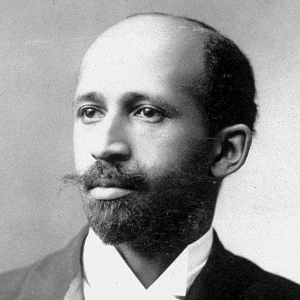
W.E.B. Dubois

Slide 27
W.E.B. Dubois
Radical
Called Washington’s teaching the Atlanta Compromise
Urged African Americans to seek liberal arts education not a vocational education
Became politically active
Helped found Niagara Movement: group of African Americans that called for full civil liberties & an end to racial discrimination
Eventually will renounce citizenship
Joined the communist party
Moved to Africa where he died

Slide 28
US.12
Explain the characteristics and impact of the Granger Movement and Populism, including the problems between farmers and the railroads, the call for banking reform, support for a graduated income tax, and regulation of public utilities.

Slide 29
Politics in the West:
Late 1800’s US economy was not in good shape
Farmers were suffering low prices
  They had more supply than demand
Tariffs: tax on imports also hurt American farmers Why?
  Raised prices on manufactured goods
  Foreigners need not earn US dollars to buy crops
  Tariffs favored eastern manufacturing not farming

Slide 30
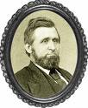
Oliver H. Kelley
Minnesota farmer, businessman, journalist, and government clerk who organized the Grange in 1867.
Closure Question #1: How did the deflation, or decrease, in the money supply in the late 1800s affect farmers? (At least 1 sentence)

Slide 31

Grange
Farmers organization established in 1867 with the goals of providing education on new farming techniques and calling for the regulation of railroad and grain elevator rates.
Closure Question #2: How did the Farmers’ Alliances begin to crusade against big business? (At least 1 sentence)

Slide 32
Politics in the West:
Period of deflation hurts farmers they want more money printed
Grange: organization founded by Oliver H. Kelly
  Concerned with education & scientific farming
  Social weekly gathering
  Economic Co-Ops buy in large quantities & sell cheaper
  Legal advice
  NOT A POLITICAL PARTY

Slide 33

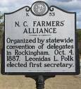
Farmers’ Alliance
Local organizations of farmers across the USA which came together to negotiate as a group for lower prices for supplies and lower transportation costs to ship their crops to market.
Dependence on one major crop was extremely risky. In the case of southern cotton, it was the boll weevil that heralded disaster. The boll weevil, a beetle which could destroy an entire crop of cotton, appeared in Texas in the early 1890s. Over the next decade, the yield from cotton cultivation in some states dropped by more than 50%.
Closure Question #2: How did southern agriculture suffer from the domination of cotton?

Slide 34
Politics in the West:
Farmers Alliance: organization
  Ask government to regulate RR monopolies
  Call for inflation: issue more money
  Government support prices
  Political support for farmers
  West and South is where power comes from

Slide 35
King Cotton Losses His Crown
Before the Civil War, many southern planters had focused on cash crops like cotton and tobacco
After the war these crops (and the lure of the money they brought) continued to dominate the efforts of southern farmers

Slide 36
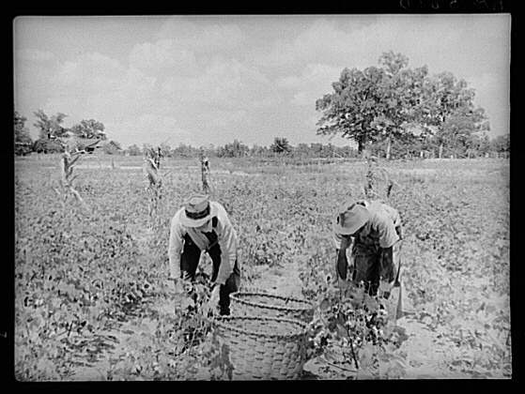
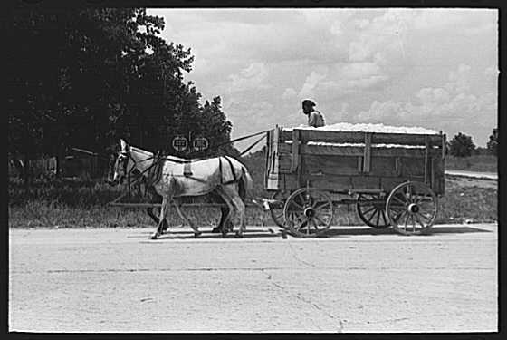

Slide 37
At the end of the Civil War, cotton prices were a third (1/3) of their prewar level
During the war European textile mills had sought out other suppliers
This caused the south cotton prices to fall
By the 1880’s the prices had rebounded

Slide 38
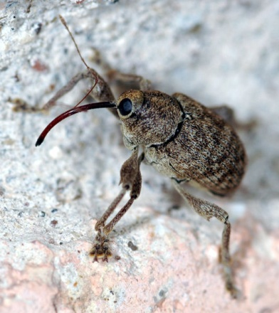
The Boll Weevils Strike Back
Dependence on one major crop is a risky proposition
For cotton farmers, they boll weevil was the worst of all enemies
First seen in Texas in the early 1890’s, the boll weevil could destroy a well developed cotton crop in a matter of no time
From 1890 to 1900, the yield of cotton in some state dropped by more than 50%

Slide 39
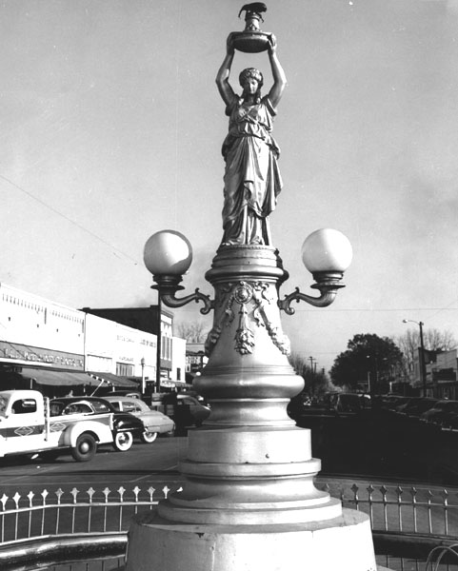
The Boll Weevil Monument
Enterprise, Alabama

Slide 40
Farmers Band Together
Texas farmers in the 1870’s began to organize (hmm have we heard this story before?) and negotiate for lower prices on supplies
These organizations linked (eventually) to form the Farmers’ Alliance-(Another example is The Grange Movement)
The Farmer’s Alliance connected farmers of the south and west for the first time

Slide 41
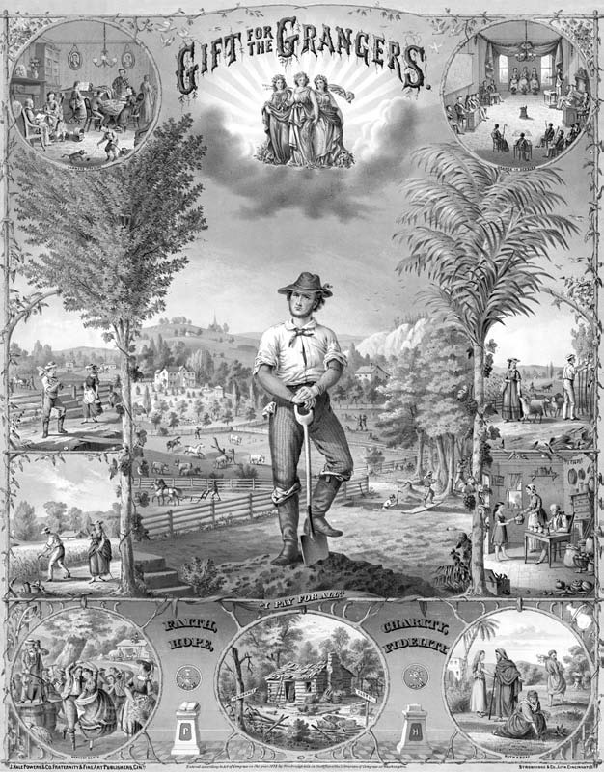
The Granger Movement
Granger Laws –
Led to Interstate Commerce Act

Slide 42
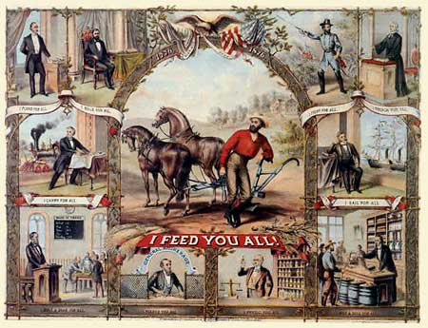
A Grange Poster

Slide 43
Farmers Band Together
Farmer in the alliance tried for two key goals:
Force lower freight costs AND Regulate interest at banks

Slide 44
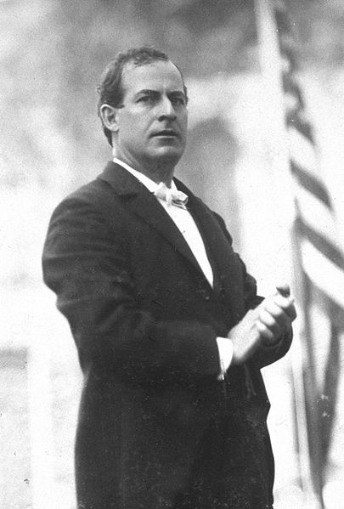
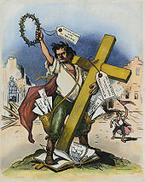
The Populist Movement
Loose coalition of …
Wanted off the Gold Standard..(Cross of Gold speech)
Many ideas later championed by the Progressives…

Slide 45
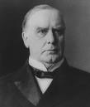
William McKinley
Republican Candidate for President in 1896; McKinley raised $15 million in campaign funds, 30 times the amount of his opponent William Jennings Bryan, and won the Presidency in 1896 and in 1900 by portraying his opponent as a potential dictator, leading to the fall of Populism.
Closure Question #3: In what ways did McKinley represent the old way of politics? (At least 1 sentence) In what ways did Bryan represent the new way? (At least 1 sentence)

Slide 46
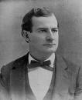
William Jennings Bryan
Democratic Nominee for President in 1896; Bryan supported Populist ideas and argued passionately for the Coinage of Silver in a speech known as “The Cross of Gold”. His defeat in the election signaled the downfall of Populism in the United States.
Closure Question #3: In what ways did McKinley represent the old way of politics? (At least 1 sentence) In what ways did Bryan represent the new way? (At least 1 sentence)

Slide 47

Populist Party
American Political Party established in 1892 with the support of farmers and farmers’ alliances; Populists aimed to end political corruption, increase the money supply by calling for the coinage of silver, and combat high transportation costs by giving the government ownership of railroads.
Closure Question #2: How did the Farmers’ Alliances begin to crusade against big business? (At least 1 sentence)

Slide 48
Politics in the West:
The Populist Party:
  increase circulation of money
  call for control of RR system
  endorse 8 hour work day
  do away with Pinkertons as strike breakers
  Progressive Income Tax
    BY TURN OF CENTURY PARTY DIES BUT GOALS LIVE ON

Slide 49
Industrial millionaires were condemned in the Populist platform of 1892
The fruits of the toil of millions are boldly stolen to build up colossal fortunes for a few…and the possessors of these, in turn despise the Republic and endanger liberty. From the same prolific womb of government injustice we breed the two great classes---tramps and millionaires.

Slide 50
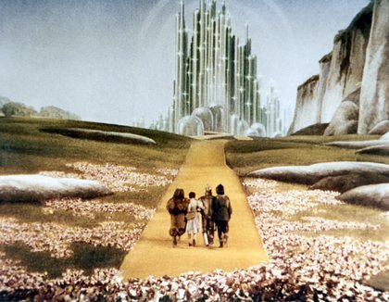
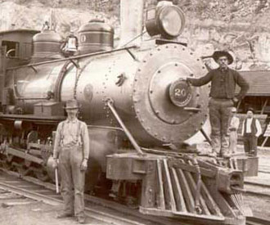

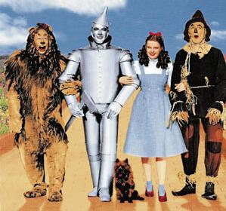
Populism and The Wizard of Oz

Slide 51
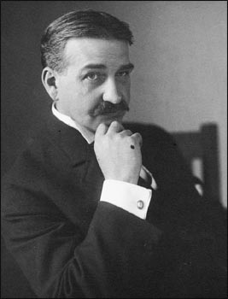
Background Information
The Wonderful Wizard of Oz was not intended to be an innocent fairy tale. Author, Frank Baum, a reform-minded Democrat who supported William Jennings Bryan's pro-silver candidacy, wrote the book as a parable of the Populists, an allegory of their failed efforts to reform the nation in 1896. However, Frank Baum never allowed the consistency of the allegory to take precedence over the theme of youthful entertainment.

Slide 52
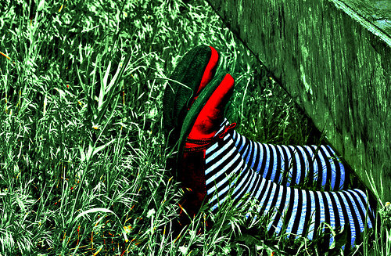
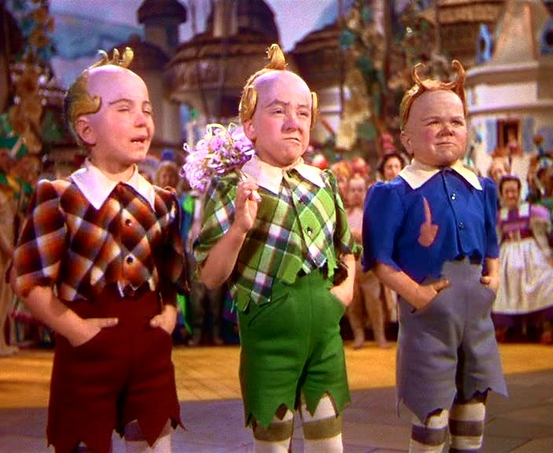
Hidden Representations:
The Wicked Witch of the East: represented eastern industrialists and bankers who controlled the people (the Munchkins).

Slide 53
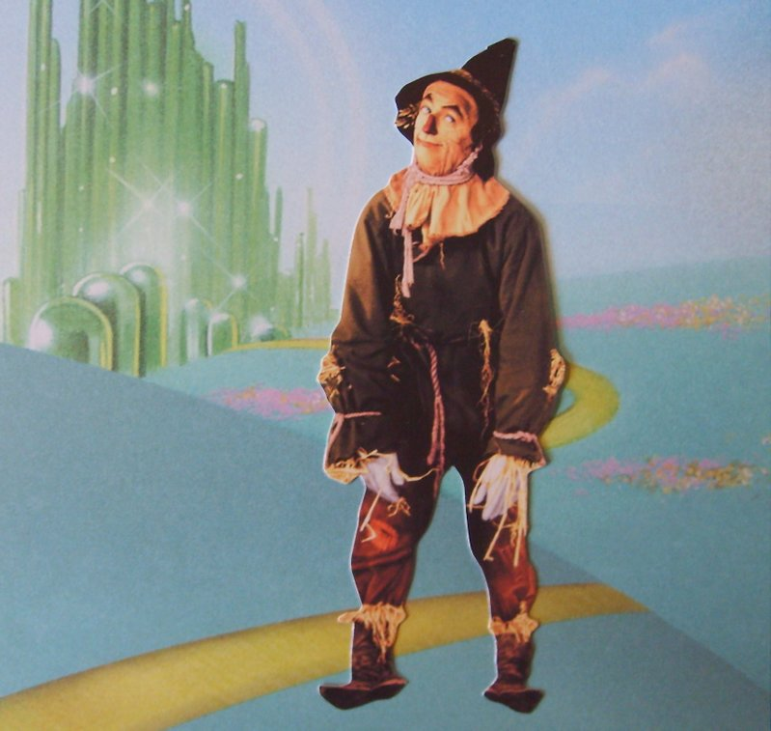
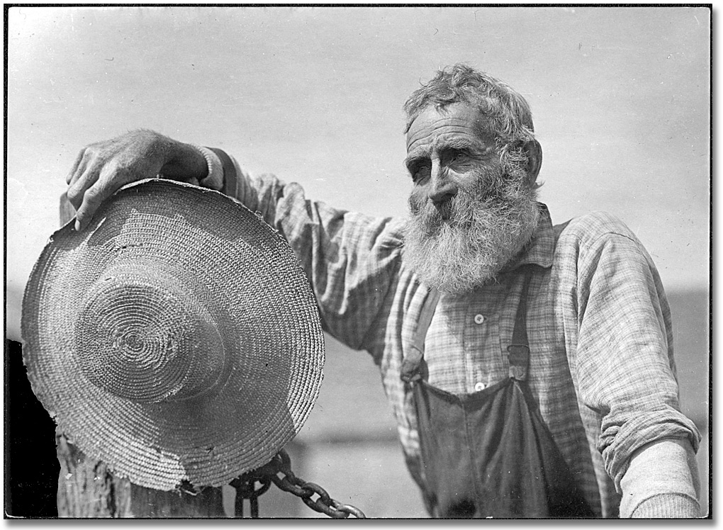

Hidden Representations:
The Scarecrow represented the wise but naive western farmer.

Slide 54
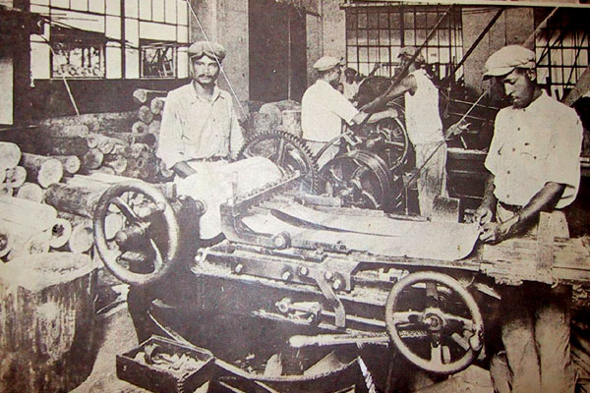
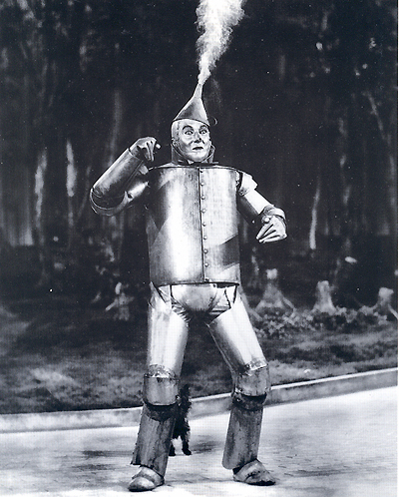
Hidden Representations:
The Tin Woodman represented the dehumanized industrial worker.

Slide 55
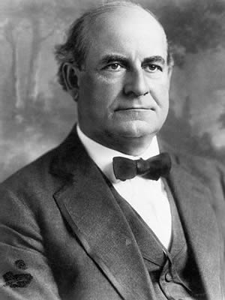
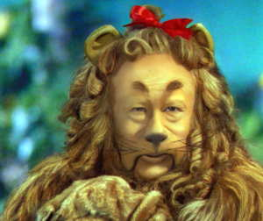
Hidden Representations:
The Cowardly Lion was William Jennings Bryan, Populist presidential candidate in 1896.

Slide 56
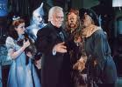
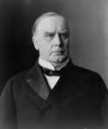
Hidden Representations:
The Wizard represents William McKinley who tried to be all things to everyone, but turned out to be a fake.
President William McKinley

Slide 57


Hidden Representations:
The Yellow Brick Road, with all its dangers, represented the gold standard.

Slide 58
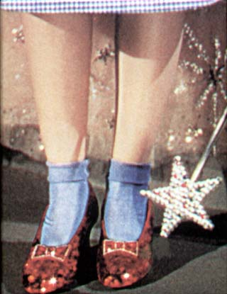
Hidden Representations
Dorothy's silver slippers (Judy Garland's were ruby red, but Baum originally made them silver) represented the Populists' solution to the nation's economic woes ("the free and unlimited coinage of silver")

Slide 59
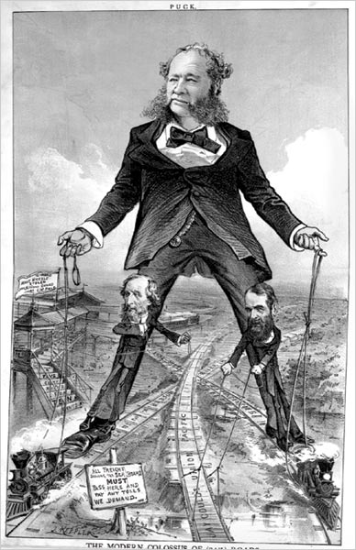
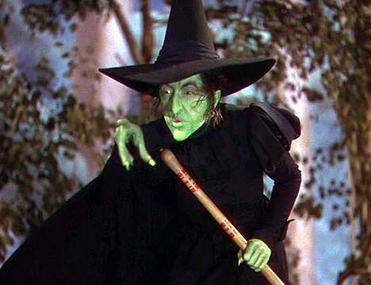
Hidden Representations
The Wicked Witch of The West represents the railroads and the control they had over the populist supporters.

Slide 60
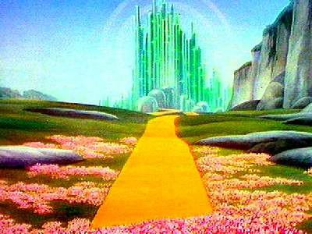
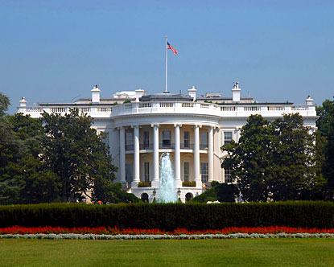
Hidden Representations
Emerald City represents Washington DC, where leaders reside and people look for significant change in their life.

Slide 61
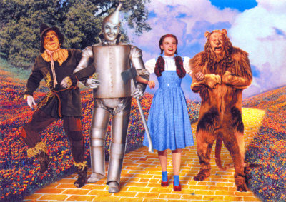

Slide 62
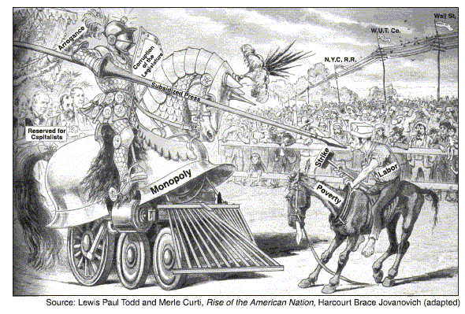

Slide 63
US.13
Describe the rise of trusts and monopolies, their subsequent impact on consumers and workers, and the government’s response, including the Sherman Anti-Trust Act of 1890.

Slide 64
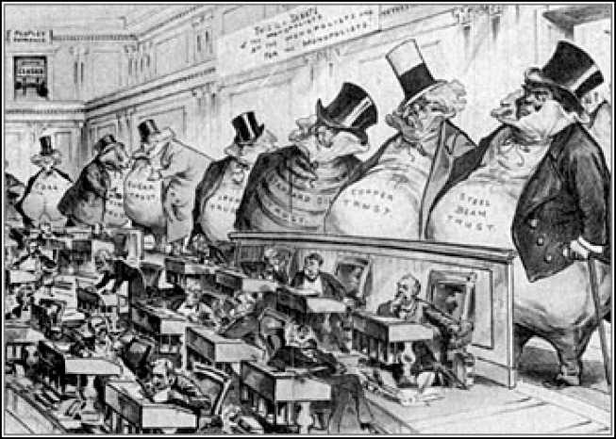

Slide 65
Terms of the Era
  Social Darwinism: applies Darwin’s theory of evolution to society. Only the fit or the strong will survive.
  Government should do as little as possible to interfere with the process by which people succeed or fail.
  Laissez faire: hands off most agreed Government will not tax or regulate relations with workers
  Monopoly: a business that would buy out all its competition and can charge any price it likes for a product.
  Cartels: loose associations of businesses making the same product usually formed in secret can limit supply & make price high
    Both designed to eliminate competition
    Government finally began to regulate @ end of 1800’s

Slide 66
The Formation of the Trust
Trust: is a kind of monopoly group of separate companies that are placed under control of a single managing board.
  Example: Standard Oil owned by John D. Rockefeller
Rockefeller had enough money to buy out competition----state law prohibited one company from owning stock in another company. So they turned them into a trust---Rockefeller controlled the board----40 companies made up the trust. They never officially merged. BY 1877 JDR controlled 95% of oil refineries.

Slide 67


Monopoly / Cartel
Monopoly – Complete control of a product or service. A monopoly is achieved when one corporation buys out its competitors or drives them out of business.
Cartel – An agreement among corporations to limit the production of a product in order to keep prices high.

Slide 68



Corporation
A form of group ownership in which a company is owned by a number of people who buy a percentage of the company, known as a stock.

Slide 69
BUSINESS ORGANIZATIONS
Corporation: form of business consisting of a group of people authorized by law to act as a single person and with the ability to sell shares of stock to raise “capital”
Shareholders or stockholders: investors who invest their money into a corporation who each receive a share of ownership in proportion to the amount they invested
  if the corporation makes a profit---than investor
  gets a “dividend” or a share of the profit.
Limited liability: Important aspect of a corporation is limited liability. Shareholders have the right to participate in the profits, through dividends and/or the appreciation of stock, but are not held liable for the company's debts.
“Risk is spread over the shareholders so if the company goes bankrupt, the lose is not so devastating”

Slide 70
PROPRIETORSHIP
Key Terms to Note about Businesses-Owning
FORMATION
Individual or person decides to operate a business
OWNERSHIP
Individual
CONTROL AND MANAGEMENT
By owner or persons delegated by
the proprietor
NET PROFITS
LOSSES
Profits to owner
Losses absorbed by owner
UNLIMITED LIABILITY

Slide 71
PARTNERSHIP
Key Terms to Note about Businesses-Owning
FORMATION
By agreement between associates (partners)
OWNERSHIP
Jointly by two or more individuals; or by terms of partnership agreement
CONTROL AND MANAGEMENT
By partners or persons they delegate
NET PROFITS
LOSSES
Shared according to partnership agreement
UNLIMITED LIABILITY

Slide 72
CORPORATION
Key Terms to Note about Businesses-Owning
FORMATION
Organized by associates and legalized through state charter
OWNERSHIP
Stockholders, according to number of shares
CONTROL AND MANAGEMENT
Through Board of Directors, elected by the stockholders (usually one vote per share of stock held)
NET PROFITS
AND LOSSES
Dividends: to stockholders = profits
Lose: only the amount invested by stockholders according to number of shares
LIMITED LIABILITY

Slide 73
BUSINESS ORGANIZATIONS
Conglomerate
A group of unrelated business owned by a single corporation. Still used today by companies that merge.
Pool
Competing companies that agree to fix prices and divide regions among members so that only one company operates in each area. Outlawed today.
Trust
(Monopoly)
Companies in related fields agree to combine under the direction of a single board of trustees, which meant that shareholders had no say. Outlawed today.
Holding Company
A company that buys controlling amounts of stock in related companies, thus becoming the majority shareholder, and holding considerable say over each company's business operations. Outlawed today.

Slide 74
BUSINESS ORGANIZATIONS
Trusts or Monopoly
Companies in related fields combine under the direction of a single board of trustees.
Shareholders had no say.
Outlawed today.

Slide 75

TRUSTS AND MONOPOLIES
BIGGER IS BETTER
A trust or monopoly controls an entire industry
Make product cheaper
Lower prices to customer
  ALL SUPPOSEDLY HAPPEN

Slide 76
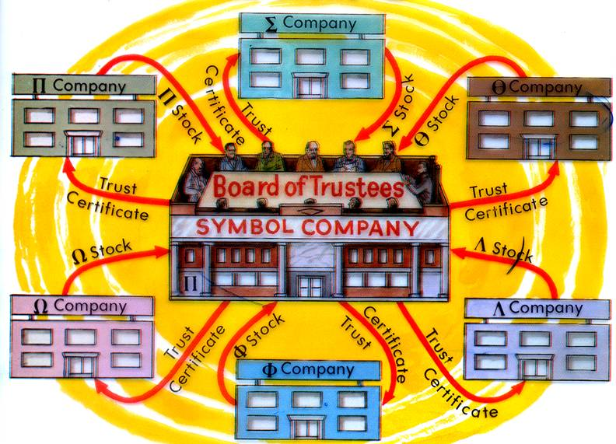
MONOPOLIES AND TRUSTS

Slide 77




VERTICAL AND HORIZONTAL INTEGRATION
Vertical Integration
You control all phases of production from the raw material to the finished product
Coke fields
Coke fields
Coke fields
Coke fields
Coke fields
purchased by Carnegie
purchased by Carnegie
purchased by Carnegie
purchased by Carnegie
purchased by Carnegie
Iron ore deposits
Iron ore deposits
Iron ore deposits
Iron ore deposits
purchased by Carnegie
purchased by Carnegie
purchased by Carnegie
purchased by Carnegie
Steel mills
Steel mills
Steel mills
purchased by Carnegie
purchased by Carnegie
purchased by Carnegie
Ships
Ships
purchased by Carnegie
purchased by Carnegie
Horizontal Integration
Buy out your competition until you have control of a single area of industry
Railroads
purchased by Carnegie
MONOPOLY

Slide 78
In Trusts We Trust?
Everyone eventually start to notice that systems like trusts (when many companies are under one person or board), cartels and monopolies were giving unfair advantages.
FINALLY! In 1890 the Senate passes the SHERMAN ANTI-TRUST ACT

Slide 79

Sherman Anti-Trust Act – 1890

Slide 80
Government Response
Americans began to fear Trust afraid they would limit industrial competition
  1890 Sherman Anti-Trust Act: outlawed any combination of companies that restrained interstate trade or commerce. Very vague & ineffective. The courts were pro-business---worked mainly against labor unions to break strikes.

Slide 81
The Sherman Anti-Trust Act of 1890
This act outlawed any trust that operated in restraint of trade or commerce among several states
In common terms:
No one can operate a trust that harms business in another state
The law never really says anything about one state
And it never defines “restraint”

Slide 82
US.14
Describe working conditions in industries, including the use of labor by women and children.

Slide 83
Picture: Workers vs Owner
WORKER VS EMPLOYER
“The old familiar relations between employer and employee were passing. A few generations before, the boss had known every man in his shop. He called his men by their first names, asked about the family and swapped jokes and stories with them. Today, you have large factories, the personal touch is gone!”
Theodore Roosevelt
“IMPERSONALIZATION”

Slide 84
INDUSTRALIZATION
Poor working conditions
Unfriendliness/impersonalization
Immigrants taking jobs
Decrease work day
Machines replacing workers
Child labor
Job security

Slide 85
WORKING FAMILIES
In the 1880s, children made up more than 5 percent of the industrial labor force.
Children often left school at the age of 12 or 13 to work.
Girls sometimes took factory jobs so that their brothers could stay in school.
If an adult became too ill to work, children as young as 6 or 7 had to work.
Rarely did the government provide public assistance, and unemployment insurance didn’t exist.
The theory of Social Darwinism held that poverty resulted from personal weakness.
Many thought that offering relief to the unemployed would encourage idleness.

Slide 86
Working Conditions
Working conditions were poor in the factories.
They were poorly ventilated, lighted, and heated.
Hours were long.
Wages were low.
Notes:
Working conditions in the factory were not regulated during this period and conditions were poor. Most workers had to toil in factories that were inadequately ventilated, poorly lighted, and barely heated. The work day often was twelve hours or more. Not only did the workers have to work long hours, they had to work for extremely poor pay. Even though working conditions and other factors made labor scarce, factories were able to find workers, especially from the ranks of the women and children.
(Click to continue to the next slide.)

Slide 87
Poor Working Conditions
Small, crowded rooms
Specialization made workers tired, bored, and more likely to be injured.
Managers paid less attention to working conditions.
Stuffy air
Unsafe workplaces
Long hours
Low wages
No job security

Slide 88
Unsafe working conditions:
late 1800’s on average about 675 people died per week in factories
  Noise was deafening
  Lighting & ventilation poor
  Lack of training & fatigue
  Frequent fires
  OSHA does not exist

Slide 89
Life in the Factory
Family Affair:
There are still women in workplace---most single but some working mothers
Children could be found in the workplace: as young as 6yrs old. 1 out of 5 workers (20%) were working
By the end of 1800’s children between ages of 10 & 16 employed
Education ignored: boys generally received more education
Children had to work so the family could survive
Many lives destroyed
1892 Jacob Riis—Children of the Poor ATTACKED CHILD LABOR
  Explained impact on Children
  Changes start in 1890’s
No welfare or government support system

Slide 90
THE WORK ENVIRONMENT
Division of Labor
Some owners viewed workers as parts of the machinery.
Unlike smaller and older businesses, most owners never interacted with workers.
  impersonalization
Work Environment
Factory workers worked by the clock.
Workers could be fired for being late, talking, or refusing to do a task.
Workplaces were not safe.
Children performed unsafe work and worked in dangerously unhealthy conditions.
In the 1890s and early 1900s states began legislating child labor.

Slide 91
FACTORIES ON THE TIME
SEEKING TO MAXIMIZE PROFITS FACTORY OWNERS WOULD HIRE:
PEOPLE WHO WOULD WORK FOR LOW WAGES
IMMIGRANTS
CHILDREN
HOMELESS
THE DISABLED

Slide 92
FAMILIES IN THE WORKPLACE
MORE JOBS FOR WOMEN WERE OPEN, BUT FOR THE MOST PART WORK WITH FAMILIES IN FACTORIES
LOW WAGES= BOTH PARENTS HAD TO WORK
WOULD HAVE TO BRING CHILDREN TO WORK WITH THEM

Slide 93
CONTINUED
CHILDREN IN THE FACTORIES MEANS THEY CAN EARN WAGE TOO
BY 1800’S- 1 IN 5 CHILDREN (AGE 10 TO 16) WORKED RATHER THAT ATTEND SCHOOL

Slide 94

Child Labor
Scarce labor made factories turn to using children.
Half of the factory laborers were children under ten years old in 1820.
Conditions caused children to be mentally, emotionally, and physically stunted.
Notes:
It is difficult to comprehend that in order for factories to find enough labor, they hired children. Half of the factory laborers were children under ten years old in 1820. The long hours and poor living and working conditions caused children to be mentally, emotionally, and physically stunted. The factory jobs not occupied by children were often filled with women.
(Click to continue to the next slide.)

Slide 95


CHILDREN AT WORK

Slide 96





Slide 97



Child Labor
Legislation enacted to protect children in the workplace…

Slide 98
Factory Work
Most people work 12 hour days---6 days a week---some even more----only federal jobs regulated
Piecework system: workers were paid based on the number of goods they could produce
  Favors young and strong
  Most workers earn very little money
    Example: Millworker NYC in 1880’s earned 1 dollar a week---5 minutes late fined 25 cents
      Same time sheriff in wild west made $150.00
      Cowhand earned about 30.00
Owner/worker relationship was not good
  As business grew the relationship became more distant. “I regard my people as I regard my machinery. So long as they can do the work for what I choose to pay them, I keep them, getting out of them all I can
  Discipline: fined or fired if late, no talking or talking back--- workers had to get used to less freedom (ruled by a clock)

Slide 99
Progressivism and Industrial Workers
In the 1900’s the U.S had the high rate of industrial accidents in the world
Each year some 30,000 worker died while on the job, and another half a million were injured
One example is the 1911 fire at the Triangle Shirtwaist Factory in NYC
Worker did not stand a chance of getting out because the factory bosses had locked the doors of the factory

Slide 100

The fire killed 146, many of the young Jewish women
Firefighters surveying the building after the blaze found many of the corpses still bending over sewing machines

Slide 101

A Modern Representation

Slide 102


Slide 103

Triangle Shirtwaist Fire
Leads to Health and Safety codes for workers
Workers compensation eventually enacted

Slide 104
US.15
Analyze the rise of the labor movement, including its leaders, major tactics, and the response of management and the government:
  Samuel Gompers, Eugene Debs, Haymarket Affair, Pullman Strike, Coal Creek Labor Saga, collective bargaining, blacklisting, open vs. closed shops

Slide 105

The Labor Movement

Slide 106
The Organized Labor Movement
THE ECONOMIC BOOMS OF THIS TIME MADE THE AMERICAN ECONOMY GROW TREMINDOUSLY
BUT ONLY FOR THOSE THAT CONTROLED THE RESOURCES

Slide 107


Two Different Worlds 1
TWO DIFFERENT WORLDS
The wealthy would manifest itself in an elite class of Americans who lived extravagant lifestyles. Many common people resented their snobbish attitudes and wealth. In some respects, there was a caste system in the U.S.
1861---------3 millionaires----------1900--------3,800
By 1900, 90% of the wealth in the U.S. was controlled by 10% of population.

Slide 108
EARLY LABOR EFFORTS
THOUGH PRICES BEGIN TO FALL, FAMILIES STILL DO NOT MAKE ENOUGH
THEY BEGIN TO GO STRAIGHT TO THE COMPANY LEADERSHIP WITH COMPLANTS

Slide 109


Tactics
Collective Bargaining
Blacklisting
Open Shops
Closed Shops

Slide 110
LABOR UNIONS
Labor Union
Workers who organize against their employers to seek better wages and working conditions for wage earners.
The unions' method for having their demands met. Workers stop working until the conditions are met. It is a very effective form of attack.
Labor Strike
Boycott
People refuse to buy a company's product until the company meets demands.
New immigrants who would replace strikers and work for less pay. Often violence would erupt between strikers and scabs who were trying to cross picket lines to work.
Scab Worker

Slide 111
LABOR UNIONS
A working establishment where only people belonging to the union are hired. It was done by the unions to protect their workers from cheap labor.
Closed Shop
List of people disliked by business owners because they were leaders in the Union. Often would lose their jobs, beaten up or even killed.
Black List or Black Balled
Type of negotiation between an employer and labor union where they sit down face to face and discuss better wages, etc.
Collective Bargaining
Yellow Dog
Contracts
A written contract between employers and employees in which the employees sign an agreement that they will not join a union while working for the company

Slide 112


LABOR UNIONS
Lock Out
Owner of industry would “lock out” workers who were trying to form a union and replace them with “scabs”.
Industry or business organization owned by and operated for the benefit of those using its services—non-profit
Cooperatives

Slide 113
LABOR UNIONS
National Labor Union
William Sylvis, 1866
Skilled, unskilled, farmers but excluded Chinese…
Cooperatives, 8 hr. work day, against labor strikes
Founded a political party in 1872
Involved in the Chinese Exclusion Act.
Lost election, faded away
Replaced by Knights of Labor.
Knights of Labor
Terrence Powderly
All workers except Chinese
8 hr. day, cooperatives, prohibition, end child labor
Several strikes won some wage gains 1885 to 1886
Unrealistic and vague goals
Loss of important strikes and failure of cooperatives
Haymarket Riot—1886
American Federation of Labor or AFL
Samuel Gompers, 1881
Skilled workers in separate unions.
Work within political system for change.
Closed shop and collective bargaining
Over 1 million workers joined and won several strikes
Small part of work force eligible to join.

Slide 114
SOCIALISM AND COMMUNISM
1843: Marx coauthors treatise titled Communist Manifesto
Denounced Capitalism
Predicts workers (The Proletarian) would over-throw it
Most Americans denounce this
Many say it is against the American (Capitalist) way
However Many Labor Activist Borrow from Marx

Slide 115



Slide 116
SOCIALISM
Economic system based on cooperation rather than competition
Many Americans opposed capitalism and believed a socialistic economy would better suit the US because some capitalists were corrupt.
Believes in government ownership of business and capital (money, natural resources)
Government controls production, sets wages, prices and distributes the goods. No profit or competition.
Opposite of laissez faire and capitalism

Slide 117

Eugene Debs

Slide 118




EUGENE DEBS
Founder of the Socialist Party in the U.S.
Overthrow the existing laissez faire and capitalistic
Believes in government ownership of business and capital (money, natural resources)
Government controls production, sets wages, prices and distributes the goods. No profit or competition.
Runs for the presidency several times & loses.

Slide 119

Railroad Workers Organize
The Great Railroad
Strike of 1877
  Railway workers protested unfair wage cuts and unsafe working conditions.
  The strike was violent and unorganized.
  President Hayes sent federal troops to put down the strikes.
From then on, employers relied on federal and state troops to repress labor unrest.

Slide 120
Railroad Workers Organize
Debs and the American Railway Union
  At the time of the 1877 strike, railroad workers mainly organized into various “brotherhoods,” which were basically craft unions.
  Eugene V. Debs proposed a new industrial union for all railway workers called the American Railway Union (A.R.U.).
  The A.R.U. would replace all of the brotherhoods and unite all railroad workers, skilled and unskilled.

Slide 121


Slide 122


Slide 123

Pullman Strike

Slide 124

The Pullman Car Strike
Beginning 1893 The Pullman Rail Car Company begin laying off worker and lowering by 25%
George Pullman required his workers to live in company town

Slide 125
Pullman charges high rents in the company town.
In May 1884 workers try to bargain, but Pullman fires representatives and shuts down their plant

Slide 126
Here Come Eugene Debs To The Rescue
Workers turn to the American Railway Union (A.R.U).
Debs runs the A.R.U
A.R.U grouped railway workers together rather than by job
By 1894-300,000 workers have walked off the job

Slide 127
Strike has the intended effect and rail traffic is stopped completely
Pullman uses the SHERMAN ANTI-TRUST ACT to show that the strikers are disrupting inner-state commerce
Government sides with the Pullman and starts the trend of the government siding with businesses over unions

Slide 128
Cleveland to the aid of……….... Well, the rich
On July 4th President Grover Cleveland sends federal troops to break the strike
Debs refuses and is imprisoned for conspiracy against inner-state commerce
The Supreme Court hears Debs appeals but side once again with Pullman

Slide 129
Strikes Rock the Nation
Pullman, 1894
  Eugene Debs instructed strikers not to interfere with the nation’s mail.
  Railway owners turned to the government for help. The judge cited the Sherman Antitrust Act and won a court order forbidding all union activity that halted railroad traffic.
  Court orders against unions continued, limiting union gains for the next 30 years.

Slide 130


Slide 131


Uriah Smith
Terence V. Powderly

Slide 132
Knights of Labor (KOL)
1869: Uriah Smith Stephens founds the KOL
KOL actively recruited workers of all races
For the most part (in the beginning at least) was a secret society
Focused on broad workers rights

Slide 133
KOL CONTINUED
1881 Terence Powderly takes over KOL
Encourages boycotts
Abandons the secretive nature
1885 KOL had grown to include 700,000 men and women
By 1890’s KOL had faded due to series of failed strikes

Slide 134

Haymarket Affair

Slide 135



HAYMARKET RIOT
May 3, 1886, joining a nation wide strike for an 8 work day Chicago workers protested against the McCormick Reaper plant.
A riot broke out and Chicago police officers killed several protesters
To protest the killing, protesters planned a rally for May 4
3,000 gather at Chicago’s Haymarket Square
During the protest, a bomb exploded
7 police officers were killed and civilians killed and injured
Chicago police hunt down murderers
8 anarchists were convicted of conspiracy to murder

Slide 136

Come One! Come All

Slide 137


HAYMARKET RIOT
4 were hanged and 1 committed suicide
This caused the public to look down on labor unions especially the Knights of Labor
Gov. Altgeld of Illinois later issued pardons for the remaining accused anarchists.

Slide 138

Picture: Workers vs Owner
LABOR UNIONS
Haymarket
Riot
Americans were suspicious of labor unions because they tended to go against laissez faire and capitalism. Labor strikes were often violent.

Slide 139


Slide 140
Labor Unions, Knights of Labor
and the American Federation of Labor
Labor unions were formed when dissatisfied workers formed in to groups to demand better pay and working conditions.
In 1886, the American Federation of Labor was officially formed. It represented many skilled workers in various crafts. The President of the American Federation of Labor was Samuel Gompers. The organization worked for higher wages, shorter hours, better working conditions, and the right to bargain collectively with employers.
In 1869 garment cutters formed the Noble and Holy Order of the Knights of Labor. The members of the labor union met secretly and had handshakes so that their employers wouldn’t find out about them. Something that was unique about this labor union was that its members included African Americans, women, and unskilled laborers. The Knights of Labor had more than 700,000 members at its peak.

Slide 141

Samuel Gompers

Slide 142
AMERICAN FEDERATION OF LABOR
1886: Samuel Gompers founds AFL
AFL is a craft union- meaning only members of specific craft could join
High dues paid by members would provide assistance and relief of striking members
Focused on specific workers rights

Slide 143

Samuel Gompers
Samuel Gompers was the first and longest serving president of the American Federation of Labor. Under his leadership, the American Federation of Labor became the largest and most influential labor federation in the world. It grew from a small association of 50,000 in 1886 to an established organization of nearly 3 million in 1924 that had won a permanent place in American society.

Slide 144

HOMESTEAD STRIKE
1892, Carnegie Steel workers strike over pay cuts
Management locks out workers and hires scab workers.
Violence erupted between strikers and scab workers.
Pinkerton Security called in to settle violence
Strikers ambush them and forced Pinkerton’s to walk the gauntlet between striking families.
Some killed and many injured
National Guard was called in by the governor of Pennsylvania to stop violence and reopen plant

Slide 145
HOMESTEAD STRIKE
Carnegie successfully broke up the attempt to organize a union.
No labor unions in steel industry until the 1920’s.
Carnegie would be remembered for events at Homestead.
His public image suffered

Slide 146
Labor strikes often turned violent and failed to accomplish their goals.
Haymarket Riot
Erupted between protesters and police in Chicago
Resulted in decline of Knights of Labor
Homestead Strike
Strike occurred at Carnegie Steel Company in Homestead, Pennsylvania.
Resulting fight left workers and Pinkerton guards dead.
Pullman Strike
Began with workers who made Pullman train cars
Spread to workers who worked on trains pulling sleeping cars
Federal troops stopped strike.

Slide 147
Workers began to organize and demand improvements in working conditions and pay.
Knights of Labor
First national labor union, founded in 1870s
Pushed for eight-hour workday, equal pay for equal work, and end to child labor
Included both skilled and unskilled workers
Terence V. Powderly became leader in 1879 and ended secrecy of organization.
American Federation of Labor
Organized individual national unions, such as mine-workers’ and steelworkers’ unions
Limited membership to skilled workers
Used collective bargaining, in which all workers acted collectively, or together, to negotiate with management

Slide 148


COAL MINING &
FACTORY WORK

Slide 149
COMPANY TOWNS
OFTEN IN REMOTE AREAS LIKE APPALACHIA
OWNED BY THE COMPANY
WORKERS HAD TO SHOP AT COMPANY STORE (MONOPOLY)
IF YOU LOST YOUR JOB YOU LOST YOUR HOME

Slide 150
CONTINUED
WERE OFTEN SEGREGATED BY RACE
POORLY BUILT
WOULD TYPICALLY HAVE CHURCHES, BUT FEW OTHER PLACES TO MEET

Slide 151

HAVE NOTS

Slide 152

HAVES

Slide 153


Slide 154


Slide 155


Coal Creek Labor Saga

Slide 156
Coal Creek War
The Coal Creek War was an armed labor uprising that took place primarily in Anderson County, in the American state of Tennessee, in the early 1890s. The struggle began in 1891 when coal mine owners in the Coal Creek watershed attempted to replace free coal miners with convicts leased out by the state government. Over a period of just over a year, the free miners continuously attacked and burned prison stockades and company buildings, hundreds of convicts were freed, and dozens of miners and militiamen were killed or wounded in small-arms skirmishes. One historian describes the conflict as "one of the most dramatic and significant episodes in all American labor history

Slide 157
Coal Creek War
The Coal Creek War was part of a greater struggle across Tennessee against the state's controversial convict-leasing system, which allowed the state to lease its convicts to mining companies to compete with free labor. The outbreak of the conflict touched off a partisan media firestorm between the miners' supporters and detractors, and brought the issue of convict leasing to the public eye. Although the uprising essentially ended with the arrests of hundreds of miners in 1892, the publicity it generated led to the downfall of Governor John P. Buchanan, and forced the state to reconsider the convict-leasing system. In 1896, when its convict-lease contracts expired, Tennessee's state government refused to renew them, making it one of the first Southern states to end the controversial practice.

Slide 158
Reaction of Employers
Employers hated & feared unions. Why?
European influences of socialism
Labor strikes always tended to be violent.
Some took steps to stop unions, such as:
forbidding union meetings
firing union organizers
forcing new employees to sign “yellow dog” contracts, making them promise never to join a union or participate in a strike
refusing to bargain collectively when strikes did occur
refusing to recognize unions as their workers’ legitimate representatives

Slide 159
What Do You Think?
Are Unions helpful?
Do they have a place in the American economic realm?
Would you go on strike to gain better wages?
Or do you believe unions are nothing but socialist scum?
In today’s world workers are given good wages without unions
Strikers should lose their jobs the second they walk out

Slide 160
US.16
Citing textual evidence as appropriate, explain the significant roles played by muckrakers and progressive idealists, including Robert La Follette, Theodore Roosevelt, Ida Tarbell, Lincoln Steffens, and Upton Sinclair.

Slide 161
Problems America Faced in 1900
Increase in Crime
Big Business Consolidation
Women & children in the workplace
Government Corruption

Slide 162


Rise of Progressivism
New reformers emerge as a reaction to the nation’s rapid industrialization, immigration, and urbanization.
  What were the negatives of these?
  Believed private charity could not do enough to help.
Progressive Era
  1890-1920
    Many plans produced with how to bring about progress.

Slide 163
1890-1920 Progressive Era:
period of reform local, state, & Federal Government involved.
The progressives were people that wanted reform or change not a Political Party was comprised of both Democrats and Republicans (Felt government needed to be more involved).

Slide 164
Why It Matters?
Industrialization, urbanization and immigration brought many benefits to American but also many challenges in the form of social problems
Progressivism emerged in the 1890’s as a response to these problems
Progressives believed in that new ideas and honest, efficient government could bring about social justice
These ideas brought reforms that are still present today BUT Progressives are still around

Slide 165
Progressives wanted reform in 4 areas:
social
economic
moral
political

Slide 166
Common Beliefs
Progressives believed that industrialization and urbanization had created social and political problems
They felt that their reforms would correct the problems and bring justice
Using logic, reason, and in some cases religion to formulate the reforms they fought for

Slide 167
Progressives v. Populist
Reform the government
Eliminate corrupt Big Business
Reformers were middle class
Believed in highly educated leaders that used modern ideas and scientific techniques
Reform the government
Eliminate corrupt Big Business
Reformers were typically lower-class
Leaders where educated but usually farmers and workers

Slide 168


Progressives We’ve Already Talked About

Slide 169
A List of Reforms Progressives Sought With Examples Of Efforts At Reform
Political reform-on the local/state/ federal level
Women’s Suffrage- we’ve heard this before
The spoils system- no more “Uncle is going to get me the job”
Political machines- Boss Tweed recruiting votes from immigrants
Ineffective government- remember how little the government had done from the last chapter
Inadequate services for the urban poor- fueled by the pictures of Jacob Riis

Slide 170
More Reforms
Big business –Robber Barons like Vanderbilt, Rockefeller and Jay Gould
The wide gap between the rich and poor- Institutions like the Hull House
Corrupt labor union bosses

Slide 171


Goals and Beliefs
Progressivism was not a unified movement.
  Included Republicans and Democrats
All Progressives held four basic beliefs in common:
  Government should…
    …be more accountable to its citizens.
    …curb the power and influence of wealthy interests.
    …be given expanded powers so that it could become more active in improving the lives of its citizens.
    …become more efficient and less corrupt so that they could competently handle an expanded role.

Slide 172



The Progressive Presidents

Slide 173

Theodore Roosevelt

Slide 174
Theodore Roosevelt Quick Facts
First To:
to fly in an airplane
to own a car
Noted Historians, Conservationist, Philanthropist, Boxer,

Slide 175
Theodore Roosevelt
Born to a wealthy family in New York City
Father hired a replacement to fight in the Civil War- this would have a huge effect on TR in future
Father did help build the Brooklyn Bridge
TR had asthma as a child and due to this is tutored at home
As you know he developed a love of the outdoors

Slide 176


Slide 177
HARVARD
TR eventual decides to “out grow” his asthma and trains himself in a gym built on the porch of his home
Eventually TR is admitted to Harvard and while at “Hahvad” he becomes the schools boxing champion and joins the rowing team
After the death of his mother and wife on the same day he leaves his life in the east and goes west

Slide 178

In the west he takes on the life of a cowboy
After the west he comes back east to take a job as NYC’s police commissioner
From that post he would eventually become governor, VP and President

Slide 179
TR AS PRESIDENT
TR had been a progressive governor and the Republicans of New York wanted him out
So they convince McKinley to run him as a VP in 1900
After McKinley is shot, TR becomes President
TR take the reins as President and immediately started formulating the Square Deal

Slide 180


The Many Lives Of TR

Slide 181
Teddy Roosevelt – The Progressive
Remember pure food & drug act
Saw presidency as “bully pulpit” used his position to rally the American People to support moral & worthy causes.
The Square Deal United Mine workers were on strike---talks going nowhere! Winter was near. Teddy Roosevelt used power to give both sides a square deal. Makes both sides submit to arbitration (impartial 3rd party decides on legally binding solution)
Will use army to operate mines
Square deal became the slogan of his presidency

Slide 182
Teddy Roosevelt – The Progressive
Teddy Roosevelt will enforce the Sherman Anti-Trust Act---really first time ever
Roosevelt administration filed 42 antitrust actions (The beef trust Standard Oil)
Allowed the ICC (Interstate Commerce Commission) to become the first true federal regulatory agency
Set limits on railroad rates (goal for a long time)
Set aside 200 million acres for conservation
Appointed Gifford Pinchott to head U.S. Forrest Service (Fired by Taft)
T-Shirt campaign design 1912 (slogan, Party Agenda)

Slide 183
TR’S REFORMS
The Square Deal was intended to give the middle and lower classes and “square deal”
It’s revolutionary because TR really stuck it to the rich/elite of the country- many of whom were his friends
TR pushed Congress to pass the Elkins Act of 1903 which imposed fines on RNR that gave special rates to preferred shippers
He pushed the Hepburn Act which gave authority to government to set shipping rates

Slide 184


The Bully Pulpit

Slide 185
Dusting off the Sherman Anti-Trust Act
TR’s administration became known as the “trustbusters”
In 1904 the Supreme Court heard an anti-trust suit filed by TR’s attorney general against the Northern Securities Company
The court deemed the company an illegal trust and forced the company to split into smaller companies
While he did destruct trusts, there was a difference between “good” and “bad” trusts in TR’s mind

Slide 186


Slide 187
Good and Bad Trusts
TR did feel that some larger companies were more efficient than smaller ones
Only when bigger business bullied smaller businesses was a big business bad

Slide 188


TR THE HUNTER

Slide 189



Slide 190
Roosevelt and Taft
TR picked Taft to be the Republican Candidate for President in 1908
Taft had been the Secretary of War under TR
TR expected many of the policies he had enacted to be carried on by Taft

Slide 191

William Howard Taft

Slide 192

Progressivism under President Taft
Republican William Howard Taft easily defeated Democrat William Jennings Bryan in the 1908 presidential election.
Among his accomplishments, Taft “busted” 90 trusts during his four years in office – more than Theodore Roosevelt during his eight years in office.
Taft, right, was Roosevelt’s War Secretary

Slide 193
Taft
Quickly Taft passed two significant laws
The Payne-Aldrich Act in 1909- lowered tariffs but not as much a TR would have liked
The Mann-Elkins Act of 1910 which gave the ICC control over telephone and telegraph rates
Taft also passed a federal income taxe

Slide 194
Taft did lose the distinction of good and bad trust that TR had kept
Under Taft the Justice Department brought lawsuits against the mighty Standard Oil
The company was effectively “busted”
Taft also supported the “rule of reason” which stated that big companies were not bad, so long as they were “reasonable” to smaller companies

Slide 195

Taft Loses Power
Taft was not popular with the American public or reform-minded Republicans. He called the Presidency, the “lonesomest” job in the world.” By 1910, Democrats had regained control of the House of Representatives.

Slide 196
Taft Displeases TR
Taft got a bit carried away and “busted” the U.S Steel Company- TR had approved the forming of the company
Taft also fires Pinchot who was a professional and personal friend of TR
You’ll remember Taft also gave up determining “good” and “bad” trust

Slide 197

1912 Election
Republicans split in 1912 between Taft and Roosevelt (who returned after a safari to Africa).
Convention delegates nominated Taft and discontented Republicans formed a third party, the Progressive Party (nicknamed the Bull Moose Party), and nominated Roosevelt.
The Democrats put forward a reform-minded New Jersey governor, Woodrow Wilson.

Slide 198


Slide 199
Election of 1912
Taft (Republican)
Roosevelt (Bull Moose)
W. Wilson (Democrats)
E. Debbs (Socialists)

Slide 200
Election of 1912
The Candidates:
Republicans: William H. Taft, but Republican Party split. Progressive Republicans walked out.
Progressive Republicans or Bull Moose: Theodore Roosevelt
Tariff reduction
Child Labor ban
Women’s suffrage
eight hour workday
More business regulation

Slide 201
Election of 1912
The Candidates Continued:
More business regulation
Attempt made on Teddy Roosevelt’s life in Milwaukee to deliver a 50 pg speech.
When he was shot the bullet traveled through his coat, vest, eyeglass case, speech, & his 5th rib
Speech slowed bullet down or it would have killed him
Delivered the entire speech

Slide 202
Election of 1912
The Candidates Continued:
Democrats Woodrow Wilson (former governor of New Jersey) reform Platform ---New Freedom Policy
Criticized big business & big government
Enforce antitrust laws
Socialists Eugene Debs (labor leader)
Wilson pretty much was assured the election due to the republican party split

Slide 203
TR’s feeling like a “Bull Moose”
TR, feeling like Taft had done it all wrong, decided to run for a 3rd term of office in 1912
TR’s leaving the Republicans to form the Progressive party split the Republicans
Jane Addams nominated TR on the Republican ticket, but eventually Taft was nominated
The election saw TR carry many votes away from the Reps and Woodrow Wilson won

Slide 204


Slide 205

Woodrow Wilson
Originally From Staunton, Virginia
Served as President of Princeton University

Slide 206

Wilson’s New Freedom
With a strong mandate from the American people, Wilson moved to enact his program, the “New Freedom.”
He planned his attack on what he called the triple wall of privilege: trusts, tariffs, and high finance.

Slide 207
Muckrakers And Reform
Sensational reports from newspapers and books uncovered a wide range of ills in the U.S at this time
Theodore Roosevelt (TR) coined the term muckrakers to describe these writers
TR thought they focused too much on the worst of everything
Taken back by the name, muckrakers eventually embraced the name
Millions of Americans read their articles and were exposed to the hardships within them *

Slide 208

Muckrakers:
Journalists on a “crusade” to expose political corruption and investigate social problems

Slide 209



Igniting Reform
At first, journalists and other writers had enormous influence on public opinion.
  Muckrakers
    Journalists alerting the public to wrongdoing in politics and business.
Many Americans were inspired to take action through reform.
  To put or change into an improved form or condition.

Slide 210


Ida Tarbell
History of the Standard Oil Company

Slide 211


Muckraker: Ida Tarbell
Author – The History of the Standard Oil Company
  Condemnation of Standard Oil’s monopoly.
“Rockefeller and his associates did not build the Standard Oil Co. in the board rooms of Wall Street banks. They fought their way to control by rebate and drawback, bribe and blackmail, espionage and price cutting, by ruthless ... efficiency of organization.”

Slide 212

The Muckrakers
Ida Tarbell.
  Attacked the Standard Oil Trust by publishing 19 articles attacking its business practices, bribes, and treatment of employees.
Lincoln Steffens.
  Targeted political machines, but praised honest government officials.
Ida Tarbell
http://www.noonewatching.com/archives/2007/09/ida%20tarbell-thumb.jpeg

Slide 213

Lincoln Steffens
In 1903 published The Shame Of The Cities a collection of articles on political corruption
Showed how politicians won elections by bribing and threatening votes

Slide 214


Jacob Riis: - How the Other Half Lives & Children of the Poor

Slide 215


Muckraker: Jacob Riis
Photographer – How The Other Half Lives
  Startling print and photographic exposés of conditions in New York City's slums.
“The slum is the measure of civilization.”

Slide 216

The Muckrakers
Jacob Riis.
  Studied the life in the tenements of New York City.
  Photographs and essays captured cramped conditions, dilapidated buildings, and filth.
  Wrote How the Other Half Lives. & Children of the Poor
Thomas Nast.
  Cartoonist who attacked Tammany Hall, Boss Tweed, and the robber barons.
One Of Jacob Riis’s Pictures
http://24.media.tumblr.com/tumblr_lhec1xPhbK1qa5mvpo1_400.jpg

Slide 217


Upton Sinclair: The Jungle

Slide 218
The Reformers:
---The Muckrakers journalist that focus on societies problems late 1800’s-early 1900’s
Upton Sinclair: probably the most famous of the Muckrakers wrote a book called The Jungle deals with the meat packing industry in Chicago. ----Leads to the passage of the Pure Food & Drug Act & Meat Inspection Act by Teddy Roosevelt.
Inspired Americans to join reform groups

Slide 219
Socialism: popularity increased (Sinclair promoted it) did not promote revolution but voting.
1912-over 1000 city/govt. offices held by socialists (Eugene Debbs)
Most progressives did not support socialism

Slide 220




Muckraker: Upton Sinclair
Author – The Jungle
  Graphic account of filthy handling, spoiled meat, and generally unsanitary conditions in stockyards.
  Socialist?
"I aimed at the public's heart, and by accident I hit it in the stomach."

Slide 221

The Muckrakers
Upton Sinclair.
  Exposed the filthy conditions of Chicago slaughterhouses.
    Meat piled in unrefrigerated areas, left to rot until processing.
    Rusty cans.
    Rats and birds fall into the processing equipment.
    Limbs and fingers of workers accidentally chopped off become part of your ground meat.
Upton Sinclair, The Jungle
http://www.nieman.harvard.edu/assets/Image/Nieman%20Reports/Images%20by%20Issue/spring08/watchdog/watchdog6.jpg

Slide 222

The Jungle
Leads to
  Meat Inspection Act
  Pure Food & Drug Act

Slide 223

The Muckrakers
Forced Theodore Roosevelt to support the Pure Food and Drug Act.
  Placed regulations on the food and drug processing industries.
Teddy Roosevelt: The Crusader
http://www.uspirg.org/html/consumer/archives/cartoon_tr_sm.jpg

Slide 224


Slide 225

Progressive Reforms
State Government
Robert LaFollette and the Wisconsin Idea.
  Pushed for the direct primary.
  Urged the state legislature to increase taxes on railroads and the utilities.
  Created commissions to regulate companies “in the public interest.”
Robert La Follette
http://www.senate.gov/artandhistory/history/resources/graphic/medium/LaFolletteCar.jpg

Slide 226

Progressive Reforms
State Government
Robert LaFollette and the Wisconsin Idea.
  Backed labor reforms.
  Conservation of the environment.
  Limits are placed on campaign contributions.
Robert LaFollette
http://upload.wikimedia.org/wikipedia/commons/thumb/2/29/Robert_La_Follette_Sr.jpg/220px-Robert_La_Follette_Sr.jpg

Slide 227


Robert Lafollette
Direct Primary led to…
Initiatives…
Referendums…
Recall….
17th Amendment
1913 – Direct election of senators

Slide 228
US.17
Analyze the goals and achievements of the Progressive movement, including the following:
  Adoption of the initiative, referendum, and recall
  Adoption of the primary system
  16th Amendment
  17th Amendment
  Impact on the relationship between the citizen and the government

Slide 229
Social welfare
promoted help to ensure a minimum standard of living
Examples:
Unemployment
Social security for the disabled & elderly
Accident insurance

Slide 230


Slide 231
16th Amendment
Created national income tax
Tax on land and tariffs reduced

Slide 232
Reform Accomplishments
Regulation of city utility monopolies (water, gas, electricity) by 1915 2 out of 3 cities had some city owned utilities.
Voters gain more direct influence in lawmaking & choosing candidates (1913 17th amendment) United States Senators elected by Popular Vote (Not State Legislator)
30 states abolished child labor (under 14) & some states adopt min wage laws

Slide 233
Government Reforms of The Progressives
The 1900 ,the hurricane in Galveston, Texas killed more than 8,000
Because many of the city officials were killed the town decided to replace their major and alderman into a five man commission.
This became known as the Galveston Plan and was used across the country as a means to curb corruption
In Wisconsin, Reform Governor Robert M. La Follette established the direct primary
This is an election in which citizens vote to select nominees for upcoming lections
By 1916 all but for states had direct primaries

Slide 234

La Follette & Direct Democracy
Initiatives Referendums and Recalls
The Initiative-the power to put a proposed law on the ballot in an election by a petition
The Referendum- allowed citizens to approve or reject laws
The Recall gave voters to remove office holders

Slide 235

Election Reform
Citizens fought for and secured such measures as secret ballots, referendums, and recalls. Citizens could petition and get initiatives on the ballot.
In 1899, Minnesota passed the first statewide primary system.

Slide 236


Slide 237

Direct Election Of Senators
Before 1913, each state’s legislature had chosen U.S. senators. To force senators to be more responsive to the public, Progressives pushed for the popular election of senators.
As a result, Congress passed the 17th Amendment in 1913.

Slide 238
US.18
Describe the movement to achieve suffrage for women, including its leaders, the activities of suffragettes, the passage of the 19th Amendment, and the role of Tennessee in the suffrage effort.
  (Anne Dallas Dudley, Harry Burn, Josephine Pearson, “Perfect 36”)

Slide 239
Women's Rights

Slide 240

Progressive Era Women
Traditional Views of Women
Barefoot, pregnant, in the kitchen.
Primary caregiver.
Stayed in the home.
  Did not have a social life.
  Main job was to run the household.
  If in a poor family, the woman also had to work.
The Cult of Domesticity
http://www.library.csi.cuny.edu/dept/history/lavender/386/graphics/gibson.gif

Slide 241

Progressive Era Women
Traditional Views of Women
Menial labor.
  Low-paying jobs.
  Worked as seamstresses, as machine operators, and as house cleaners.
  Very few professions: teaching, nursing, secretary.
No political or property rights.
  Once married, all property went to the husband.
  No suffrage (voting rights).
Subordination of women.
Second Industrial Revolution Seamstress
http://www.accd.edu/sac/history/keller/Serr/blunden1.jpg

Slide 242
All For The Big Bucks, Right?!
Remember that whatever these women made would go to their husbands or male guardians
For less that two dollars a week these women would work 50 or 60 hours a week….only to have to hand it over to their husbands

Slide 243



Slide 244

Progressive Era Women
SIR: New Jobs
More women enter the workforce thanks to the creation of new jobs.
  Center around the new consumerism.
New jobs include women being in the majority of salespersons and cashiers.
  Women are more polite, easier to control, and more honest than male workers.
Typing Pool
http://imagecache2.allposters.com/images/pic/MEPOD/10005620~An-Early-Typing-Pool-The-Typing-Office-of-the-Society-for-the-Employment-of-Women-Posteres.jpg

Slide 245

Progressive Era Women
SIR: New Jobs
Educated, middle-class women begin to gain prestige.
Dominate the nursing field, which was expanding.
  Made great nurses.
  Could not work as doctors.
Nurses, ca. 1920
http://www.berkshirerecordoffice.org.uk/collections/images/fairmile/Nurses-early-1920s-7.14.gif

Slide 246

Progressive Era Women
SIR: New Jobs
Grade school teachers.
  Take over for males.
  Have a more caring attitude for the children, increasing the level of education.
Classroom, Late 19th Century
http://www.co.brown.wi.us/Museum/Collections/Collections/Photo_Reproduction_services/Snapshots_in_Time/2721.gif

Slide 247

Progressive Era Women
SIR: New Jobs
Clerks, secretaries, and typists.
  Any man who has the same skills would be open for better jobs or were disinterested in office work.
Telephone Operators, Ca. 1910
http://cache.viewimages.com/xc/3226574.jpg?v=1&c=ViewImages&k=2&d=27D044C0A019FA6C8629D8D39FBF6609A55A1E4F32AD3138

Slide 248
Women Of The Early 1900’s
Education would be the first place that these up-ward moving women could obtain equality
Women of this time wanted to do more with their lives that simply have/raise children and keeping house

Slide 249
Women’s Colleges
Examples: Randolph-Macon College Women’s College in Virginia
Martha Washington College in Abingdon, Va
Sweet-Briar College also in Va
Milligan College
Tennessee Teacher’s College (Tennessee Tech)
A growing number of women’s colleges begin to spring up through out the country
These colleges tended to prepare women for careers in nursing and teaching

Slide 250

MAWA

Slide 251

Progressive Era Women
Consumer Protection
The Consumers’ League.
  “Investigate, agitate, legislate.”
One of the most effective of women’s reform organizations.
Pushed for reforms to protect consumers, as well as changes in labor hours and safety.
Helped in the development of the Brandeis Brief.
  First to introduce economic and social evidence in the Supreme Court.
Louis Brandeis
http://images.brandeis.edu/41/116370089113521.jpg

Slide 252
Muller v. Oregon
A 1903 Oregon capped women’s work day at ten hours
Five years later in Muller v. Oregon the Supreme Court reviewed the law
It agree with the original law and upheld that long hours were harmful to women and their family

Slide 253
Continued
Based on their role as mothers, the court states that women could be “placed in a class” by themselves
Laws could now limit hours that women worked, even if similar laws were not on the books for men
Later this distinction would be used to justify not paying women equally for the same job

Slide 254
National Consumer League
In 1899 Florence Kelly help found the National Consumer League
The NCL monitored the manufacturing of good and labeled them as made under “fair, safe, and healthy working conditions”
They urged women to buy goods that were given these labels

Slide 255

Women’s Trade Union League

Slide 256
NCL AND WTUL ARE THE REFORM CANDIDATES
The Women’s Trade Union League- made up of middle, upper and working class women
WTUL pushed for a minimum wage and eight hour work day
The NCL pushes for reforms in the meat packing industry
Also in safer working environments

Slide 257


Slide 258

Progressive Era Women
Resistance in the Antebellum Era
Started with the antislavery movement.
  Women are very active in the movement.
  Questioned not only the equality of the races, but began to question the equality of the sexes.
  Some start believing that their lot in life is worse than that of blacks.
Lucretia Mott, Antebellum Era Abolitionist
http://www.assumption.edu/ahc/Kansas/abolition/lmott.gif

Slide 259
End Women’s Suffering
Start Women’s Suffrage
Women had been fighting for the right to vote since (forever) the 1860’s, but had failed at all attempts on the federal level
By the end of the 1890’s women in western states had won the right to vote in local and state elections

Slide 260

Progressive Era Women
Key Reformers
Margaret Fuller.
Sarah and Angelina Grimke.
Elizabeth Cady Stanton.
Lucretia Mott.
Susan B. Anthony.
Margaret Fuller
http://www.etsu.edu/cas/history/resources/Private/Faculty/Fac_To1877ChapterDocFiles/ChapterImages/Ch11fuller.jpg

Slide 261

Progressive Era Women
Seneca Falls Convention, 1848
Women’s rights meeting, drafts a Declaration of Sentiments.
  Similar to the Declaration of Independence.
  List the grievances of women.
  Instead of King George III being the villain, it was man.
Elizabeth Cady Stanton, ca. 1848
http://www.constitutioncenter.org/timeline/flash/assets/asset_upload_file556_11985.jpg

Slide 262
Review Seneca Falls 1848
Mott & Stanton, few years later Susan B Anthony joins the cause.
2 strategies to gain voting rights
Push for constitutional amendment
Push for individual states (worked in western states) 1890 Wyoming 1st state to grant women full suffrage

Slide 263

Reformer: Susan B. Anthony
Led the fight for women's suffrage for more than 50 years.
"The true republic: men, their rights and nothing more; women, their rights and nothing less."
"It may be delayed longer than we think; it may be here sooner than we expect; but the day will come when man will recognize woman as his peer, not only at the fireside but in the councils of the nation.”

Slide 264

Progressive Era Women
Impact of the Early Reformers
Limited practical and political results.
  Had to start somewhere.
  Developed the goals that women would rally under.
The leaders of the movement would live a long time.
  Spread the ideas to new generations of women.
Susan B. Anthony &
Elizabeth Cady Stanton, ca. 1875
http://cache.eb.com/eb/image?id=19569&rendTypeId=4

Slide 265
Suffrage @ Last
Strategy
Get individual state to let women vote
Push for a constitutional amendment how 2/3rds support from each house then 3/4ths of state legislatures

Slide 266
Basic Argument Against
was that women would become too masculine

Slide 267

Progressive Era Women
Suffrage
The right to vote is denied to women well into the early 1900s.
British Suffragettes
http://www.educationforum.co.uk/teachnet2006/suffragettes201.jpg

Slide 268
Passing the Amendment not easy
1st introduced in 1868 –failed
1878 failed
1887-1896 failed every year
Reappeared in 1913
At the heart of this persistence Susan B. Anthony & National American Woman Suffrage Association (NAWSA)

Slide 269

Progressive Era Women
National American Women’s
Suffrage Association (NAWSA)
Founded by Elizabeth Cady Stanton and Susan B. Anthony.
Did not focus purely on suffrage.
  Unionization of women workers.
  Better working conditions.
  Government reform and business regulation.
  Social reform, including banning the consumption of alcohol.
  By 1906 Stanton & Anthony had died
NAWSA Headquarters
http://www.nwhm.org/ProgressiveEra/images/NAWSA.JPG

Slide 270

Catt Takes Over
Carrie Chapman Catt had studied law
In 1900 she became the President of the National Suffrage Association
She promoted her “winning plan” to thousands of women as President

Slide 271

Progressive Era Women
National American Women’s
Suffrage Association (NAWSA)
Carrie Chapman Catt.
  Great organizer who would have been a good politician.
  Focuses on social reform and the impact of women.
Carrie Chapman Catt
http://www.nps.gov/wori/historyculture/images/Catt_cropped.jpg

Slide 272

Progressive Era Women
National American Women’s
Suffrage Association (NAWSA)
Its main objective: win the right to vote.
  Early strategy: state-by-state.
  By 1896, Wyoming, Utah, Colorado, and Idaho extend the right to vote.
  Becomes more militant.
    Picketed the White House, organizes rallies, and refuses to do “womanly duties.”
  Changes strategy to campaign for a constitutional amendment.
NAWSA Picketing the White House
http://www.nwhm.org/images/in%20their%20footsteps/3a.jpg

Slide 273
We’re gonna hit’em from the left and hit’em from the right
The “winning plan” included teams of women that lobbied the national government to pass federal laws allowing women to vote
Other teams would use the referendum to pass state suffrage laws
This works! By 1918 women had won the right to vote in New York, Michigan and Oklahoma

Slide 274
Civil Disobedience
Alice Paul (a Quaker) was the leader of a more rebellious group of reformers
She earned a PhD from The University of Pennsylvania in social work in 1912
Paul believed that more drastic steps should and could be taken to ensure that women would vote

Slide 275

Progressive Era Women
National American Women’s
Suffrage Association (NAWSA)
Alice Paul.
  Organized the Congressional Union to press for a constitutional amendment granting women the right to vote.
  President Wilson refused to support the amendment.
    Paul organizes a protest in front of the White House.
    Is arrested and sentenced to 60 days of hard labor.
    Due to public opinion, Wilson grants pardons for the leaders.
Alice Paul
http://content.answers.com/main/content/wp/en/thumb/5/50/250px-AlicePaul_1901.jpg

Slide 276



Slide 277
TAKENING IT TO THE STREETS
By 1917 Paul had organized the National Women’s Party which used protest and public marches to spread the word of women’s suffrage
They even picketed the White House
Some NWPers went on hunger strikes and refused to eat until they could vote
This did make some the other peaceful groups look weak, but Paul never seemed to care

Slide 278


Slide 279
Passing the Amendment not easy
Carrie Chapman Catt President of NAWSA
Anne Dallas Dudley President of TN Equal Suffrage Association VP of NAWSA
Worked hard to get the 19th amendment
1917 largest volunteer organization in United States (2 million members)
1917 World war I breaks down separate spheres between men & women

Slide 280

Progressive Era Women
National American Women’s
Suffrage Association (NAWSA)
After the contributions made by women in World War I, the mood changes.
  Women are patriotic, work in factories, and run families while the men are fighting in Europe.
1919, the 19th Amendment is proposed.
  Ratified in 1920, grants women the full right to vote.
19th Amendment
http://content.answers.com/main/content/wp/en/thumb/5/50/250px-AlicePaul_1901.jpg

Slide 281
World War One Helps The Cause
Most women’s organization helped in the WW I war effort
These actions helped to soften legislators and caused many to strengthen their support for the suffrage movement
By June 1919, Congress had pass the Nineteenth Amendment which stated that the right to vote “shall not be denied or abridged on account of sex”

Slide 282


Slide 283
Tennessee’s Part In All This
On August 8, 1920 Tennessee’s House of Representatives passed the amendment by one vote
With this action Tennessee tipped the balance and the law became official

Slide 284
Passing the Amendment not easy
Aug 1920: 19th Amendment had been proposed
Needed 36 states Tennessee a tie existed in state legislature up to state senator Harry T. Burn he votes yes
19th Amendment ratified women can vote & hold political office.
Marks last major reform of the Progressive Era.

Slide 285

19th Amendment – grants suffrage to women
TN Gov. Albert Roberts…
Harry Burn….
TN – 36th State to Approve
The “Perfect 36”

Slide 286

Progressive Era Women
Alcohol
Women’s Christian Temperance Union (WCTU) is organized.
Wanted to outlaw the consumption of alcohol entirely (prohibition).
  Stop domestic abuse.
  Increase the available money for the family.
  Increase the health of alcoholic workers.
Eventually will lead to the 18th Amendment (the Prohibition).
WCTU Member Patch
http://library.thinkquest.org/04oct/00492/wctu_logo.jpg

Slide 287

Progressive Era Women
Confronting Sexual Discrimination
Motivations for women.
  Belief in the progress of society.
  Sense of personal responsibility.
  Conviction that institutions could be changed.
  Time for change was limited.
Woman’s Declaration of Independence
Seneca Falls Convention, 1848
http://www.libertybellmuseum.com/MuseumShop/images/1350.jpg

Slide 288

Progressive Era Women
Early Feminism
Began as a revolt against the separate-sphere ideology.
  Sexual revolution emerges as young, single, working-class women were mixing with men their own age at the workplace and in the new entertainment areas.
Women’s Rights
http://www.nwhm.org/images/VictorySB.jpg

Slide 289

Progressive Era Women
Early Feminism
Margaret Sanger.
  Wanted women to enjoy the sexual revolution without worry of unexpected motherhood.
Margaret Sanger
http://upload.wikimedia.org/wikipedia/commons/archive/2/2f/20050109201659!MargaretSanger-Underwood.LOC.jpg

Slide 290

Margaret Sanger
Sanger thought that mother’s and families’ health would improve if women started having fewer children
She was in fact one of 11 children

Slide 291
Continued
In 1916 Sanger opened the nation’s first birth control clinic
She was jailed several times for doing this, but eventually courts allowed doctors could give out information on family planning
Finally in 1921 Sanger founds the American Birth Control League to publish on the subject

Slide 292

Progressive Era Women
Moral Conservatism
Emerging sexual revolution leads to reaction from both men and women.
Vice commissions.
  Sprang up in every city to clamp down on prostitution, public intoxication, and pornography.
Tubbs & Crockett from Miami Vice
http://6weeksystem.com/images/miamivice.jpg

Slide 293

Progressive Era Women
Moral Conservatism
Mann Act, 1910.
  Reaction to the tales of international pimps delivering young women to American brothel owners.
  Made the transportation of women across state lines for immoral purposes a federal crime.
  Also allowed the government to interfere in the private sexual relations of consenting adults.
Jack Johnson, American Boxing Champion Wrongly Accused of Violating the Mann Act By Sending his White Girlfriend a Train Ticket from Pittsburgh to Chicago to See Him
http://www.blackathlete.net/Images/johnson415.jpg

Slide 294
US.19
Analyze the significant progressive achievements during the administration of Theodore Roosevelt including the Square Deal, “trust-busting,” the passage of the Pure Food and Drug Act, the Meat Inspection Act, and support for conservation.

Slide 295


Theodore Roosevelt’s
Square Deal

Slide 296

Theodore “Teddy” Roosevelt
Progressive Reformer
Governor of NY in 1898
Party bosses wanted him out, so they had him elected to the vice-presidency.
William McKinley was the President
At the time, the VP had very little power, so there was not much Roosevelt could do to reform corrupt business

Slide 297

Teddy Roosevelt
Early Career
  Roosevelt was determined to end corruption and protect the public interest.
  By 26, he was serving in the NYS legislature.
  Served on the Civil Service Commission.
  Head of the NYPD and assistant secretary of the navy.
  He was a war hero in the Spanish-American War.

Slide 298

Teddy Roosevelt
Progressive Governor
  Progressive governor of New York.
  Reformed New York government and tried to end corruption.
  He was nominated to run as Vice President with William McKinley.
  In September 1901, an assassin shot President McKinley. At age 42 Roosevelt became the youngest President.

Slide 299

How did Teddy become president?
President William McKinley was assassinated by Leon Czolgosz.
Teddy now held the highest office in the land
He was a very energetic and lively person

Slide 300


Slide 301


Slide 302


Roosevelt became the
Youngest President
after the McKinley Assassination

Slide 303


I. Roosevelt Becomes President
Most presidents in the 1800’s were hands-off
Not him…He saw the White House as a:
  Bully Pulpit: a powerful platform to publicize important issues and seek support for policies.

Slide 304

Theodore Roosevelt & Big Business
Taking on the Trusts
  Roosevelt continued McKinley’s pro-business policies.
  Believed that there were good trusts and bad trusts.
  Good trusts were efficient and fair-- the government should leave them alone.
  Bad trusts cheated workers and the public--they needed government regulation.
  He broke up Standard Oil, American Tobacco, among others.
  Roosevelt became known as the “Trustbuster”

Slide 305

II. United Mine Workers Strike
A. The Problem
1902 Coal mine strike for higher wages
Owners refuse to negotiate
Roosevelt encourages an arbitration

Slide 306
Coal strike in Pennsylvania (1902)
Roosevelt wanted the strikers and mine owners to agree to arbitration
  Arbitration: two opposing sides agree to allow a third party to settle a dispute.
The miners agreed to it but the coal owners did not.
150,000 coal workers went on strike for:
  Higher wages, shorter hours, and recognition of their union
Roosevelt knew if this was not resolved, it would become a major issue

Slide 307

B. The Solution
Roosevelt threatened the owners or he would take over their company.
OUTCOME:
  Arbitrators gave the workers shorter days, higher pay but did not require the owners to recognize the union.
This was the first time that the federal government intervened on a strike to protect the rights of workers.

Slide 308


Slide 309

III. The Square Deal
Roosevelt 1904 campaign slogan

Slide 310
Limiting Power of Trusts
Balancing interests of Business, Consumer, and Labor
Square Deal
Promoting Public Health and Safety
Improving Working Conditions

Slide 311

The Square Deal
Defined his presidency
He promised to “see that each person is given a square deal, because he is entitled to no more and receive no less.”
The Square Deal:
  Limits the power of trusts
  Promote public health and safety
  Improve working conditions

Slide 312

A. Regulating Businesses
Trustbusting
  Roosevelt went after companies that had monopolies and hurt the publics interest
  It violated Sherman Antitrust Act

Slide 313

Interpreting Political Cartoons

Slide 314


Slide 315
Regulating Big Business
In business, competition is healthy.
If there is competition, then companies will compete for your business
They will do whatever they need to do to bring you in as a customer.
For example: Cell phone companies.
Which company do you have?
They will offer you the best deals in order for you to stick with them.

Slide 316
Tycoons
.A wealthy, powerful person in business or industry
J.P. Morgan, James J. Hill, and E.H. Harriman joined their railroad companies together to eliminate competition
New Company: Northwest Securities Company
They dominated the shipping industry from Chicago to the Northwest.

Slide 317
Roosevelt Steps In
The federal government sued Northwest Securities for violating the Sherman Anti-Trust Act
Sherman Anti-Trust Act: A law that outlawed the creation of monopolies to limit free trade.
Why is the board game Monopoly called monopoly??
  What is the point of the game?

Slide 318
Acts to Protect Consumers…
Interstate Commerce Commission (ICC) regulated 2 new Acts
Elkins Act:
  Outlawed railroads from receiving rebates
  Customers paid the same rates for shipping
Hepburn Act
  Strengthened the Interstate Commerce Commission (ICC).
  Power to set maximum railroad rates.

Slide 319
Trustbusting
Teddy Roosevelt
  Good Trusts
  Bad Trusts
Northern Securities v. U.S.

Slide 320


B. Regulating Food and Drug Companies
Companies selling old foods, adding chemicals and calling it “fresh”
Drug comp. added alcohol, cocaine, and morphine to drugs
Companies sold products as “wonder drugs”

Slide 321



Slide 322


Slide 323

B. Protecting the Consumer
The Jungle - Written by Upton Sinclair
Book about immigrants working in Chicago Meat Factory
Showed the terrible conditions for workers & Unsanitary food

Slide 324

The Jungle by Upton Sinclair
Sinclair was a “muckraker”
He wrote about the horrors that
happened in the meat packing industry.
Ex: Rat feces in the meat, diseased and dead animals were processed.
We will read more about this later.
When Roosevelt read this book, he was outraged and launched an investigation into this industry.
Sinclair was right.

Slide 325

The Response to “The Jungle”
  Congress passed 2 consumer – protection laws:
Meat Inspection Act:
  Required federal inspection of meat shipped across state lines
Pure Food & Drug Act
  Forbid the use of harmful ingredients in medicine and food
  Required food and medicine to carry accurate ingredient labels

Slide 326


Slide 327


Slide 328



Slide 329

C. Protecting the Environment
Created the first national park Yellowstone
Teddy set aside 200 million acres

Slide 330

Protecting Resources
TR was a big outdoorsman and wanted to protect America’s wilderness.
TR was the first conservationist president.
He believed in the protection of natural resources.
He allowed some forests and mountain areas to be used for industry.
He also set aside other areas as national parks (170,000 acres).

Slide 331
TR and the Environment
TR also had a deep interest in the Western Wilderness
He was involved in Congress setting aside thousands of acres of land for federally protected National Parks
A particularly close friend was John Muir who would play an important part in founding Yosemite National Park in 1890

Slide 332



Slide 333
TR did feel that the setting aside of lands was important BUT did realize that there were valuable resources within some of those lands
He brought in Gifford Pinchot to help decide which lands to use
Pinchot suggested that the lands be protected into order to mature, then put to good use the resources from them

Slide 334



Slide 335


Slide 336

Yosemite National Park

Slide 337
Conclusion
Why is Theodore Roosevelt considered a Progressive President?
  Square Deal provided equal opportunities for all citizens.
  As a “trustbuster” he broke up unfair trusts & monopolies.
  Helped workers gain fair contracts from owners.
  TR made food and medicine safer for public use.
  Protected America’s natural resources and created the national park system for future generations to enjoy.

Slide 338
US.20
Analyze the significant progressive achievements during the administration of Woodrow Wilson, including:
  his New Freedom, the Underwood Tariff, the Federal Reserve Act, and the Clayton Anti-Trust Act.

Slide 339

Wilson’s New Freedom

Slide 340
Woodrow Wilson
Grew up in the South during and after the Civil War
Was the son of a Presbyterian minister; had a strict moral upbringing
Tapped by the Democratic political machine to run for governor of New Jersey
He turned against the machine ASAP!

Slide 341
Woodrow Wilson
former president of Princeton
governor of New Jersey
Progressive, intellectual, inspiring orator
One of America's most effective presidents

Slide 342
The New Freedom in Action
1913--Underwood Tariff cuts duties
1913--Federal Reserve Act reforms banks, establishes stable currency
1914--Clayton Antitrust Act outlaws unfair trade practices, protects unions
1914--Federal Trade Commission

Slide 343
New Legislation
Clayton Antitrust Act
  Passed in 1914
  Declared certain business practices illegal
    No more monopolies
    Unions were OK
Federal Trade Act of 1914
  Created the Federal Trade Commission
  Ended unfair business practices

Slide 344

Clayton Anti-Trust Act

Slide 345
More Policies
Wilson lowered tariffs
The 16th Amendment added a federal income tax to replace the lost income
The Federal Reserve System
  New money could be issued without the gold backing
  Saved banks from closing and protected people’s money

Slide 346

Federal Reserve Act

Slide 347
New Freedom in Action: Retreating from Reform
November, 1914--Wilson announces the "New Freedom" has been achieved
It was “a time of healing because a time of just dealing”
Statement stuns many progressives

Slide 348
Wilson Moves Toward the New Nationalism
Reasons for the move
  distracted by the outbreak of war in Europe
  needs conservative Southern support
  Republicans seem to gain by attacking his programs
1916--Presidential election

Slide 349
Wilson Moves Toward the New Nationalism
Wilson renews reform in reelection bid
  Federal Farm Loan Act
  intervenes in strikes on behalf of workers
  attempts to ban child labor
  increases income taxes on the rich
  supports women’s suffrage
Program wins Wilson a close election

Slide 350

Woman Suffrage
Local groups were on the rise
Were inspired by British suffrage
The National American Woman Suffrage Association and its president Carrie Chapman Catt were on the rise
The 19th Amendment was passed in 1919 giving all women the right to vote!

Slide 351
Limits to Wilson’s Progressivism
He opposed a federal child labor law
He opposed anti-lynching legislation
He didn’t fight segregation and it actually increased during his presidency

Slide 352
The Fruits of the Progressivism
Reform of government at all levels
Intelligent planning of reform
World War I ends Progressive optimism

