Slide 1
The Roaring Twenties
Jaclyn Cleveland
Sweetwater High School
Sweetwater, TN

Slide 2
What would you do today if:
You were diagnosed with Type 1 Diabetes?
You wanted a slice of bread?
You had a minor cut on your hand?
http://www.history.com/topics/roaring-twenties/videos/1920s-inventions

Slide 3
Daily Opener
What is your favorite time period/topic in history?

Slide 4
When You are finished:
Quizlet
Edit – Check for errors
Email the link or share to:
Price_Jaclyn@Hotmail.com
Junior Scholastic
Be sure to read the chocolate article.
Read other articles of interest.
Be able to discuss.
Place magazines on teacher desk.

Slide 5
Objective:
Recognize the new trends, ideas, and innovations of the 1920's popular culture
Automobile
Radio
Flapper
Birth Control
Prohibition
Organized Crime
Sports

Slide 6
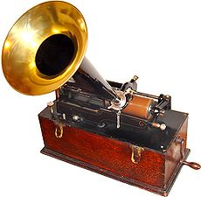
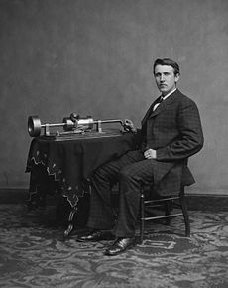
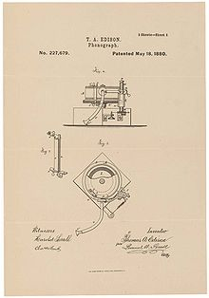
Phonograph
Thomas Edison and his early phonograph.

Slide 7
Phonograph
most common device for playing sound recordings in the 1870s

Slide 8
Presidents of the 1920s
Wilson 1913-1921
Harding 1921-1923
Coolidge 1923-1929
Hoover 1929-1933

Slide 9
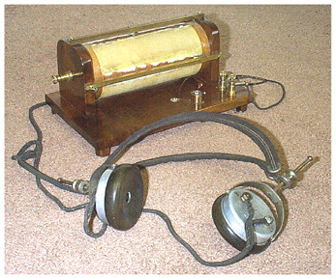
Radio

Slide 10
Mass Media
Increases in Mass media during the 1920s
Print and broadcast methods of communication.
Examples:
Newspapers
Magazines
Radio
Movies

Slide 11
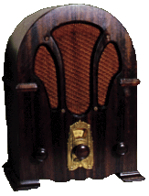
RADIO
Most powerful communications medium to emerge in the 1920s
News was delivered faster and to a larger audience.
Americans could hear the voice of the president or listen to the World Series live.

Slide 12
Newspapers:
27 million to 39 million
Increase of 42%
Motion Pictures:
40 million to 80 million
Increase of 100%
Radios:
60,000 to 10.2 million
Increase of 16,983%

Slide 13
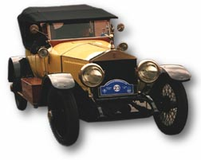
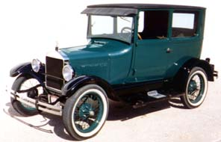
Automobile

Slide 14
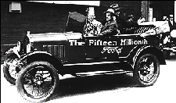
Automobile
Henry T. Ford
Improved transportation
Gave economy boost it needed
By 1927, Model-T had really taken off.

Slide 15
http://www.biography.com/people/henry-ford-9298747/videos/henry-ford-a-car-for-the-people-2087064480 - short
Bio - http://www.biography.com/people/henry-ford-9298747
Long episode - http://www.biography.com/people/henry-ford-9298747/videos/henry-ford-full-episode-2073247507

Slide 16
Flapper
Short hair
Short skirts
Smoking/ drinking
Shift away from traditional values took place mainly in the cities

Slide 17
Women
Women were independent and achieving greater freedoms.
Examples: right to vote, more employment, freedom of the auto

Slide 18
The Changing American Family
American birthrates declined for several decades before the 1920s.
Trend continues in 1920s with development of birth control.
Margaret Sanger
Birth control activist
Margaret Sanger and other founders of the American Birth Control League - 1921

Slide 19
1920s – more people living in urban than rural settings, first time

Slide 20
Migration from Rural to Urban
Urbanization still accelerating
More Americans lived in cities than in rural areas
1920:
New York 5 million
Chicago 3 million

Slide 22
URBAN VS. RURAL
Farms started to struggle post-WWI.
6 million moved to urban areas
Urban life – a world of anonymous crowds, strangers, moneymakers, and pleasure seekers.
Rural life - safe, with close personal ties, hard work and morals.
Suburban boom: trolleys, street cars etc.

Slide 23
Farms were innocent.
Cities were impersonal.

Slide 24
Prohibition

Slide 25
Prohibition
18th Amendment, 1920
Launched era known as Prohibition
Made it illegal to make, distribute, sell, transport or consume liquor.
Prohibition led to...

Slide 26
https://www.youtube.com/watch?v=FTIA84IrEvc
First 1.30
Where are they?

Slide 28
SPEAKEASIES AND BOOTLEGGERS
Most immigrant groups were not willing to give up drinking.
Hidden saloons-speakeasies
People also bought liquor from bootleggers who smuggled it in from Canada, Cuba and the West Indies
Speakeasies

Slide 29
Organized Crime

Slide 30
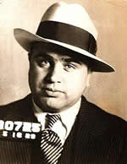
Al Capone
From an Italian immigrant family
Also known as "Scarface," rose to infamy as the leader of the Chicago mafia during the Prohibition era.

Slide 31
Prohibition contributed to the growth of organized crime in every major city
Al Capone –
Took over Chicago mob in 1925
Ran brothels
Famous bootlegger
60 million a yr (bootleg alone)

Slide 32
Al Capone was known to kill his enemies but later he also encouraged peace among rival gangsters.
Most famous murder - St. Valentine's Day Massacre
https://www.youtube.com/watch?v=VzfWQ7TRF8w
Mini bio

Slide 33
Talent for avoiding jail
1931 sent to Alcatraz prison for tax-evasion. Capone’s death - http://www.history.com/topics/roaring-twenties/videos/al-capone?m=528e394da93ae&s=undefined&f=1&free=false

Slide 34
Sports
Baseball
Babe Ruth

Slide 35
Harlem Renaissance
Flowering of culture in the African American community

Slide 36
Lost Generation
the generation reaching maturity during and just after World War I, a high proportion of whose men were killed during those years.
an unfulfilled generation coming to maturity during a period of instability

Slide 37
Take 3 Quizlet Quizzes under US History tab on the www.clevelandhistory.com website
Meet with your group – discuss details, topic, members, etc.

Slide 38
US.40 Describe the Harlem Renaissance, its impact, and its important figures, including an
examination of literary and informational text of or about:

Slide 39
Harlem Renaissance
Spanning the 1920s to the mid-1930s, the Harlem Renaissance was a literary, artistic, and intellectual movement that kindled a new black cultural identity as a black art form.

Slide 40
Its essence was summed up by critic and teacher Alain Locke in 1926 when he declared that through art, “Negro life is seizing its first chances for group expression and self determination.”
Harlem became the center of a “spiritual coming of age” in which Locke’s “New Negro” transformed “social disillusionment to race pride.”
Clip - http://www.history.com/topics/black-history/harlem-renaissance

Slide 41
In your group, look up your assigned person and answer the following questions:
Give a brief bio of this person.
What were their major accomplishments?
Evaluate their lasting legacy to the African American community and to the world.
Be ready to briefly present to the class.
Langston Hughes – Diana
Harlem Renaissance – Seth
Zora Neale Hurston – Tori
James Weldon Johnson - Zack
Duke Ellington – Haley
Louis Armstrong – Morgan

Slide 42
The 1920s Review Quiz
What was the Harlem Renaissance?
Name one person involved with the Renaissance.
Use ten key words that would describe the 1920s(For example – flappers, now think of 9 more)
What was the new mass media of the 1920s?

Slide 43
Daily Opener – Briefly describe the Harlem Renaissance.
https://www.youtube.com/watch?v=YBOoQcoPL1I
The best of Louis Armstrong
US.40 Describe the Harlem Renaissance, its impact, and its important figures, including an examination of literary and informational text of or about Langston Hughes, Zora Neale Hurston, James Weldon Johnson, Duke Ellington, and Louis Armstrong. (C)
Work in groups to evaluate the importance of your assigned Harlem
Renaissance figure and create a visual presentation.

Slide 44
Harlem Renaissance
Period during the 1920s in which African American novelists, poets, and artists celebrated their culture.

Slide 45
Review Harlem Renaissance Notes
Take Notes on PPL
Read page 359 and answer questions
Read Aloud & Think/Pair/Share

Slide 46
After WWI, most African American migrants to the north probably found a better life.
Wages were better
There was a growing middle and upper class
African American ministers, physicians, lawyers, and doctors practiced their profession and served as role models to the younger generation.

Slide 47
Jazz
It was F. Scott Fitzgerald who called the 1920s the “Jazz Age” but it was African Americans who gave the age its jazz.
Jazz musicians creatively recombine different forms of music, including African American blues and ragtime, and European-based popular music.
Jazz emerged in the South and Midwest, particularly in New Orleans.

Slide 48
Jazz
From the south, jazz spread north with the Great Migration of African Americans.
Louis Armstrong’s ability to play the trumpet and his subtle sense of improvisation made him a legend and influenced the development of jazz.
Many Jazz artists featured vocalists like Bessie Smith, the “Empress of the Blues”.

Slide 49
Daily opener
What are two nicknames for the 1920s?
Get out your study guide from yesterday.

Slide 50
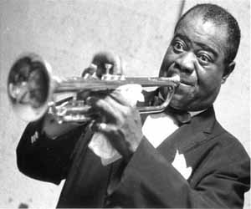
Louis Armstrong
http://www.biography.com/people/louis-armstrong-9188912 OR
https://www.youtube.com/watch?v=sIILBeUrYLk\
Trumpet player
“What a Wonderful World”
https://www.youtube.com/watch?v=E2VCwBzGdPM
“Star Dust”

Slide 51
Duke Ellington
Became one of the most important early figures in jazz and probably its greatest composer.
Gained fame in 1920s when his band played in Harlem nightclubs.
Hiring many skilled musicians
Wrote or arranged around 2,000 pieces of music that range from popular songs to ballets and movie music
http://www.biography.com/people/duke-ellington-9286338

Slide 52
What exactly was Jazz?
Symbol of the 1920s
Played in speakeasies
Sound of the Cotton Club, one of Harlem’s most famous attractions
Demonstration of the depth and richness of African American culture

Slide 53
James Weldon Johnson
An early civil rights activist
Leader of the NAACP
A leader in the founding and creation of the Harlem Renaissance

Slide 54
Langston Hughes
http://www.biography.com/people/langston-hughes-9346313/videos/langston-hughes-mini-biography-2174109638
leading voice of the Harlem Renaissance
whose poetry showcased the dignity and beauty in ordinary black life
The hours he spent in Harlem clubs affected his work, making him one of the innovators of Jazz Poetry.
Read primary sources found on page 359 in your book.

Slide 55
Daily opener
How do you know if a source is reliable?
How can you tell if it might not be a reliable source?
Assignment: By yourself, research your project topic. Find at least 3 reliable sources and record the bibliography for them. Take notes for each source as well.
Group: Collaborate on the sources you foudn.

Slide 56
Sources for Project
Assignment: By yourself, research your project topic. Find at least 3 reliable sources and record the bibliography for them. Take notes for each source as well.
When time is called:
Group: Collaborate on the sources you found. Are all of these sources reliable? Why or why not?

Slide 57
Zora Neal Hurston
http://www.biography.com/people/zora-neale-hurston-9347659
Fixture in the Harlem Renaissance
Most famous piece – Their Eyes Were Watching Gods – expressed the new longing for independence felt by many women, black and white.

Slide 58
In your Notebook, answer the question:
Write a thesis statement and introductory paragraph for an essay in which you compare the influence of jazz to the influence of the Harlem Renaissance. Consider the similarities and differences in the two cultural developments.
Read Section 5 in Chapter 11 and look at your notes for help.

Slide 59
US.40 Describe the Harlem Renaissance, its impact, and its important figures, including an examination of literary and informational text of or about Langston Hughes, Zora Neale Hurston, James Weldon Johnson, Duke Ellington, and Louis Armstrong. ©
EXTRAS:
https://www.youtube.com/watch?v=Z3ozfYC9CZE
10 minutes – 3 clips on Renaissance from PBS

