Slide 1
Daily Opener
Gilded Age Politics: Scandalous or Respectable?
List and explain three examples from the reading to back up your answer.

Slide 2
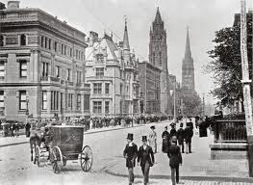
America Moves to the City

Slide 3
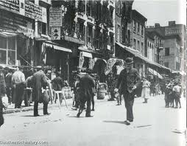
Mass Migration
By 1900, 4 in 10 Americans lived in cities
US had 3 cities with over 1 million people (NYC 3.5 million)

Slide 4
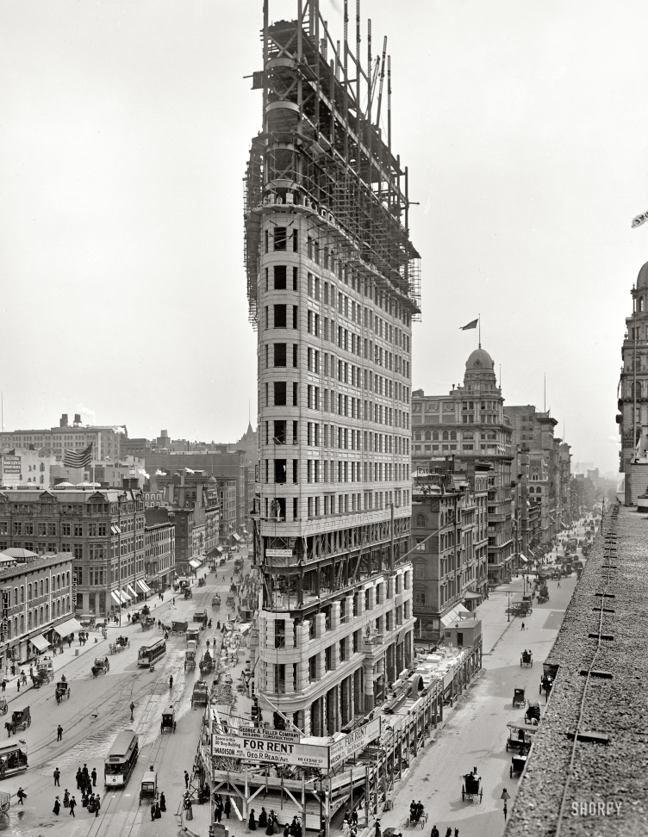
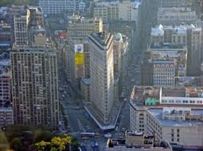
Cities Reach Skyward
Skyscrapers became possible due to steel and the electric elevator

Slide 5
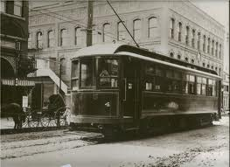
Mass Transit
Electric trolleys and subways brought workers from suburbs to cities

Slide 6
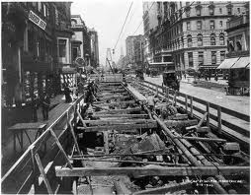
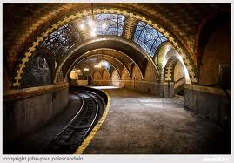

Slide 7
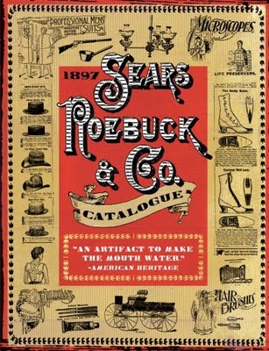
Department Stores
Macy’s (NYC) & Marshall Fields (Chicago)
Mail order catalogs (Sears & Roebucks)

Slide 8
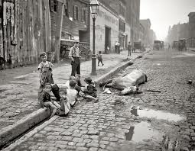
City Living Side Effects
Most buildings had no indoor plumbing
No trash pick-up service
No water treatment facility

Slide 9
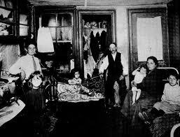
Tenement Housing
Several poor families would be crammed onto each floor
Harbored insects and disease

Slide 10
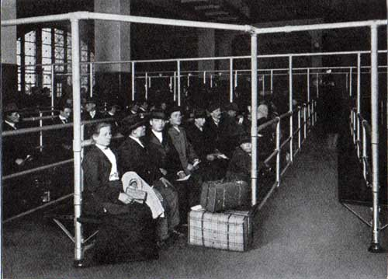
Immigration

Slide 11
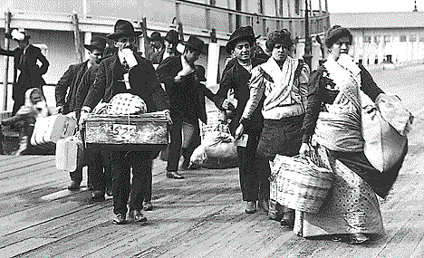
Europeans
Between 1870-1920, 20 million people came from Europe
Most came from southern and eastern Europe to find land and jobs in US

Slide 12
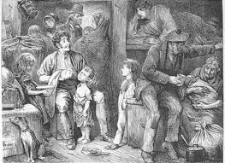
Journey to America
Most immigrants came by steamship
Traveled in crowded cabins, shared beds, toilets, and suffered from disease

Slide 13
Ellis Island
Immigrant processing station for Eastern US
Pass a medical exam and legal requirements
1892-1924, 17 million people passed through Ellis Island
http://www.history.com/topics/ellis-island/videos

Slide 14
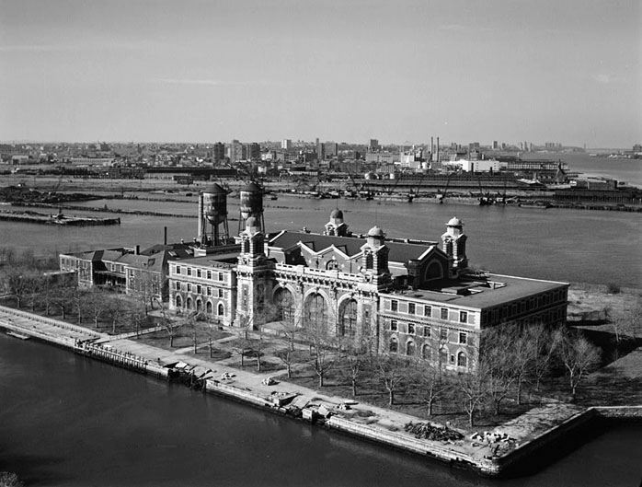

Slide 15
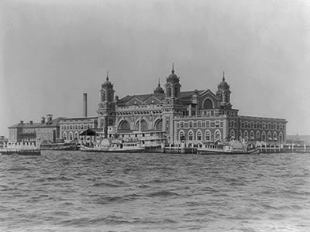

Slide 16
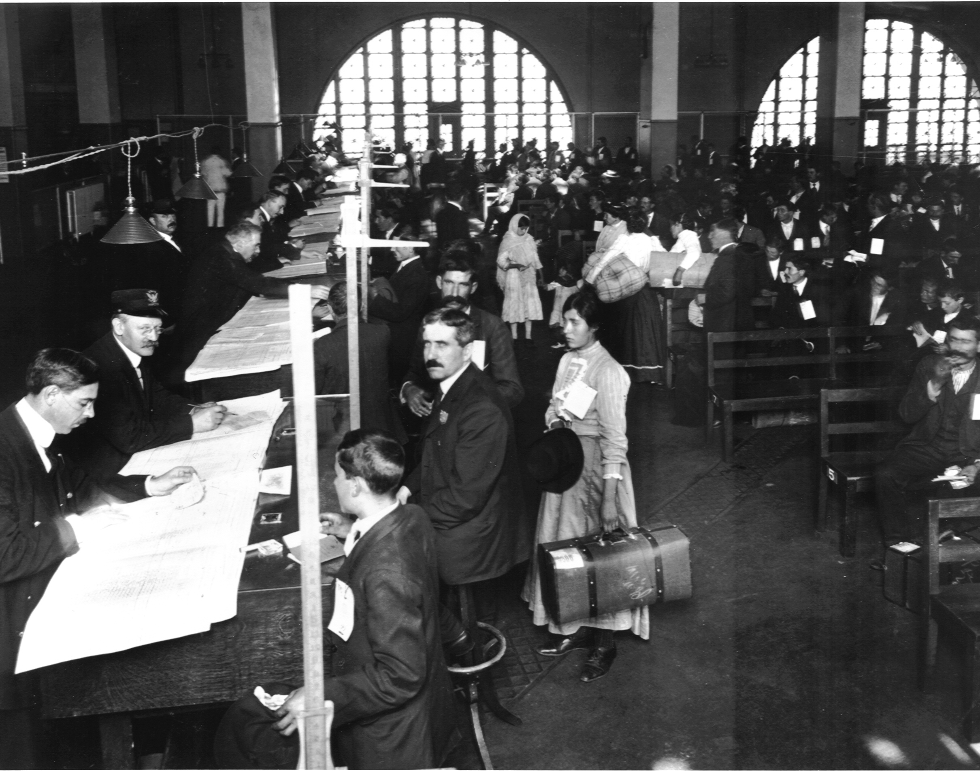

Slide 17
Angel Island
Immigrants suffered harsh questioning and long detention in filthy buildings
Located in San Francisco Bay, CA

Slide 18
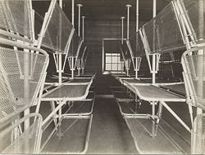

Slide 19
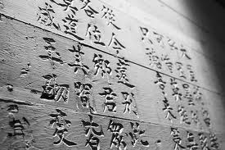

Slide 20
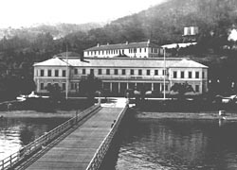

Slide 21
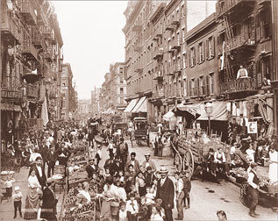
Immigrant Hardships
Find a place to work and live
Sought out people with same language and culture
Created Ethnic clusters

Slide 23
Immigration
Old Immigrants
New Immigrants
From Northern and Western Europe
Many were:
Protestant
knew English
Skilled laborers
& therefore treated better than the new immigrant
From Eastern and Southern Europe
Many were:
Catholic
Did not know English
Unskilled laborers
Treated the worst

Slide 24
Chinese Exclusion Act
Gentleman's Agreement
a United States federal law signed by President Chester A. Arthur on May 6, 1882.
It was one of the most significant restrictions on free immigration in US history, prohibiting all immigration of Chinese laborers.
an informal agreement between America and Japan, enacted via unilateral action by President Roosevelt.
Japan would limit emigration to the US if the US (mainly in CA) would stop segregating Japanese students.

Slide 25
Nativism
Native-born Americans formed anti-immigrant groups
Only opposed Italian, Greek, Jewish, Polish, and Asian immigrants

Slide 26
Nativism
Work was scarce out west after railroads went bankrupt
1882 Congress passed Chinese Exclusion Act, which restricted immigration until 1943

Slide 27
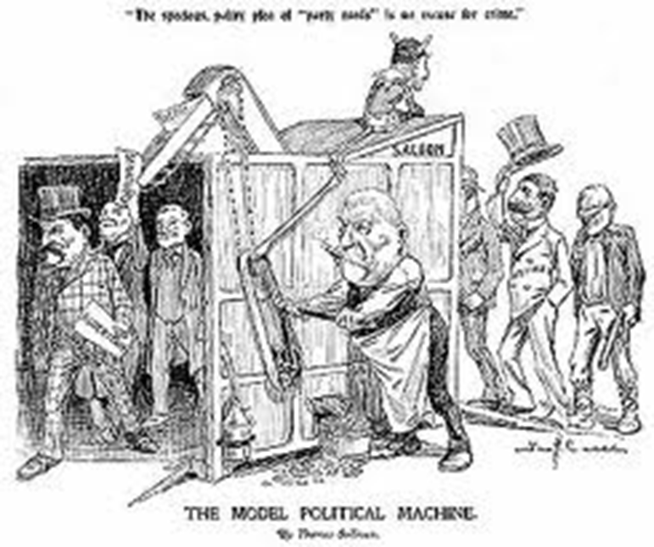
Immigrants and the Political Machine
Machines helped with jobs, housing, and citizenship in exchange for votes

Slide 28
Hypocrisy
1886 the Statue of Liberty was assembled in NYC harbor
“Give me your tired, your poor
Your huddled masses yearning to breathe free
The wretched refuse of your teeming shore”

Slide 29
Reforming Society
Jacob Riis

